Slide 1

re
2nd Webinar of the Tourism Sprint of the United Nations Network of Economic Statisticians
Building Data Stewardship: Perspectives from Asia and the Pacific
26 November 2025
Alick Mjuma Nyasulu
Statistician
ESCAP Statistics Division

Slide 2

Content
Understanding Data Stewardship
Data Governance Framework
Select national profiles
Looking ahead

Slide 3
What is Data Stewardship?
A governance framework for the ethical, secure, and effective management of data throughout its lifecycle.
Core functions include:
Data Governance: Establishing policies and standards.
Equity & Inclusion: Ensuring data represents all people.
Sharing & Collaboration: Facilitating data use across organizations.
Conceptual Frameworks: Creating common understanding and models.

Slide 4
How ESCAP is Championing Data Stewardship
Guided by a decision from the ESCAP Committee on Statistics:
Feature data governance in its work with an emphasis on sharing country experiences
Data stewardship as part of a Data Governance framework
ESCAP produced a Stats Brief on Data Governance practices in the Asia-Pacific Region
https://repository.unescap.org/server/api/core/bitstreams/0c7f3bb4-9c36-48d6-87c2-86eedba6d1e6/content

Slide 5
Data governance
The exercise of authority and control over the management and transformation of data with the objective of enhancing the value of data assets and mitigating data-related risks.
Our approach is across all domains of statistics
Notes:
Data governance is defined as
the exercise of authority and control
over the management and transformation of data
with the objective of enhancing the value of data assets
and mitigating data-related risks.

Slide 6





DATA GOVERNANCE FRAMEWORK
PILLAR 1
PILLAR 2
PILLAR 3
PILLAR 4
PILLAR 5
Vision
and
policy intent
Data managementpolicies,
rules
and institutions
Data
custodians
and
data
stewards
Data sharing, data accessibility and
data integration
Data sharing, risks
and mitigation
Notes:
These are the five pillars in the data governance framework.
Pillar 1 concerns the ultimate objective for data – what is it that the government wants to achieve?
Pillar 2 looks at the means of implementation - how is data to be managed, what are the rules and institutions involved in managing the data.
Pillar 3 looks at data custodians and data that is the key entities who are responsible for ensuring the data system as a whole runs smoothly.
Pillar 4 looks at what data management practices are adopted and these are functioning to provide a sound management framework for integrating, sharing, and accessing data.
Pillar 5 concerns risks. As digital technology brings new opportunities to enhance the value of data assets, it also exacerbates risks to the protection of personal data and risks to public trust in data.

Slide 7
VISION
AND POLICY INTENT
Is the vision for data part of a broader digital services agenda?
Is the vision for data about better public services?
DIGITAL AGENDA
BETTER PUBLIC SERVICES
GOVERNMENT VISION FOR DATA
Is the vision for data part of efforts to see data as a service?
Is the vision for data about building a stronger economy?
DATA AS A SERVICE
STRONG ECONOMY
Notes:
Pillar 1 looks at the vision and policy intent for data. Does the government have a strategic vision for data?
What are the main drivers of this vision? For example, Is it part of the government’s wider policy of moving towards digital government?
Is it about better public services or building a strong economy? Does it aim to support data as a service? Is the focus on government data, non-government data or a mixture of both?

Slide 8

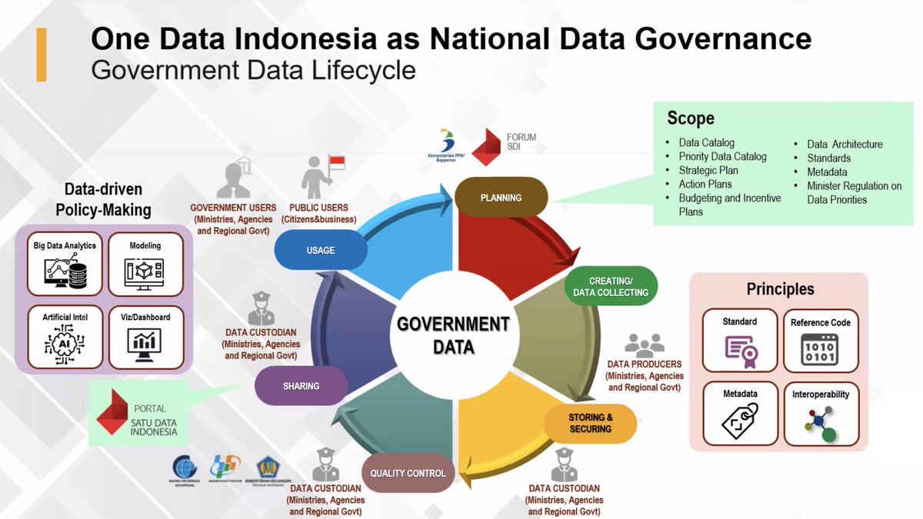
Vision and policy intent: Indonesia
One Data Indonesia
Aims to make government data timely and accurate, increase the use of data for policy, and allow for integrated and interoperable data platforms across central and local government
Notes:
Example of a vision and policy intent:
Leverage dfigital technology to bring greater social cohesion
Support a digital economy and provide betetr public services
Transformation of government data is needed for the vision, therefore the Oce Data Policy Initiative

Slide 9
NSO is whole of government data steward
NSO supports another agency taking government data steward role
NSO one stakeholder with no one agency taking the government data steward role
THE ROLE OF GOVERNMENT DATA STEWARD IS EVOLVING
AND NSOs ARE RESPONDING IN DIFFERENT WAYS

Slide 10

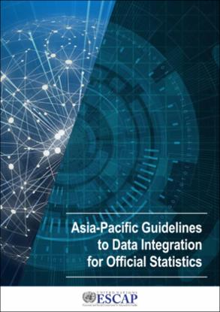

DATA SHARING, DATA ACCESSIBILITY AND DATA INTEGRATION
Challenges
Need quality administrative data
Need public approval
Need a legal basis
Need collaboration mechanisms
Need technical skills
Opportunities
Bridge data gaps
Reduce response burden
Provide granular data
Improve relevance
Improve coverage
Improve timeliness
Improve frequency
Lower costs
Notes:
Pillar four looks at how data is shared and the arrangements by which this is done. These arrangements could cover government data or could go much wider and include non-governmental data. Whilst there are many opportunities provided by data integration including lowering costs, increasing granularity and frequency of data there are also many challenges. You need high quality administrative data sources and you will need public approval and a legal basis for sharing data as well as the technical capacity.

Slide 11
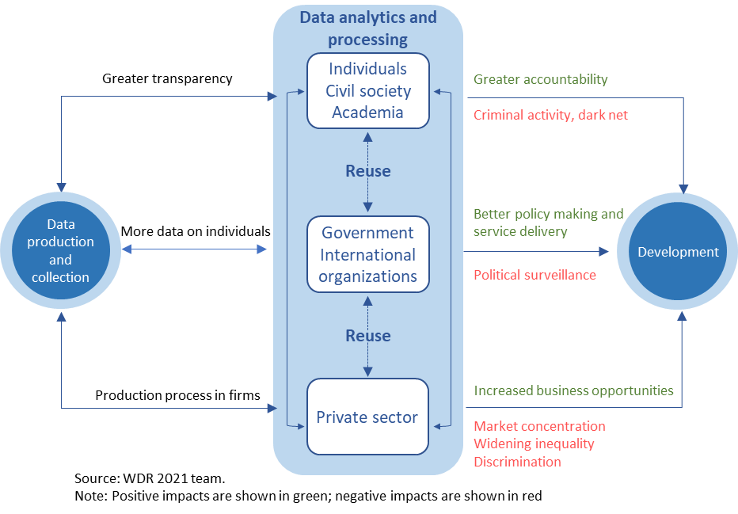
DATA SHARING RISKS AND MITIGATION
c
Notes:
In pillar 5 we look at the risks around data sharing and how these are being mitigated. Data can contribute to development through multiple pathways as shown in this figure from the 2021 World Bank’s World Development Report. “Although use, reuse, and repurposing of data offer great prospects for fostering development, they simultaneously pose significant risks that must be managed to avoid negative development impacts.”
WDR 2021

Slide 12
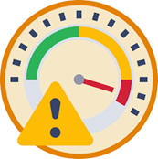
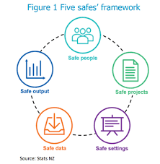
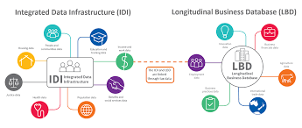
Data sharing, risks & mitigation:
New Zealand using Five safes’ framework
Notes:
Five Safes being used by Stats NZ but now also followed by Australia
Safe people – researchers can be trusted to use data appropriately and follow procedures. Before accessing data researchers must:
pass referee checks
sign a declaration of secrecy under the Statistics Act 1975
sign a researcher undertaking
attend confidentiality training
follow Stats NZ rules and protocols. Consequences for breaking protocols include being banned, blacklisted, or prosecuted.
Safe projects – the project has a statistical purpose and is in the public interest. Research is restricted to the analysis of groups, not individuals. This means that the research is focused on finding solutions to issues that are likely to have a wide public benefit.
Safe settings – security arrangements for data access are designed to prevent unauthorised access to the data. Data can only be accessed through a secure Data Lab environment. Computers are not connected to a work network and only Stats NZ staff can release data to researchers.
Safe data – the data inherently limits the risk of disclosure. We de-identify data, which means we remove personal identifying information such as names and addresses, and encrypt (ie replace with another number) identifiers such as IR and NHI numbers. Researchers get access only to the data relating to their research.
Safe output – the statistical results produced do not contain any information that could lead to the identification of an individual or entity. Researchers must confidentialise output before it can be released from the Data Lab, and Stats NZ staff check results for confidentiality to ensure individuals cannot be identified. All output must go through a two-phased confidentiality checking process.

Slide 13
One page country data governance profiles
Australia
Malaysia
Fiji
India
Indonesia
Japan
Mongolia
Nepal
New Zealand
Pakistan
Papua New Guinea
Philippines
Republic of Korea
Singapore
Solomon Islands
Tajikistan
Türkiye
Viet Nam
Thailand
Disclaimer: All profiles were produced by ESCAP to illustrate differing data governance arrangements and practices and reflect the situation from when they were compiled. Refer to the country’s own website for the latest information.

Slide 14

Indonesia: Data governance profile
STATISTICS INDONESIA
The government is committed to leveraging digital technology to bring greater social cohesion, support a digital economy and provide better public services.
This commitment requires a transformation in government data, which the government aims to achieve through its One Data Policy Initiative launched through a Presidential Regulation in 2019.
This policy aims to make government data more timely, accurate, accountable, and accessible. It also aims to strengthen data sharing and integration arrangement between government institutions and to make better use of government data and official statistics for policy making.
The policy is envisaged to become a governance framework that would allow the development of integrated and interoperable data platforms across central and local government through a common standard.
Moving towards Indonesia One Data entails data principles: Data Standards, Metadata standards, Interoperability, and Reference Code.
The Presidential Regulation assigned responsibilities to:
National Data Steering Council is responsible for national data policy and evaluating its implementation.
The Ministry of National Development Planning leads the Council and has overall responsibility for One Data implementation.
BPS-Statistics Indonesia as a national data steward provides guidance, statistical recommendations and technical assistance.
Data Forum facilitates collaboration among stakeholders to resolve data needs and issues.
Data steward in a government institution is responsible for data management, security, quality, sharing, and dissemination.
Data Producer is responsible for producing data that meets data quality standard.
The government facilitates One Data Portal as a means of government institutions to share their data and to give access to public by providing data sets with various topics in open data format.
The government has initiated socio-economic register to capture the entire population about their profile, social economic condition, and welfare level. The database of socio-economic register is linked to population master database, while other databases owned by other government institutions will be synchronized to this database.
Under e-Government priority initiative, the Ministry of National Development Planning is assigned to develop data platform utilized across government institutions.
In addition, with the mandate of Presidential Regulation Number 132 Year 2022 on National e-Government Architecture, BPS has been developing a National Statistical Infrastructure System to support statistical production, big data utilization, and One Data implementation under the National Statistical System.
1. Vision and policy intent
2. Data Management: policies, rules & institutions
3. Data custodians and data stewardship
4. Data sharing, accessibility and integration
Challenges in transforming government data are the need to improve data capability and capacity for producing quality data, to strengthen coordination among ministries and government agencies, and to align sectoral data regulations owned by ministries and government agencies with the One Data governance framework.
The roles of data custodian and data steward are set up and performed by an organization unit called the Center of Data and Information in every ministry, government agency and local government.
BPS is empowered by Law Number 16 Year 1997 on Statistics to serve as a National Data Steward that has responsibility of providing guidance on data standards, metadata standards, and data interoperability, and building statistical capacity through technical assistance and trainings to government institutions in central and local governments.
5. Data sharing, risks & mitigation
To avoid and mitigate personal data breaches that may cause some violations of confidentiality and privacy to individual, as well as significant losses of economy, competitiveness and reputation to organization, Law Number 27 Year 2022 on Personal Data Protection and Presidential Regulation Number 95 Year 2018 on e-Government provides legal basis for personal data protection and information security to organizations and government institutions.
BPS-Statistics Indonesia implements data confidentiality and security by applying non-disclosure control, providing secured IT systems, controlling the use of micro data, training enumerators in data collection handling, and setting data access rights.
BPS-Statistics Indonesia collaborates with the National Cyber and Crypto Agency in securing IT system and infrastructure, improving security skills, and joining a member of Indonesia Cyber Incidence Response Team (CSIRT).

Slide 15
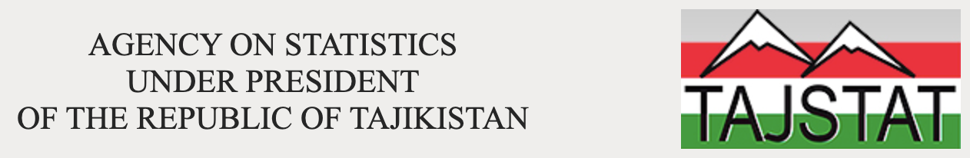
Tajikistan: Data governance profile
Tajikistan’s National Development Strategy
of the Republic of Tajikistan
for the period up to 2030 envisages a steadily growing, competitive country that provides decent living standards for the population, equal opportunities for each person to realize his or her potential on the basis of equality, justice and respect for human dignity.
The strategy includes goals (e.g. "strengthening the legal framework for the information society" and "developing e-government services.”) that require effective data collection, analysis, and utilization to be achieved effectively.
National Development Strategies and the Poverty Reduction stress the importance of relevant and reliable statistical data to make decisions for successful program implementation and identify the demand for expanded capacity to analyze and interpret statistics in support of evidence-based policy making and implementation monitoring.
The Interdepartmental Council on Statistics under the Agency on Statistics under the President of the Republic of Tajikistan is an advisory body for coordinating activities in the field of organizing state statistical observations based on scientifically based statistical methodology. The interdepartmental working group directly carries out work on improving the methodology of statistical accounting and strengthening interdepartmental activities.
The Agency on Statistics at the President of the Republic of Tajikistan provides the official portal offering statistical data across various sectors like demographics, economy, agriculture, and social indicators.
The Statistical Agency is authorized by law to keep the state statistical register - a tool of statistical accounting containing an obligatory list of administrative and primary statistical indicators characterizing the activity of statistical units according to the Unified system of technical-economic and social-information classification and coding.
The statistics collected and disseminated by the Statistical Agency are governed by the Law of the Tajik Republic on State Statistics (No 588, dated January12,2010) that establishes the independence of the Statistical Agency and guarantees the confidentiality of the data provided by the individual statistical units.
Tajikistan's data protection framework relies on several different laws and regulations including:
Law on Personal Data (PDPL): This is the central piece of legislation outlining the core principles of data protection, including definitions of personal data, processing requirements, and data subject rights.
Constitution of the Republic of Tajikistan: Article 23 guarantees the right to protection of personal data.
Law on Information: This law sets out general principles concerning information access, dissemination, and storage.
1. Vision and policy intent
2. Data Management: policies, rules & institutions
3. Data custodians and data stewardship
4. Data sharing, accessibility and integration
The Statistical Agency under President of the Republic of Tajikistan is the central statistical office of the country. The Agency on Statistics is administratively autonomous and its head serves as the country's chief statistician who reports to the President and government.
The Statistical Agency is responsible for population censuses, household surveys, demographic statistics and a wide range of economic statistics involving establishment and enterprise surveys, as well as prices, international trade, the national accounts, government finance, agricultural, labor and social statistics.
In the case of social statistics, the Agency on Statistics compiles the data from administrative records of corresponding Ministries. The National Bank of Tajikistan (NBT) compiles monetary data.
5. Data sharing, risks & mitigation

Slide 16
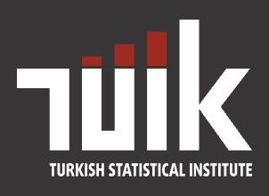
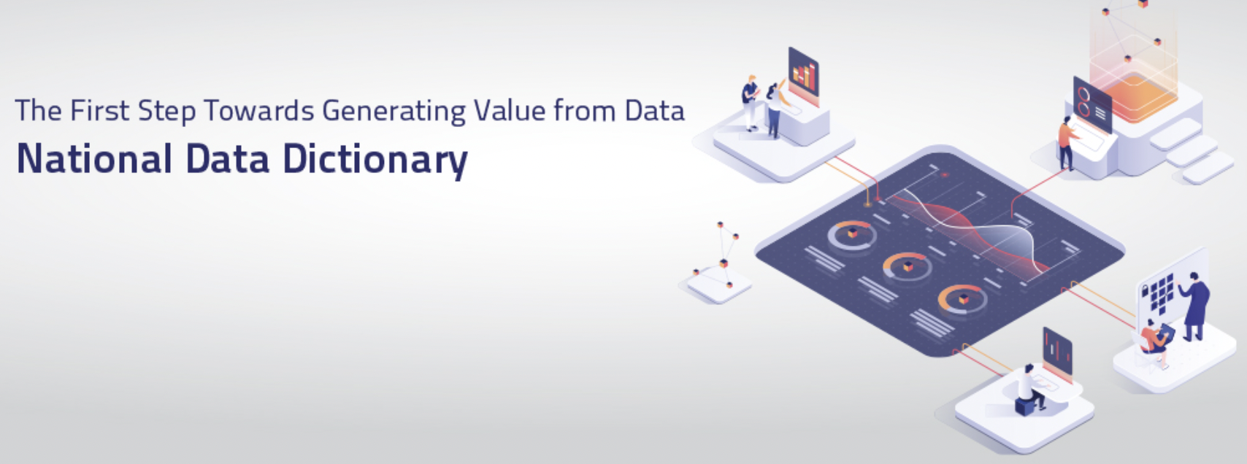
Türkiye: Data governance profile
1. Vision and policy intent
The Digital Transformation Office will lead the implementation of the digital transformation ecosystem by enhancing the performance of public institutions and increasing the efficiency and quality of their services in line with the goals, policies and strategies set by the President of the Republic of Türkiye.
The Turkish Statistical Institute (TurkStat) plays a crucial role in collecting, compiling, and disseminating official statistics, setting and implementing data standards, and promoting data literacy.
The Information and Communication Technologies Authority is responsible for developing and implementing policies and regulations related to information and communication technology, including those related to data privacy and cybersecurity
Several regulations and laws in Turkey govern data sharing and use, aiming to strike a balance between promoting data-driven innovation and protecting personal privacy.
The Law on the Protection of Personal Data sets out principles for collecting, storing, processing, and transferring personal data, including consent requirements, data security measures, and individual rights.
Regulation on the Processing of Personal Data in the Electronic Communications Sector sets out specific rules for the processing of personal data in the electronic communications sector.
Turkish Criminal Code contains provisions criminalizing various data-related offenses, such as unauthorized access to personal data, unlawful use of personal data, and data breaches.
Law on Information and Communication Technologies (ICT Law) establishes the ICT Authority and assigns it responsibility for developing and implementing policies and regulations related to ICT, including data privacy and cybersecurity.
2. Data Management: policies, rules & institutions
3. Data custodians and data stewardship
4. Data sharing, accessibility and integration
The preparations towards a new Digital Government Strategy, which will set out the roadmap of Türkiye in its transition from an "e-government" to a "digital government" for the upcoming period, is currently in progress.
The new Digital Government Strategy, a successor of the 2015-2018 Information Society Strategy and Action Plan and the 2016-2019 National e-Government Strategy and Action Plan, is being prepared with the vision of a data-driven government structure and a user oriented public service delivery.
Data dictionary and corporate architecture activities continue with the purpose of providing a more sustainable structure for the corporate information systems needed for Digital Türkiye (e-Government) service delivery.
This will eliminate obstacles hindering data sharing among public institutions and provide high quality integrated services with high value added.
Duties of Turkstat under the Statistics Law include Data Stewardship functions in relation to Official Statistics including:
Determining the statistical methods, definitions, classifications and standards to be used in the production of official statistics in line with national and international norms; and
Identifying the standards for the establishment of the national register systems, implement these standards, and to ensure their observance through inter-agency coordination
The Digital Transformation Office also plays a central role in whole-of-government data stewardship The DTO leads and coordinates efforts to ensure the effective and efficient management, utilization, and sharing of government data across all agencies.
The Digital Transformation Office is developing the National Open Data Portal to make the data available to the public as open government data. The National Open Data Portal is a data sharing platform that will present anonymized and confidential open government data to citizens.
DTO has launched the National Data Dictionary project, which will include standards and definitions for the data used by public institutions and organizations in all application, platform and infrastructure layers.
Several sector-specific initiatives are underway to integrate and share data within specific domains, such as healthcare, education, and agriculture. These initiatives aim to improve efficiency, effectiveness, and evidence-based decision-making in their respective sectors.
5. Data sharing, risks & mitigation

Slide 17
Our Focus: Building Stewardship in Asia-Pacific
Integrating data stewardship principles directly into ESCAP’s statistical capacity building programs.
Supporting member states in developing national data governance policies across all statistical domains
Fostering partnerships for better data sharing and collaboration.
Championing data equity to ensure no one is invisible in our statistics (e.g.SDG progress report.)

Slide 18
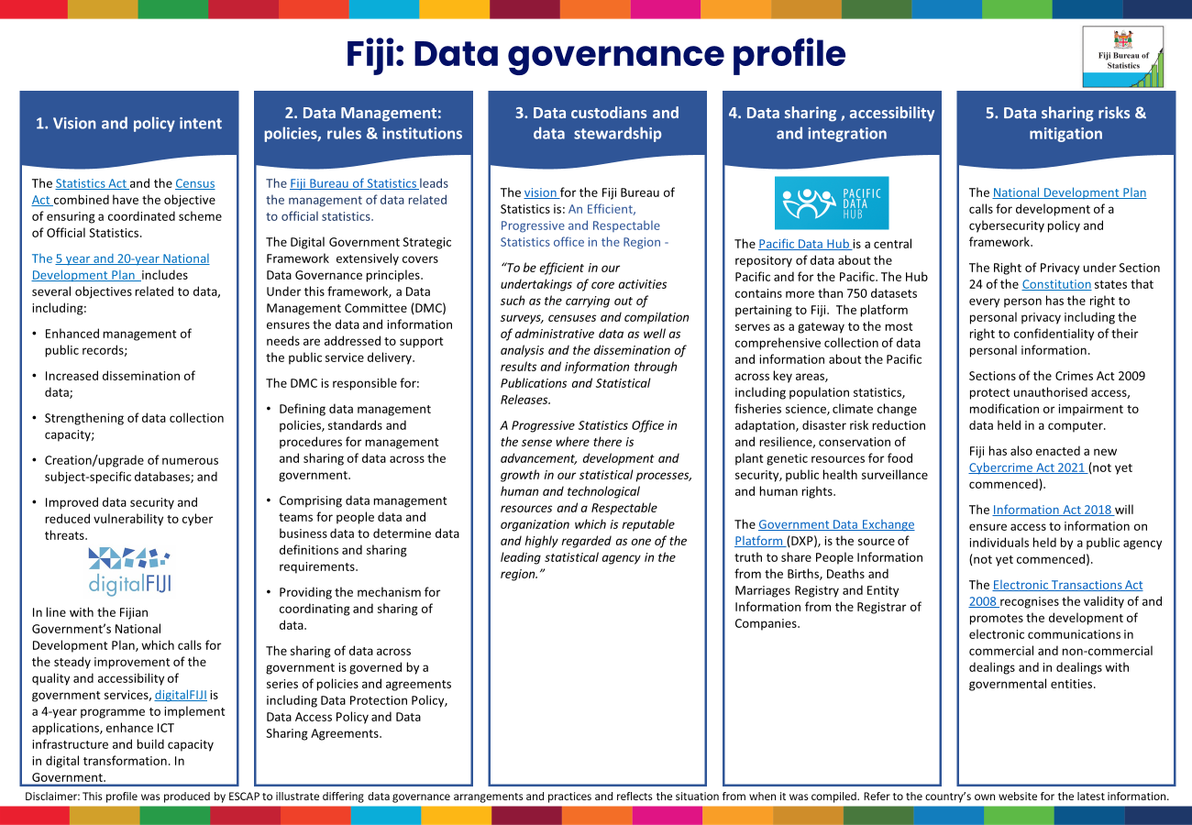
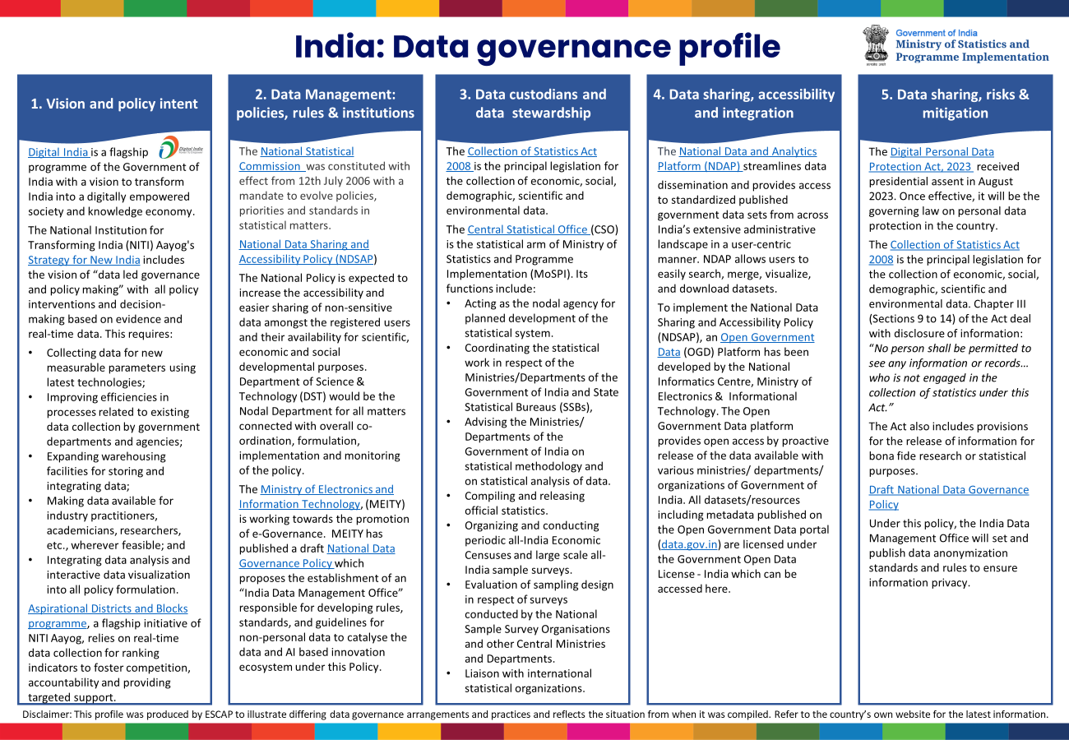
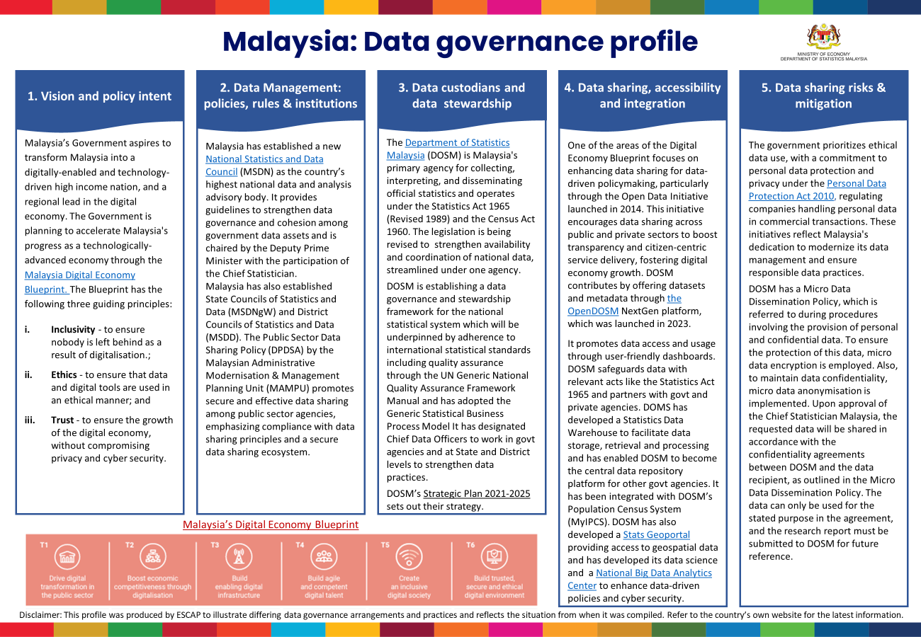
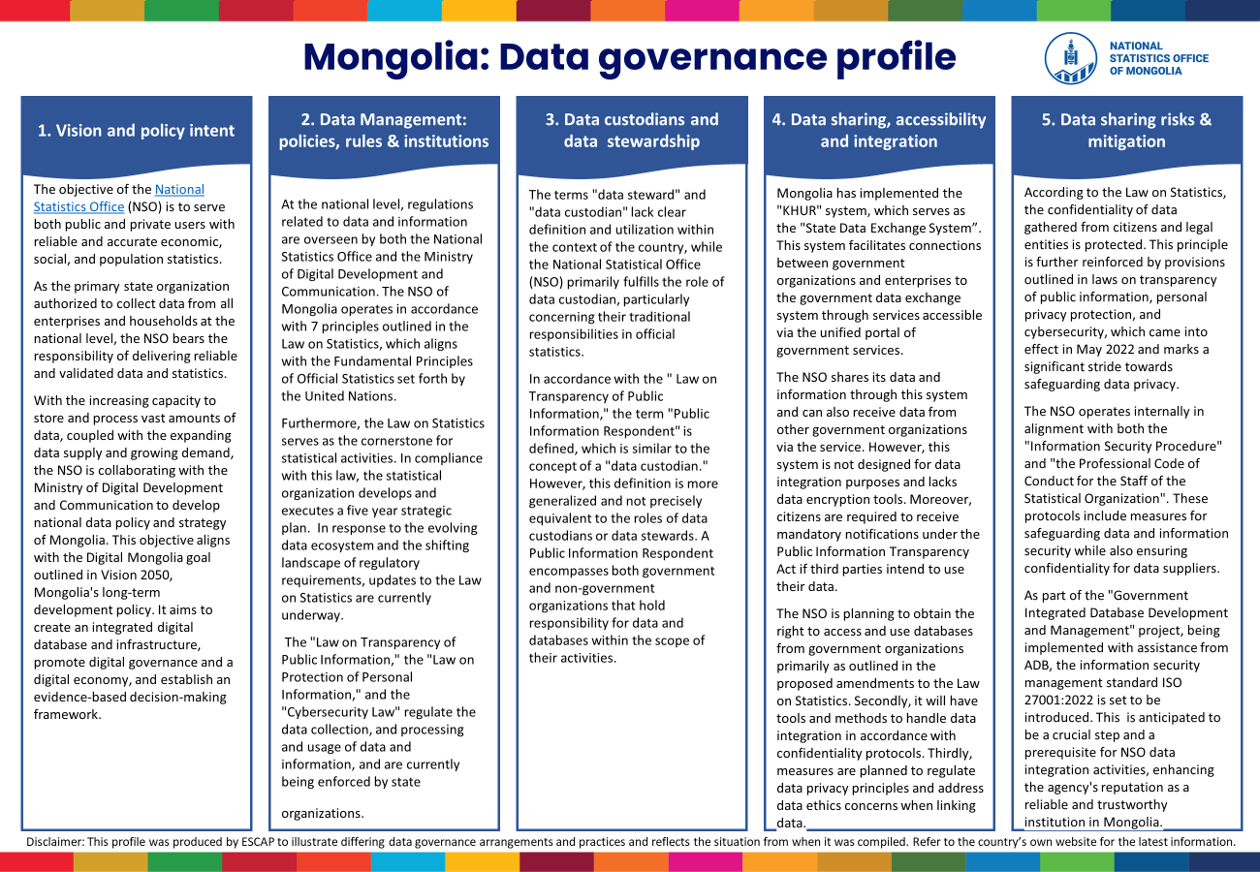
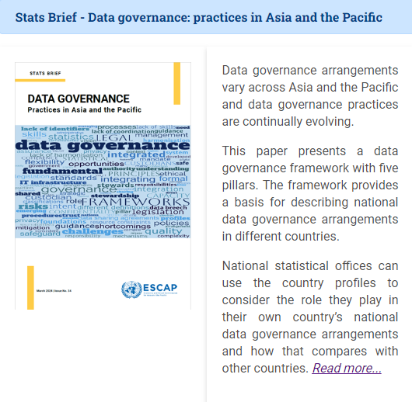
https://www.unescap.org/our-work/statistics/data-governance
Further information

Slide 19
The Journey Ahead
Data stewardship is essential for building trusted, inclusive, and agile statistical systems.
ESCAP is committed to supporting our member states on this journey.
Focus is to navigate policy with data and leave no one behind.

Slide 20
THANK YOU
Follow us:
unescap
unitednationsescap
www.unescap.org
unescap
unescap
united-nations-escap

