Slide 1

Measuring tourism industry GHG emissions using BC Stats’ economic modeling framework
November 26, 2025
Rasim Jafarov, BC Stats

Slide 2
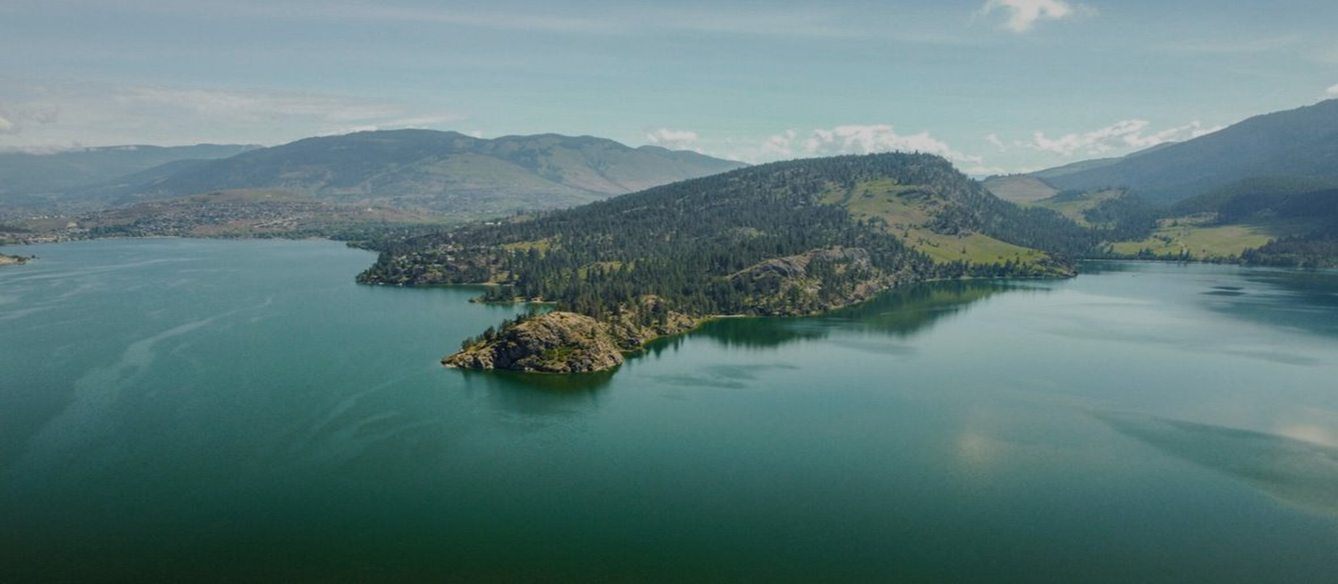
Today’s Objective
Explain how our economic modelling approach estimates the impact of tourism on greenhouse gas (GHG) emissions
Show how the approach integrates the tourism model with Statistics Canada’s industry-level GHG emissions data
Explore how this approach can be used to assess emission intensity of tourism industry over time.

Slide 3

Project Background
Purpose: Supports British Columbia’s (BC) progress toward climate action targets and climate change resilience
CleanBC Strategy: Part of The Sustainability & Climate Adaptation Data Framework to guide evidence-based decision-making.
Application: Helps BC’s tourism industry identify ways to build a cleaner, more climate-resilient sector.
For more details:
https://www2.gov.bc.ca/assets/gov/environment/climate- change/action/cleanbc/cleanbc_2018-bc-climate-strategy.pdf
https://www.destinationbc.ca/
Notes:
Original content on the slide:
This project was undertaken in response to the BC government CleanBC strategy to build “The Sustainability & Climate Adaptation Data Framework”, designed to measure the province’s progress in meeting its climate action targets and building climate change resilience.
Using this framework, BC Tourism industry can focus on what needs to change to effectively build a cleaner tourism industry that is better prepared to adapt to climate change.
For more information about Clean BC strategy and related tourism indicators please visit:
https://www2.gov.bc.ca/assets/gov/environment/climate- change/action/cleanbc/cleanbc_2018-bc-climate-strategy.pdf
https://www.destinationbc.ca/

Slide 4
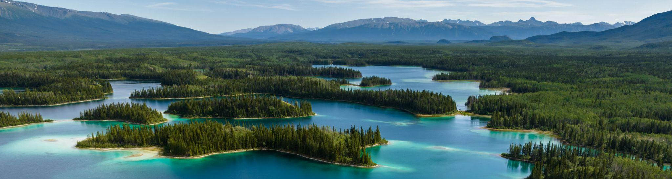










Tā Ch'ilā Provincial Park | Northern BC Tourism/Andrew Strain
$3 MILLION
Notes:
The BC Tourism Climate Resiliency Initiative was a two-year project that was developed by the Province of BC to support a provincial approach to sustainability and climate adaptation in the tourism sector.
Working in partnership with regional tourism associations and Indigenous Tourism BC, Destination BC, our provincial tourism Destination Management Organization, led four pieces of work to address both short- and long-term strategies.
One project was focused on the development of a new provincial data framework for setting standards and targets for measuring industry-wide improvement on climate change. In order to measure the reduction in the amount of fossil fuels used by tourism businesses, BC Stats was commissioned to develop a framework for measuring the sectors overall GHG emissions so that it can be tracked over time and compared to other BC industries.

Slide 5





Economic Modeling Framework
Tourism Sector
Demand
Tourism Output by Industries
(Input-Output Modeling)
Industry Emission Multipliers
(Estimated using Statistics Canada’s Data)
Tourism Spending:
- Accommodation
- Transportation
- Retail
- Recreation
GHG Emissions by Tourism Industry and Consumption Categories

Slide 6

Tourism Output Estimates
BC Tourism Spending:
Categories: Retail, Transport , Accommodation & Food, Recreation
Input – Output Model
(Mapps spending into IO commodities and service categories)
Data Sources:
Household Spending and National Travel Surveys. Tourism Satellite Accounts, other consumer spending data
Tourism Output by Industries
(Demand for commodities and services generate industry outputs)

Slide 7
Input Data: Tourism Spending in BC

Slide 8
Tourism Output: Top Tourism Supporting Industries
Million CDN,
Year 2022

Slide 9
Tourism GHG Emissions
Tourism Output by Industries
GHG Emission Multipliers for Industries
GHG Emissions by Tourism Industry

Slide 10
Top Emission Multipliers by Industries
Kt of GHG per Million Dollar Output, Year 2022

Slide 11
Top GHG Emitting Industries & Consumption Sources
Kt GHG,
Year 2022

Slide 12
GHG Emissions by Tourism Spending Categories
Kt. GHG,
Year 2022

Slide 13
Measuring Progress to inform the CleanBC Strategy
Share of Tourism Sector GHG Emissions
GHG Intensity of Tourism

Slide 14

Limitations and Key Takeaway
One of the challenges of this approach is to ensure the alignment of industry outputs with corresponding emission profiles (240 output categories and 119 emission account categories by Statistics Canada).
Another limitation is data dependency of the multipliers: they reflect only recent emission intensity and may not be good predictors for future, as more environmentally friendly technologies and production processes are introduced. (Stats Canada’s GHG data is also three years behind..). (i.e. less pollution per every unit of output..)
Nevertheless, the economic modeling framework allows not only to measure the GHG footprint of the tourism, but also progress in reducing GHG emissions over time and in comparison to other industries.

Slide 15
Thank you
For any questions
BC Stats public portal:
https://dpdd.atlassian.net/servicedesk/customer/portal/12

