Slide 1
Using alternative data approaches to support evidence-based tourism policies
Second Tourism Webinar - Tourism Statistics: Leveraging Data for Responsible Tourism
Julie Reimann, OECD Centre for Entrepreneurship, SMEs, Regions and Cities, OECD
26 November 2025

Slide 2




OECD’s integrated approach to tourism
Analysis and policy advice: Policy recommendations & support for tourism reforms
TOURISM COMMITTEE PRIORITIES 2025-26
Measuring and comparing:
Tourism trends, policies & performance
Policies
& Programmes
TRENDS & POLICIES Flagship publication OECD Tourism Trends and Policies 2026
Statistics
&
Indicators
DATA & EVIDENCE Using alternative data sources and tools for tourism, tourism database
Co-operation
&
Engagement
SUSTAINABILITY Improving evidence for managing tourism more sustainably, optimising social impacts of tourism
Whole-of-government approach: Connecting with other policies; industry and multi-stakeholder engagement
RESILIENCE, TRANSITION Digitalisation and AI adoption, adapting to weather-related events

Slide 3


Balanced tourism development calls for reliable data to support decision-making
The strong rebound in tourism has highlighted the need for more balanced and sustainable tourism development
Reinforces the importance of evidence-based tourism policies for a resilient, sustainable and inclusive future
Calls for more timely and reliable data to support tourism decision-making, at all levels of government
Understanding the economic, social and environmental impacts of tourism are key to manage and balance the trade-offs

Slide 4
Recent OECD work on alternative data approaches
Publication with good practices, challenges and lessons learnt on using alternative sources, this includes 18 country case studies
Workshop on building strong tourism destinations
OECD-EC workshop on “Tourism Data Sharing, Governance and Integration”
TSI projects on using alternative data sources, and developing a near real-time tool in Slovenia
Work going forward
Discussions ongoing on further work the Working Party on Tourism Statistics can support, including potential (and risks) to use AI for more timely, accurate and granular insights

Slide 5




Opportunities for using alternative data sources and tools to measure tourism
Complement traditional methods by improving the timeliness and granularity of existing tourism data, filling gaps, and reducing the burden on survey respondents
Inform strategic decision-making processes for effective tourism management
Allow policy makers to tailor interventions and policies
Increased
Timeliness
Increased
Granularity
Cost
savings
Wider
coverage

Slide 6
Challenges to use alternative data sources within tourism remain
Unstructured data
Data not created to answer the specific question
Access
Accessing business data from private companies
Resources
Investments required to work with new data
Identifying tourists from usage patterns
Micro-data analysed by other entities
Costs
Data not covering the entire market
Missing data due to data protection rules
Skills in the team and educating users
No socio-demographic information
Opaque overview of market
Time
Methods - New sources require new methods and interpretation

Slide 7



Selected use cases
Transaction data
Mobile positioning data
Existing data
Improving granularity of tourism expenditure
Spain uses transaction data to increase the granularity of inbound and outbound tourism expenditure and publishes this as an experimental statistic
Strengthening data on visitor flows
Australia uses mobile positioning data to improve the accuracy and precision of domestic tourism in response to declining survey response rates
New ways of utilising existing data
Slovenia’s interactive dashboard Tourism Daily publishes daily data on tourist arrivals and overnights with only a three-day delay

Slide 8

Indicators to measure the sustainability of tourism
Level
Selected initiatives & frameworks
Key characteristic
Global
UN Tourism SF-MST
Statistical framework to harmonise international data collection
European
e.g. Eurostat, EU Tourism Dashboard
Indicators harnessing existing data
Country
e.g. Austria, Denmark, Finland, Malta, Portugal, Slovenia and Spain
Capture contextual specificities, monitor national policy priorities
OECD
Work to develop core set of indicators informed by country-specific work
Policy-driven indicators, capacity building, closing data gaps
Alternative data approaches have the potential to fill data gaps and develop better metrics in time

Slide 9
Key takeaways: data
Each new data source presents its own unique challenges. These are not necessarily new and can mirror issues encountered with existing sources
Alternative data is not a miracle cure, and many parts of tourism will still require traditional surveys
Value comes from combining the new data source with traditional statistics. This can also help alleviate some of the data challenges
Beyond legal compliance, maintaining public trust that data is handled responsibly is important

Slide 10
Key takeaways: ways of working
End-user focus, with close co-operation between policy makers and the experts in tourism measurement can support evidence-based decision-making
Sufficient resourcing is required to develop and maintain data hubs, and to work with new sources of data within tourism measurement
Capacity building can help meet the growing demand for skilled professionals capable of navigating complex data landscapes and interpreting analytical insights
Leveraging peer learning and collaboration allows practitioners to accelerate progress, avoid pitfalls, and identify innovative solutions

Slide 11
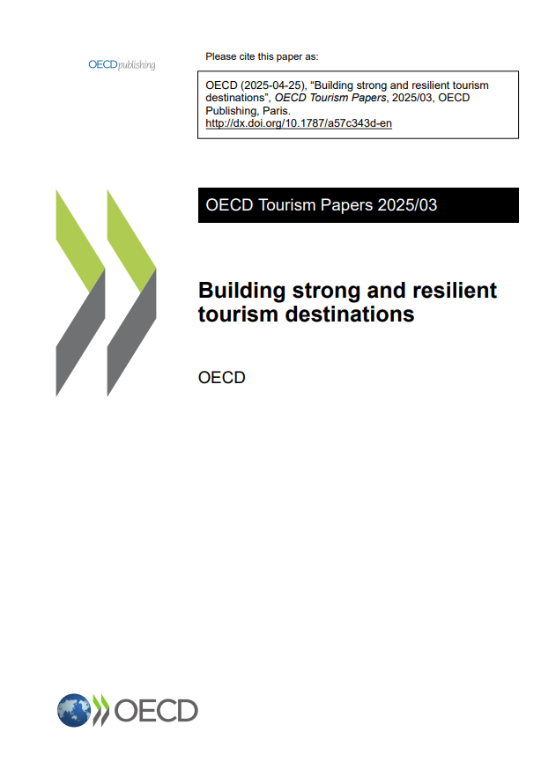
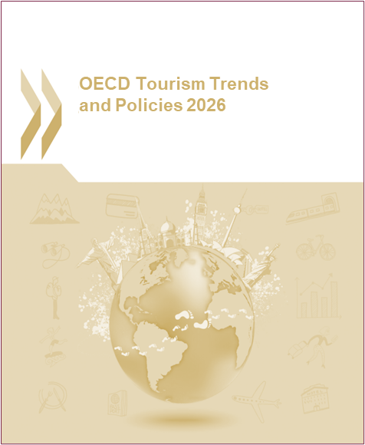
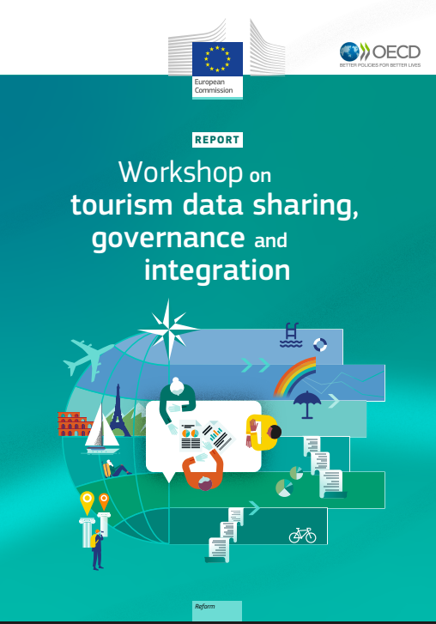
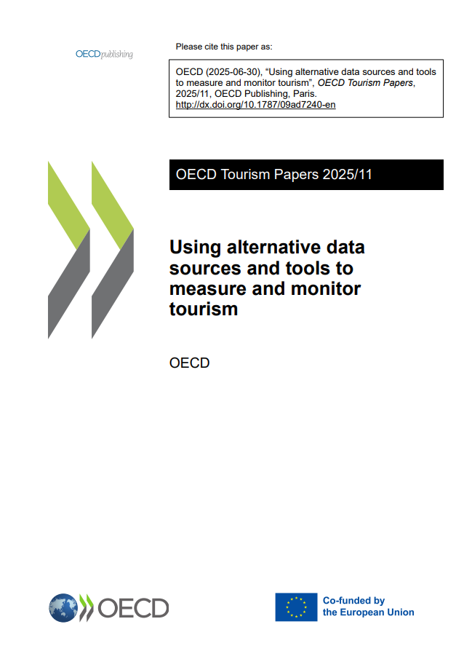
Selected OECD publications and resources
Building strong and resilient tourism destinations
OECD Tourism Trends and Policies (2026 edition forthcoming)
Workshop on tourism data sharing, governance and integration
Using alternative data sources and tools to measure and monitor tourism
Tourism data on OECD Data Explorer
Tourism at OECD

Slide 12
Thank you!
Julie.Reimann@oecd.org
tourism@oecd.org

