Slide 1

Regional Accounts in Europe
1 October 2025, United Nations Network of Economic Statisticians
Second Webinar of the Sub-national Sprint
Enrico INFANTE, Panagiota BISIELA, Martina PATONE

Slide 2
Summary
The role of Eurostat
Collection, validation, dissemination
Use of the data
Future challenges

Slide 3
1. The role of Eurostat
About the institutional and legal frameworks, the organisational aspect and what Eurostat does
3

Slide 4


Eurostat
Eurostat is the statistical office of the European Union
Our mission is to provide high-quality statistics and data on Europe
Eurostat produces European statistics in partnership with National Statistical Institutes and other national authorities in the EU Member States (ESS)
Member States
(+ others)
Processing

Slide 5

European System of Accounts
ESA 2010 is based on SNA 2008
European regional accounts are based on ESA 2010
ESA 2010 is a regulation
Manual on regional accounts methods
Mandatory data transmissions, based on the ESA 2010 Transmission Programme (amended in 2023)
Statistical output quality ensured with the European Statistics code of Practice

Slide 6
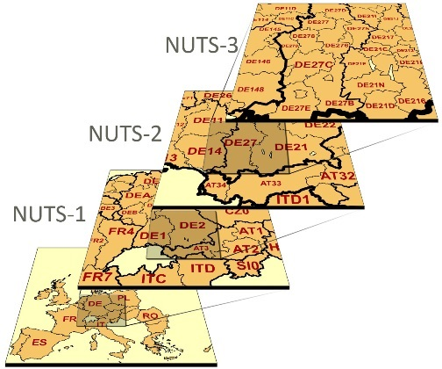
NUTS classification
Nomenclature of territorial units for statistics
Introduced in the 1970s, it’s legally binding since 2003
Hierarchical regional classification, applicable to all EU data
1165 NUTS 3 regions
244 NUTS 2 regions
92 NUTS 1 regions
27 EU Member States

Slide 7
NUTS classification
Changes only after at least 3 years (currently: NUTS 2024; next: NUTS 2027)
Exception: major administrative change
Population thresholds:
Exceptions: regions defined before 2003; administrative regions
Level | Minimum | Maximum
NUTS 1 | 3 million | 7 million
NUTS 2 | 800 000 | 3 million
NUTS 3 | 150 000 | 800 000

Slide 8
2. Collection, validation, dissemination
About the technical and practical aspects of our work, and on the published products
8

Slide 9

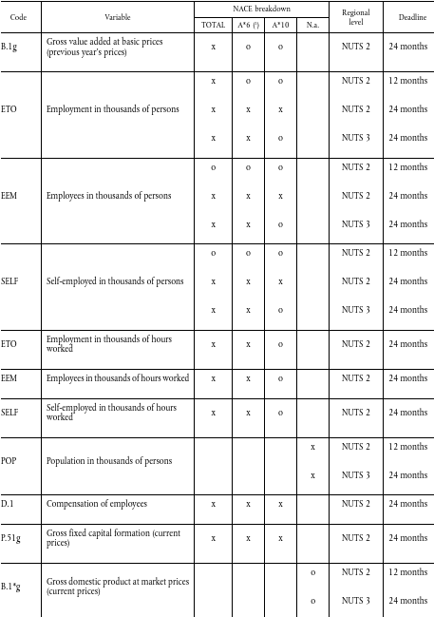
Collection
Data transmitted by 31 December (mostly T+24, but NUTS 2 GVA, EMP totals T+12)
Current prices GVA at NUTS 3 (by 10 industries)
Employment, employees, self-employed:
In person at NUTS 3
In hours worked at NUTS 2
Average population at NUTS 3
Compensation of employees and GFCF at NUTS 2 (by 10 industries)
Household accounts at NUTS 2
EU Member State, EFTA, enlargement countries
Communications with countries and EG RA

Slide 10
Validation – Two-step approach
Standardised validation report
Automatically produced
All purely quantitative checks reported
Countries contacted in a limited time frame
1st STEP
More in-depth review of data
Gives time to Eurostat for analysing the data, and to countries to fix the issues reported in the first step
2nd STEP

Slide 11

Validation checks
Pre-validation checks, structural checks
Basic checks (completeness, zero and negative values)
NUTS and NACE consistency
Households consistency
Cross-domain consistency (GDP, HH, LFS, POP, …)
Revision analysis
Outlier detection
Growth, shares, visual analysis, …

Slide 12

Validation
Transparent and clear policy, with defined thresholds
Well documented
Specific and structural metadata reporting
It’s all about quality!

Slide 13
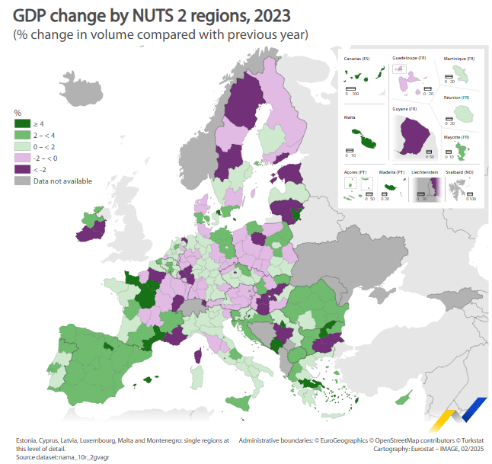
Dissemination
Typically around 6 weeks after transmission. Next: 10 February 2026
Regional GDP computation
News article
Statistics Explained articles: NUTS 3, Households
Productivity indicators (labour)
Additional releases (like the Regional Yearbook)
Database release (nama_10reg)

Slide 14
3. Use of the data
About the reasons we do produce regional accounts, who is looking at the data and why
14

Slide 15
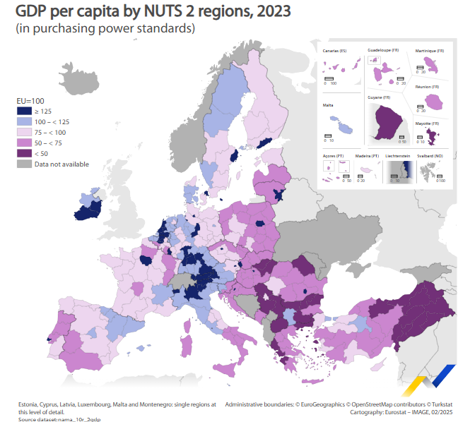
Why European regional accounts?
Increased comparability across regions
Geographical patterns
Allocation of the EU cohesion fund based on regional accounts data: less developed regions (GDP/head (PPS) less than 75% of the EU-27 average)
Regional EU policies
Non-institutional users (media, academics, etc.)

Slide 16
4. Future challenges
About the next steps for European regional accounts
16

Slide 17
What’s next?
Update of the ESA regulation, following the updated SNA
Regional investment of the general government
Structural metadata
Even better data quality (timeliness, completeness)

Slide 18
Thank you
ESTAT-REG-ACCOUNTS@ec.europa.eu
© European Union 2025
Unless otherwise noted the reuse of this presentation is authorised under the CC BY 4.0 license. For any use or reproduction of elements that are not owned by the EU, permission may need to be sought directly from the respective right holders.

