Slide 1


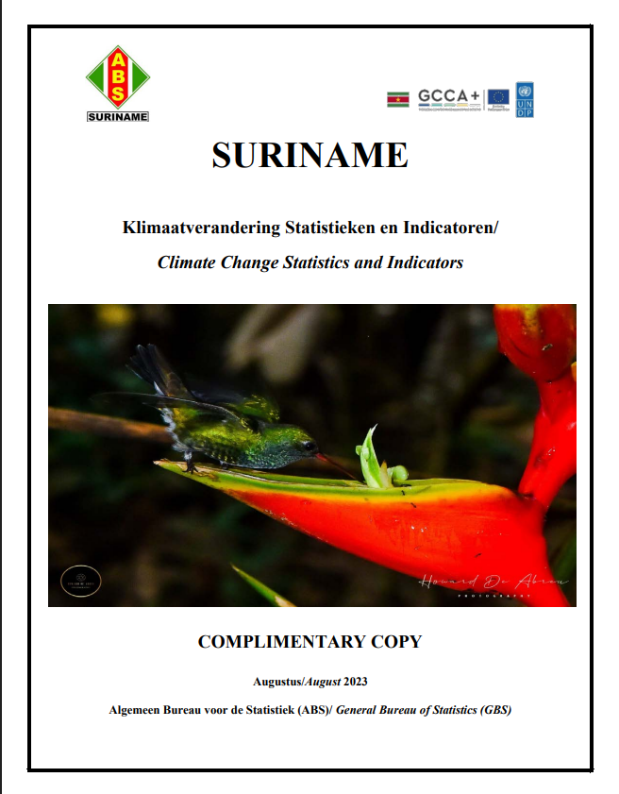
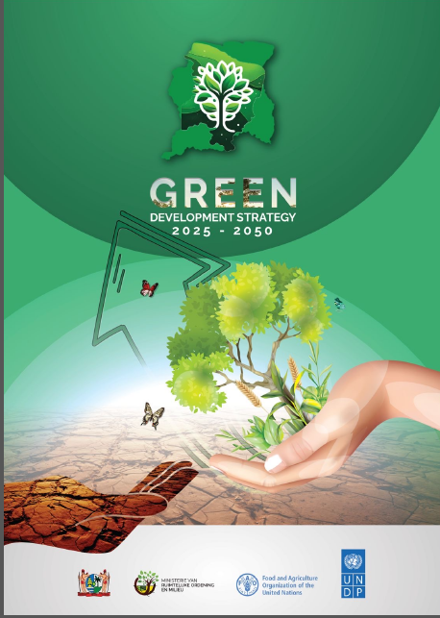

"Suriname’s Net Zero’s story” “Maintain Our Carbon Negative Status”
Name: Mrs. Anjali De Abreu-Kisoensingh, MSc.
Institute: General Bureau of Statistics (ABS)
Webinar: Mastering Net Zero Measurement
Date: 15 October 2025

Slide 2
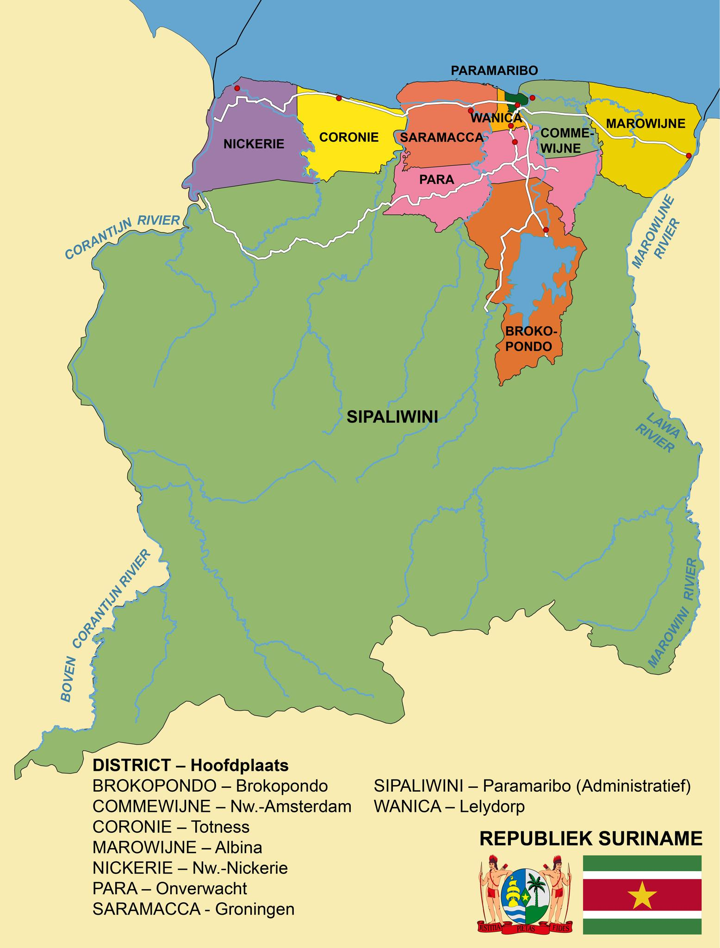
CONTENT
General Overview
Climate Change Commitments
Suriname’s Carbon negative Status
Suriname’s Green Development Strategy (GDS) 2025-2050
The Four Pillars of the GDS
Outcomes GDS measured across 3 pillars
Climate Change Data Reports
Advantages
Challenges
Whats Nexts

Slide 3








GENERAL OVERVIEW SURINAME
POPULATION AND SIZE
Suriname has an area of 163,820 km2 and a population of circa 633,400
ECONOMY
Suriname's economy depends on mineral resources, mainly gold and oil and agriculture.
We are highly dependent on the global market prices for these commodities.
Suriname faced frequent economic crises and high debt in recent decades that have created and, in principle, continue to create challenges at the socio-economic level.
Suriname is a SIDS country
small size, remoteness, fragile ecosystems, dependence on imports, vulnerability to external economic shocks, and high susceptibility to climate change impacts like sea level rise and extreme weather.
RAINFOREST
Suriname has 15.3 million ha (93%) of Rainforest
CARBON NEGATIVE
Suriname is one of the few countries in the world that is Carbon Negative (30-million-ton CO2 or NET 20 million ton each year
VULNERABILITY
Suriname has a low-lying coast (80% population), where the major economic activities and infrastructure are concentrated.
These areas are suffering extensive losses and damages from the effects of climate change
GAS AND OIL
Since 2019 circa 750 million barrels of reserves
Offshore oil discoveries: After 2028, Suriname's income could be between US$ 16 and US$ 26 billion.
CARBON CREDITS
Suriname submitted the BUR to the UNFCCC for Vintage (upto 2022) 17 Mton ( based on reduction)

Slide 4
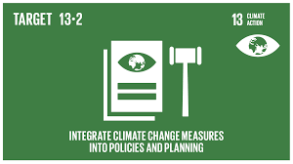
2.Climate Change Commitments
The Republic of Suriname has ratified
The United Nations Framework Convention on Climate Change (UNFCCC) (1997);
The Kyoto Protocol to the United Nations Framework Convention on Climate Change (1997);
The Paris Agreement for Climate Change (2016).
Indicator 13.2.1:
Number of countries with nationally determined contributions, long-term strategies, national adaptation plans and adaptation communications, as reported to the secretariat of the United Nations Framework Convention on Climate Change
Suriname’s UNFCCC Submissions &
Environment and Climate Change Statistics Reports
2005
2015
2016
2018
2019
2020
2021
2022
2023
2025
State of the Climate Report
First
Biennial
Report (BUR)
Green Development Strategy
(GDS)
First
National
Communication (FNC)
First National
Climate
Change
Policy,
Strategy
and Action
Plan for
Suriname
2014-2021
(NCCPSAP)
Intended
Nationally
Determined
Contribution
(INDC)
Second
National
Communication
2008
(SNC)
First
Forest Reference
Emission
Level
(FREL)
Second
Nationally
Determined Contribution
(NDC)
National
Adaptation
Plan
2019-2029
(NAP)
Environmental Framework
Act
(2020, amended 2024)
Second
Forest Reference
Emission
Level
(FREL)
Third
National
Communication
2008
(SNC)
First
Climate
Change Statistics
and
Indicators Report
2002-2024:
Environment Statistics Reports

Slide 5

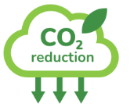
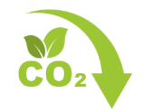
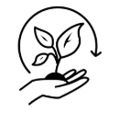






3. Suriname’s Carbon negative Status
Year 2017
Suriname’s Emissions (excluding removals)
3,591.5 Gg CO2eq
Indicator 13.2.2:
Total greenhouse gas emissions per year
Agriculture sector
538.1 Gg CO2eq
Energy sector 2,949.4 Gg CO2eq
industrial processes and product use (IPPU)
8.5 Gg CO2eq
Waste sector
95.5 Gg CO2eq
LULUCF sector :
Net removals of - 17,860.2 Gg CO2eq
Suriname’s Emissions (including removals)
net balance of
-14,268.7 Gg CO2eq
Suriname’s zero FRL aims to recognize the country’s special circumstance of being a net carbon remover.

Slide 7

2025-2050
Move from a Developing country to a Developed Country by 2050
Economic growth, environmental sustainability, and social equity.
Between 2028 -2033:
2028: First Oil Production (production capacity of 220,000 barrels per day)
2033: Suriname can be out of the high Debt
Surinamese Economy will transform and unlock vast new revenues that will propel our nation forward.
DILEMMA:
Keep our Carbon Negative Status
Have Sustainable Development
High GDP p/capita
USD 40,000
Reduced
Debt
Reduced
Poverty and inequality
CONTRADICTION
Keep our forest above 90%
Protect our eco-systems
Keep our Carbon negative Status
The core of our Green Development Strategy is finding the right balance between economic growth and diversification, social inclusivity, and environmental protection.
We are committed to ensuring that the benefits of our natural resources contribute to the well-being of all citizens, while also safeguarding our environment. As we move forward, we must ensure that our development efforts do not come at the cost of our precious ecosystem
BALANCE
Sustainable Development
Keep 93% Forest & have Economic Growth

Slide 8
4. Suriname’s Green Development Strategy (GDS) 2025-2050
FOCUS
The GDS addresses the challenges by outlining a long-term vision for the period 2025–2050, focusing on Sustainable economic diversification, environmental conservation, and social equity.
RESPONSIBLE
The Suriname Development Council (SDC) will oversee execution and ensure coordination among stakeholders. The Development Strategy Monitoring Institute (DSMI) will provide technical Guidance and track performance
LEGISLATION
To ensure stability and continuity across political cycles, it will be institutionalized through a GDS Act, preventing short-term policy shifts from undermining long-term development
The GDS aligns with Suriname’s national frameworks, such as the Constitution and the Planning Act, while also meeting international commitments like the Paris Agreement, Sustainable Development Goals (SDGs), and Nationally Determined Contributions (NDCs).
Planning instruments such as spatial planning, multi-annual development plans (MOPs), and sectoral plans will translate the long-term strategy into actionable policies.
By shifting from resource dependency to a diversified, climate-resilient economy, Suriname aims to maintain its carbon-negative status while ensuring inclusive growth for all citizens.
ALLIGNMENT

Slide 9
5.Four Pillars of the GDS
SURINAME VISION 2050
1. Sustainable Economic diversification and growth
2.Environmental protection and climate resilience
3.Social inclusivity and equity
4.Governance and institutional strengthening
Focus on expanding industries such as;
Agriculture,
Forestry,
Ecotourism,
Financial services,
ICT,
Renewable energy,
Reducing reliance on extractive industries.
Emphasize
Biodiversity conservation,
Climate change mitigation,
Sustainable land and water management, and
Pollution control.
Aim to improve
Education,
Labor market participation,
Gender equality, Indigenous rights, and
Healthcare access
Focus on improving
Transparency,
Stakeholder engagement, and
Institutional capacity to drive long-term development
USD 25.39 billion (35%) for economic diversification
USD 21.76 billion (30%) for environmental protection
USD 18.14 billion (25%) for social inclusivity
USD 7.25 billion (10%) for governance and institutional strengthening
The estimated investment required for GDS implementation is
USD 72.5 billion between 2025 and 2050

Slide 10
6.Outcomes GDS measured across 3 pillars
ECONOMIC
GROWTH
Target GDP per capita of at least USD 40,000 by 2050, driven by non-extractive Industries.
Reduce the GINI coefficient to 0.30 or lower, ensuring greater income equality.
Increase the Human Development Index (HDI) to 0.85+ by enhancing education, healthcare, and overall quality of life.
SOCIAL DEVELOPMENT
Improve the Environmental Performance Index (EPI) score from 57 to 70,
reinforcing Suriname’s status as a HFLD country
ENVIRONMENTAL
PERFORMANCE
Maintain Suriname’s carbon-negative status by balancing economic growth with climate commitments through sustainable land use and forest conservation strategies.
CARBON
NEUTRALITY

Slide 11
Business-as-Usual
Each scenario considers the time period 2024 (as the base year) till 2050, where the offshore oil and gas industry have been factored in
Sustainable Economy
Sustainable Economy with Large-Scale Agriculture
Forest (ex; PA) : 12,329,051 ha
Agriculture : 574,132.98 ha
Mining : 908,228.53 ha,
Urbanization : 119,747.82 ha
Protected Areas (PA): 2,240,000 ha
Forest (exc PA) : 4,939,608.21 ha
Agriculture : 448,513.30 ha
Mining : 423,291 ha
Urbanization : 119,747.82 ha
Protected Areas (PA): 10,240,000 ha
Forest : 9,223,531.72 ha,
Agriculture : 4,284,132.98 ha
Mining : 303,747.81 ha
Urbanization : 119,747.82 ha
Protected Areas (PA): 2,240,000 ha
This scenario reflects a status quo approach, where economic growth is driven by the extractive sector, mainly oil, gas, and gold mining, with limited industrial diversification.
The continued deforestation from ASGM and minor agricultural expansion contributes to environmental concerns, potentially threatening Suriname’s carbon-negative status. Forest cover can be below 90%.
The expansion of protected areas to 10.24 million hectares highlights Suriname’s commitment to conservation, maintaining its carbon-negative status and securing international climate finance.
The economy shifts towards services such as eco-tourism, digital transformation, and high-value knowledge industries. This approach minimizes environmental degradation while promoting long-term economic stability.
This scenario envisions a diversified economy driven by sustainable agriculture, improving food security and rural employment. However, the loss of forest cover and expansion of agriculture
might compromise Suriname’s carbon sink capacity.
Careful land-use planning and sustainable farming practices, such as agroforestry and controlled deforestation, are crucial to maintaining environmental balance.
OVERALL, IF WE DO NOT IMPLEMENT THE GREEN DEVELOPMENT STRATEGY (GDS)
WE WILL SEE A DECLINE IN OUR FOREST COVER (POSSIBLITY TO GO FROM 93%-64% in 2050 (Loose Carbon negative Status).
But if we implement the GDS strategy we will maintain our status and our forest covers can be above 90%.
We Need Climate funding, and a stable economy.

Slide 12


7.Suriname Net Zero Key Mitigation Programs (1)
Transform our energy sector, committing to reduce emissions by 40% by 2035 compared to a business-as-usual trajectory being fully aligned with the first Global Stocktake.
Contribute to "transitioning away from fossil fuels in energy systems, in a just, orderly and equitable manner.
Have a future powered by renewables. As of 2025, over 50% of our electricity is renewable, thanks to hydropower. But as our economy grows, this share is projected to drop.
Strategically using our natural gas resources to decisively phase out polluting heavy fuel oil
( Global stocktake recognition).
Energy
Sector
Expand access to higher education with a goal of 35% of the workforce achieving tertiary education by 2050.
Develop educational programs focusing on ICT, and technical skills to meet the demands of a green and diversified economy.
Strengthen TVET to equip youth with practical skills for emerging sectors like green technologies and eco-tourism.
Education
and Skills Development
Scale up reforestation projects and sustainable forest management to maintain Suriname’s carbon-negative status.
Implement stricter regulations and support mechanisms to phase out environmentally harmful practices like ASGM.
Expand renewable energy capacity, focusing on hydropower and solar energy
Environmental Sustainability

Slide 13



7.Suriname Net Zero Key Mitigation Programs (2)
Strengthen social welfare systems and implement poverty reduction programs targeting vulnerable groups, including Indigenous and tribal peoples.
Enhance gender equity through policies that ensure equal access to education, employment, and leadership opportunities for women.
Protect Indigenous land rights and integrate their traditional knowledge into sustainable development strategies.
Social Inclusivity and Equity
Establish a National Development Council to oversee GDS implementation, coordinate across sectors, and ensure alignment with international sustainability commitments.
Increase transparency and accountability through public monitoring frameworks and dashboards to track GDS progress.
Strengthen institutional capacity to enforce environmental regulations and manage risks effectively.
Governance and Institutional Strengthening
International Cooperation and Climate Finance
Actively pursuing innovative financing tools like green bonds, carbon credits, and Public-Private Partnerships (PPPs) to fund sustainability initiatives.
Strengthen participation in global carbon markets and leverage mechanisms like ITMOs to finance conservation and resilience projects.

Slide 14
8.Climate Change Data Reports
Environment Statistics
reports
Since 2002, GBS/Suriname published 11 Environment Statistics Reports, where the FDES 2013 and ESSAT tool, the SDGs, the CARICOM core set of Indicators and the Global Set of Climate Change Statistics and Indicators are used as main guidelines for data collection
https://statistics-suriname.org/milieustatistieken-4/
Having a separate Climate Change statistical publication, makes it easier to make the link with the existing Climate Change projects and UNFCCC submissions (NDC, NAP, National Communications), whereas having an Environment Statistics Report is much broader and it did not contain some of the social indicators and GHG data. (https://unfccc.int/documents/627964)
GHG data
Third National Communication Report
This report contains GHG emission data for the period 2000-2017, which is data that is needed for the IPCC area “Drivers” from the 2020 UNSD-Global Set of Statistics and Indicators ttps://unfccc.int/sites/default/files/resource/SURINAME%20NC3_2023_FINAL.pdf
Global Set on Climate Change Statistics and Indicator report
It was a milestone for Suriname to publish their first Climate Change Report in August 2023, following in the footsteps of Jamaica and Tanzania. The Global on Climate Change Statistics and Indicators and the CISAT tool were used as the main Guideline
https://statistics-suriname.org/wp-content/uploads/2023/08/First-Suriname-CC-report_21-aug23-Climate-Change-Statistics-and-Indicators.pdf )
The ministry of Oil and Gas and Environment (Climate Change focal point of Suriname), use both reports for Climate Change Policy for all IPCC areas, but mostly for Mitigation and Adaptation processes.

Slide 15
9.Challenges
Lack of good quality and disaggregated data
Limited institutional and human capacity
Limited funding for adaptation efforts
Reliance on donor funding (uncertain and don’t cover long-term costs.
Coordination issues between different ministries affect the alignment of policies and create inefficiencies.
Legislation to enforce climate commitments is still inadequate.
Lack of Environmental and Climate Change Awareness Education
Lack of Access to International Climate Finance (justice)

Slide 16
10. Advantages
Good collaboration between the NSO and the ministry of Oil, Gas and Environment (OGE).
Participation in (national, regional and international) Climate Change workshops and Technical assistance received from (CARICOM,ECLAC, UNSD, UNFCCC, FAO, etc.).
Members of various working groups;
GBS: Since 2016, member and more recently Vice-chair of the UNSD Expert Group on Environment and Climate Change Statistics (EG-ECCS), since 2017 a member of the Technical Working Group of CARICOMs Environment Statistics and CARICOM SDGs.
Min. of Oil, Gas and Environment: COP meetings, IPCC and UNFCCC workgroups etc.
Environmental Framework Act (No. 97 of 2020), where in Article #16 & #17 (data collection)
National Environment Authority as of 2024
Availability of Climate Change Data

Slide 17
11.Whats next
The statistical capacity at the government needs to be enhanced/increased through more training especially in the metadata to better understand the Climate Change and SDG indicators
Have a Geospatial hub (MRV)
Have a comprehensive data management System
Implement de GDS actions
Get access to Green funding
Data Quality Improvement from tier 1 to tier2 (IPCC) before 2028
Collect more Climate Change Statistics indicators in the 12th Environment Statistics Report
Have our BTR in 2026 (Dependance on GEF Funding for SIDS country)

Slide 18


BEDANKT Gran Tangi Thank You Gracias Merci Beaucoup

