Slide 1

Second Webinar of the Tourism Sprint of the United Nations Network of Economic Statisticians – Tourism Statistics: Leveraging Data for Responsible Tourism 26 November 2025
Session 2 – Tourism and Sustainability
Towards harmonised European indicators on the Sustainability of Tourism
Presenter: Christophe Demunter, European Commission / EUROSTAT

Slide 2

A key priority in tourism policy
European Commission 2024-2029 priorities :
Commissioner Tzitzikostas
in charge of Sustainable Transport and Tourism

Slide 3
A key priority in tourism policy
Europe:
Sustainability of tourism is an important dimension in all policy documents, for instance the EC’s ‘Transition Pathway for Tourism’ and the ‘EU Sustainable Tourism Strategy’ (forthcoming, April 2026) .
Focus on sustainability in the EU Tourism Dashboard
Worldwide:
Major topic for UN Tourism (for instance the recent endorsement and roll-out of the Statistical Framework for Measuring the Sustainability of Tourism (SF-MST)) and OECD
Statistical community:
Already mentioned in the 2011 EU Regulation on tourism statistics: pilot studies on “data showing the effects of tourism on the environment”
Methodological work on new indicators in many Member States

Slide 4
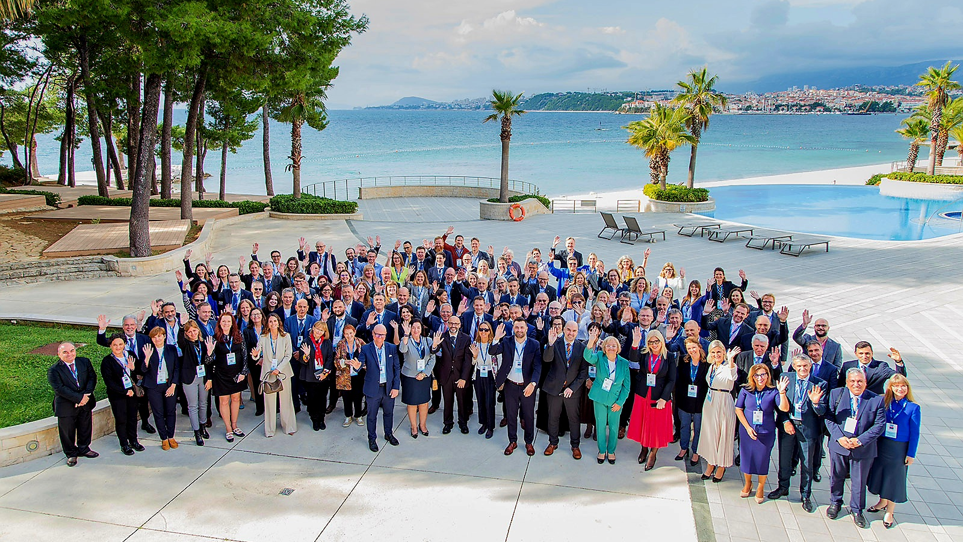
Statistical community (continued):
Recent meeting of the directors-general of the national statistical institutes in the EU
110th DGINS Conference, Split, Croatia
“European tourism statistics :
A forward looking and innovative response to 21st century user needs”
Selection from the conference Conclusions
[…] understanding better the economic dimension of tourism, its interaction with the labour market and its impact on local communities and on the environment.
[…] new sources and methods must be continuously explored to produce relevant, reliable, and more granular official tourism statistics that cover sustainability in all its dimensions
[…] importance of enriching tourism statistics with indicators derived from existing information in other areas of official statistics to cover economic, social and environmental dimensions in a balanced way
[…] importance of data measuring the sustainability of tourism in its economic, socio-cultural as well as environmental aspects. To this end, a revision of the legal framework should enable the production of relevant indicators with a sufficient geographical, temporal and sectoral granularity

Slide 5
Building process for the set of indicators
Re-use existing harmonised European statistics (not only tourism statistics)
+ speed, harmonisation, data availability and continuity, time series
- existing data doesn’t cover all dimensions of sustainability equally
Avoid new net respondent burden (and keep burden on administrations minimal)
+ speed (new surveys take a lot of time), in line with burden reduction policy
- less flexibility in measuring under-covered aspects
Step by step approach : release of a first batch, then further deepening (*) or widening (**)
+ can be delivered in (relatively) short-term
- risk of being unbalanced (in terms of aspects of sustainability) and lacking granularity
(*) deepening: increasing geographical, temporal, sectoral granularity ; increasing scope/coverage (e.g. sdv)
(**) widening: adding indicators
to be achieved by better exploiting existing data in the EU, by exploring new sources (e.g. PHD) or methods (e.g. disaggregation to grid level), by modifying surveys (burden neutral) to better cover sustainability

Slide 6
Building process for the set of indicators
2020-2023
Regular discussions and exchanges at Task Force and Working Group level
November 2023 Working Group on Tourism Statistics: detailed proposal for indicators based on existing data
General support for the work done, the identified dimensions and the initial list of proposed indicators
Long-list considered a comprehensive and good starting point, but to be slimmed
Need for a coordinated approach in the ESS but also at international level (EC, UN Tourism, OECD)
2025
Focus Group meetings with a handful of countries, to discuss indicators per dimension
Assessment of relevance and feasibility of indicators in the long-list ; what to drop and keep
2-3 December … next Working Group on Tourism Statistics, held at Eurostat

Slide 7
Building process for the set of indicators
January – March 2026
Based on the discussions at the Working Group on 2-3 December, Eurostat will launch a more detailed consultation of the WG on the set of indicators
In parallel, metadata regarding sources, scope, definitions, gaps, etc. will be documented
Coordination with UN Tourism and the OECD, in particular regarding a common set of core indicators
March – June 2026
Preparation of a first release for the set of indicators that will come out of the Working Group consultation
2026 and onwards
Further development and fine-tuning of the first set of indicators where necessary
Further work on expanding the first set of indicators with information currently not yet available (mainly relating to the Social and to the Environmental dimension)

Slide 8
Dimensions of sustainability
Initial list:
Economy Monetary (f.i. tourism gross value added, BOP travel balance)
Non-monetary (f.i. evolution of nights spent, seasonality, survival rate of enterprises)
Labour market
Social and cultural impact
Environment
Digitalisation
Revised list
Economic
Social
Environmental
Alignment to other international initiatives and classifications (e.g. SF-MST)
Changing policy priorities (e.g.  digitalization)
Labour market indicators now spread over Economic and Social sustainability

Slide 9
Economic sustainability - examples
Dim. | Topic | Example of an indicator
Econ | Tourism share in the economy | Tourism direct gross value added in basic prices [% of total gross value added in the economy]
Econ | Tourism economic structure and international dependency | Inbound tourism expenditure [% of internal tourism consumption]
Econ | International position | Travel balance (BOP travel item – balance) [euro]
Econ | (Household) spending on tourism | Average expenditure per night during trips made by residents [euro]
Econ | Level/volume of tourism activity | Nights spent in tourist accommodation establishments [% change compared to previous period]
Econ | International dependency (generating markets) | Nights spent by visitors from the top 3 foreign markets in tourist accommodation establishments [% of total nights spent]
Econ | Seasonality of tourism supply | Nights spent in tourist accommodation establishments in the peak months [% of annual total nights spent]
Econ | Dynamics of tourism businesses | Survival rate in year t of enterprises in selected tourism industries newly born in year t-5 [%]
Econ | Employment in tourism industries | Persons employed or self-employed in tourism industries [% of total economy]

Slide 10
Social sustainability - examples
Dim. | Topic | Example of an indicator
Soc | Tourism participation | Participation in tourism by residents [number of tourists as % of the total population 15+]
Soc | Tourism pressure | Tourism density [number of nights spent in rented accommodation per km2]
Soc | Tourism pressure | Tourism intensity [number nights spent in rented accommodation per inhabitant]
Soc | Tourism pressure | Tourism concentration [dispersion measure expressed as the share of LAUs (area) accounting for x% of tourism nights]
Soc | Tourism acceptance | To be developed – indicator(s) on residents’ perception of tourism
Soc | Tourism labour market (characteristics) | <socio-demographic or employment groups to be determined> in tourism industries [as % of employment in selected tourism industries]
Soc | Remuneration in tourism industries | Gross hourly earnings in selected tourism industries [euro]

Slide 11
Environmental sustainability - examples
Dim. | Topic | Example of an indicator
Env | Green mobility | Trips by airplane as main means of transport [% of total number of trips]
Env | Green mobility | Trips by train as main means of transport [% of total number of trips]
Env | Long-haul dependency | Arrivals by residents from outside Europe [% of total number of arrivals at tourist accommodation establishments]
Env | Bathing water quality | Bathing waters classified as excellent or good quality [% of all bathing waters]
Env | Greenhouse gas emissions (tourism industries, air travel) | To be developed
Env | Energy use , energy intensity | To be developed
Env | Water use | To be developed
Env | Waste | To be developed

Slide 12
“Hot potatoes”
Contents and scope:
Scope: balancing the ideal delineation with the pragmatic delineation, considering constraints of data sources
e.g. scope of ‘tourism industries’ differs depending on the source considered (LFS, SBS, Environmental accounts, etc.).
Concepts and definitions: subjective choices linked to relevance
e.g, the types of transport to classify as sustainable or not sustainable?
Scientific quality versus ease of communication and clarity for users
e.g. using Gini coefficient for assessing seasonality or the share of the top 2 or 3 months in the annual figures?
Governance:
Need for international coordination
Need for coordination in the European Statistical System, also across statistical domains?
Design, maintenance, and continued fine-tuning a set of indicators

Slide 13
Methodological “hot potatoes”
Methodology:
Bias because of scope of data collection (or data availability)
e.g. when relying on accommodation statistics, same-day visitors and tourists staying at non-rented accommodation are out-of-scope.
Deciding between optimal data sources within the European Statistical System
e.g. LFS or SBS or NA for employment data, or even country-specific sources that may be of superior quality
Allocation of impacts to the appropriate geographical reference area
e.g. how to allocate the emissions of a flight from an origin airport in country A to a destination airport in country B, operated by a carrier established in country C to transport a tourist residing in country D to a holiday destination in country E?
Use of modelling or auxiliary information (from unconventional data sources) to improve granularity
e.g. production of municipality level data?
Measuring aspects of sustainability currently not available in official statistics
e.g. tourism acceptance by residents

Slide 14
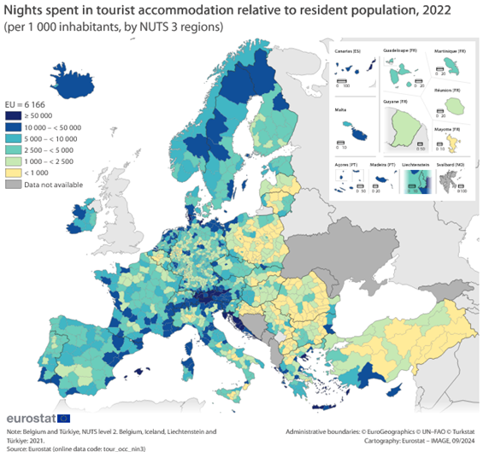
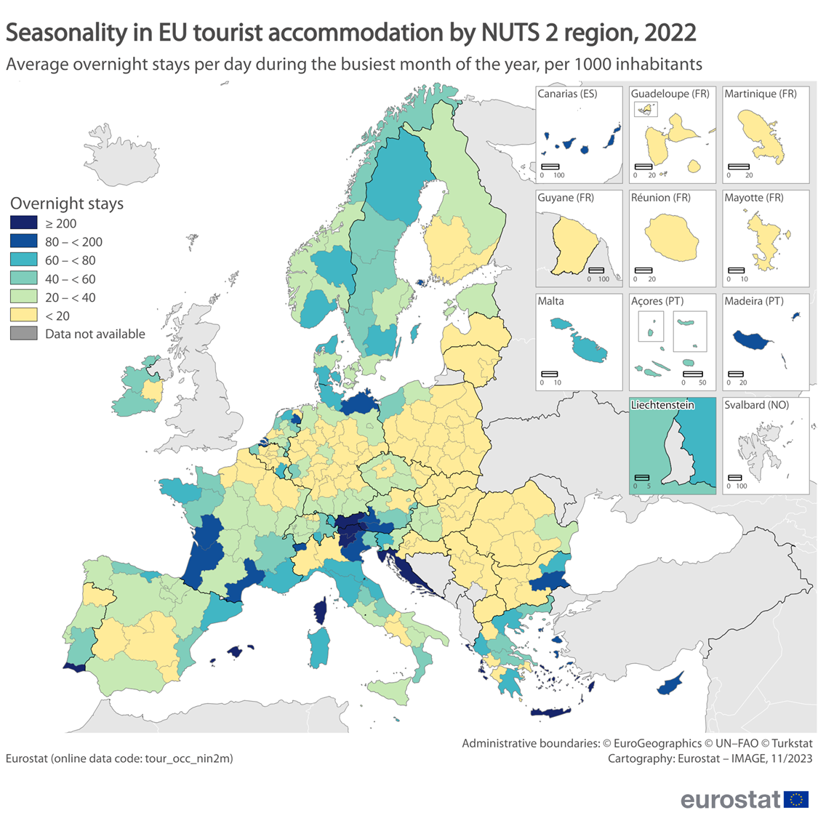
Example 1: tourism pressure
Tourism intensity - year
Tourism intensity – peak month
Nights spent in peak month, per 1000 inhabitants
Busiest regions: exceeding 200
Highest value: 787 in August in Notio Aigaio (Southern Aegean, Greece)
Underestimation of the real tourism pressure (nights spent in second homes or same-day visitors not included)
+ NUTS 3 granularity
- Annual average,
flattening out peaks
+ Better temporal
granularity (peak)
- NUTS 2 granularity

Slide 15
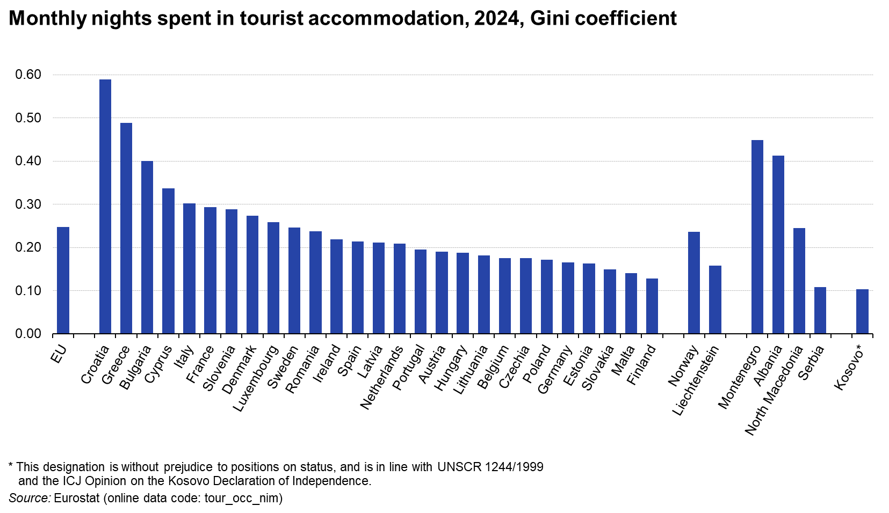
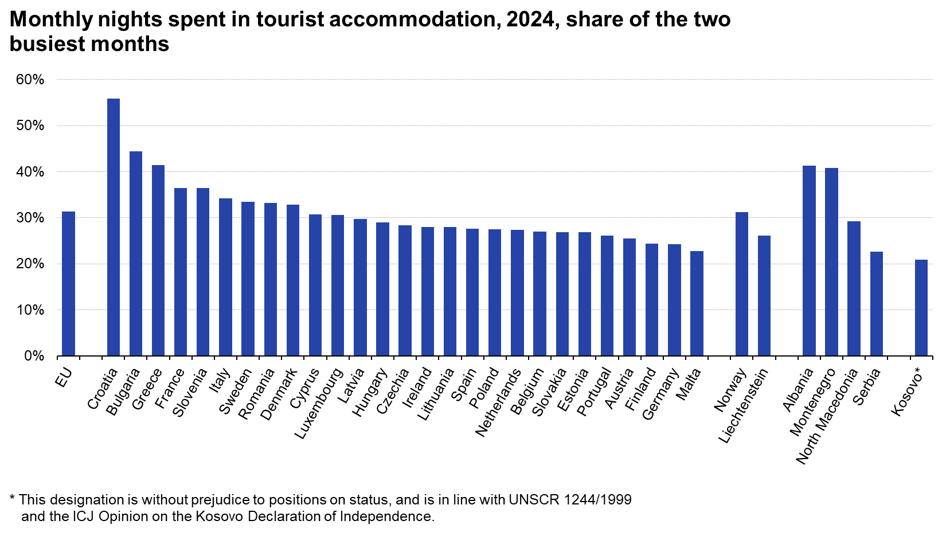
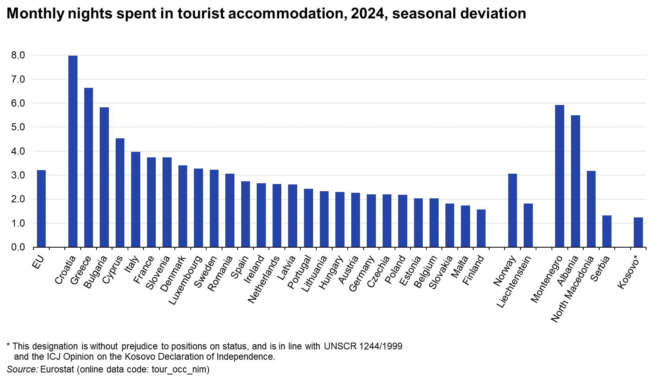
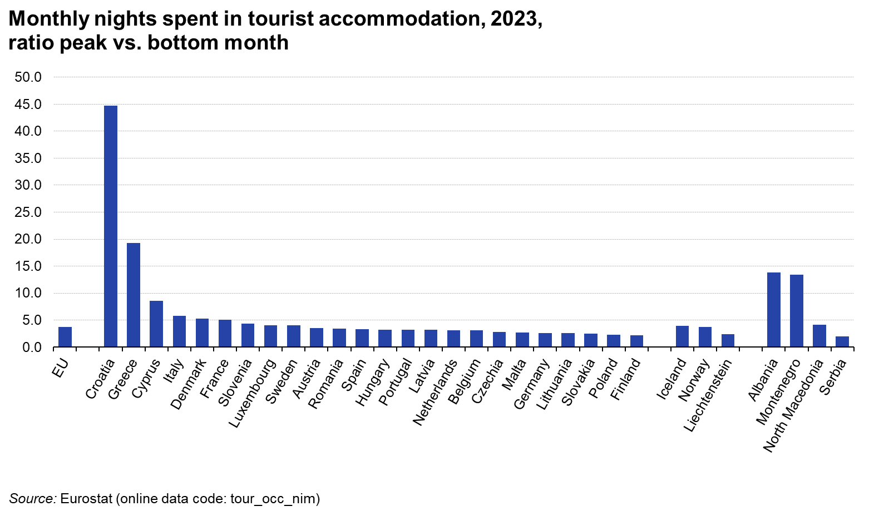
Example 2: seasonality
Gini coefficient
Difference between the cumulative share of monthly nights spent (ranking the months from lowest to peak) and the distribution in absence of seasonality (or uniform distribution of the annual nights spent over the twelve months)
+ Conceptually the best measure
- Difficult to communicate to users (clarity?)
Share of 2 busiest months
Share of the two dominant months in the annual number of nights spent
+ Easy to understand and communicate
- Ignores the other ten months in the analysis
? Peak month? Top 2 months? Top 3 months?
Seasonal deviation
Average of the (absolute) deviations of the monthly data points from their annual mean
+ Easier to communicate than Gini coefficient
- Less intuitive than “share of busiest months”
Ratio peak / bottom month
Value for the peak month in the year divided by the value for the bottom month in the year
+ Easy to understand and communicate
- Can be strongly influenced by extreme values in the two months considered
- Ignores the other ten months in the analysis

Slide 16
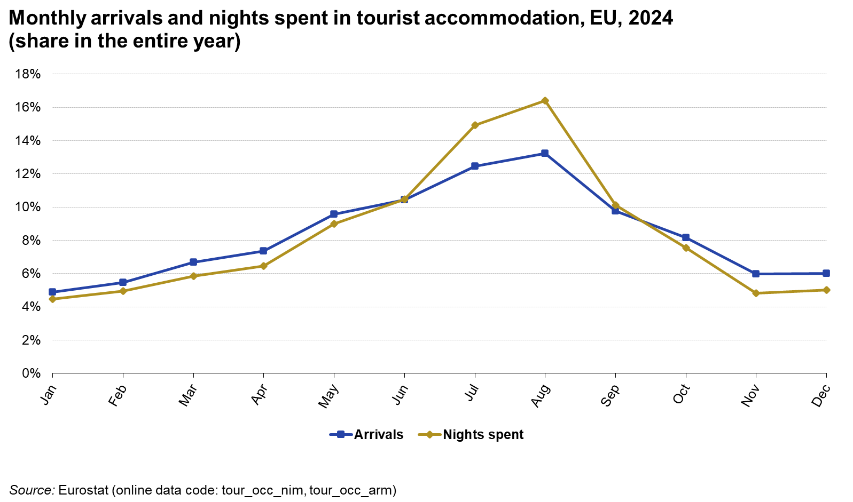
Example 2: seasonality
Nights spent versus arrivals
Nights spent
+ more relevant for pressure by tourism presence or for monitoring optimal use of infrastructure/capacity
Arrivals
+ more relevant for environmental impact linked to transport to/from destination

Slide 17
Thank you
© European Union 2025
Unless otherwise noted the reuse of this presentation is authorised under the CC BY 4.0 license. For any use or reproduction of elements that are not owned by the EU, permission may need to be sought directly from the respective right holders.

