Slide 1
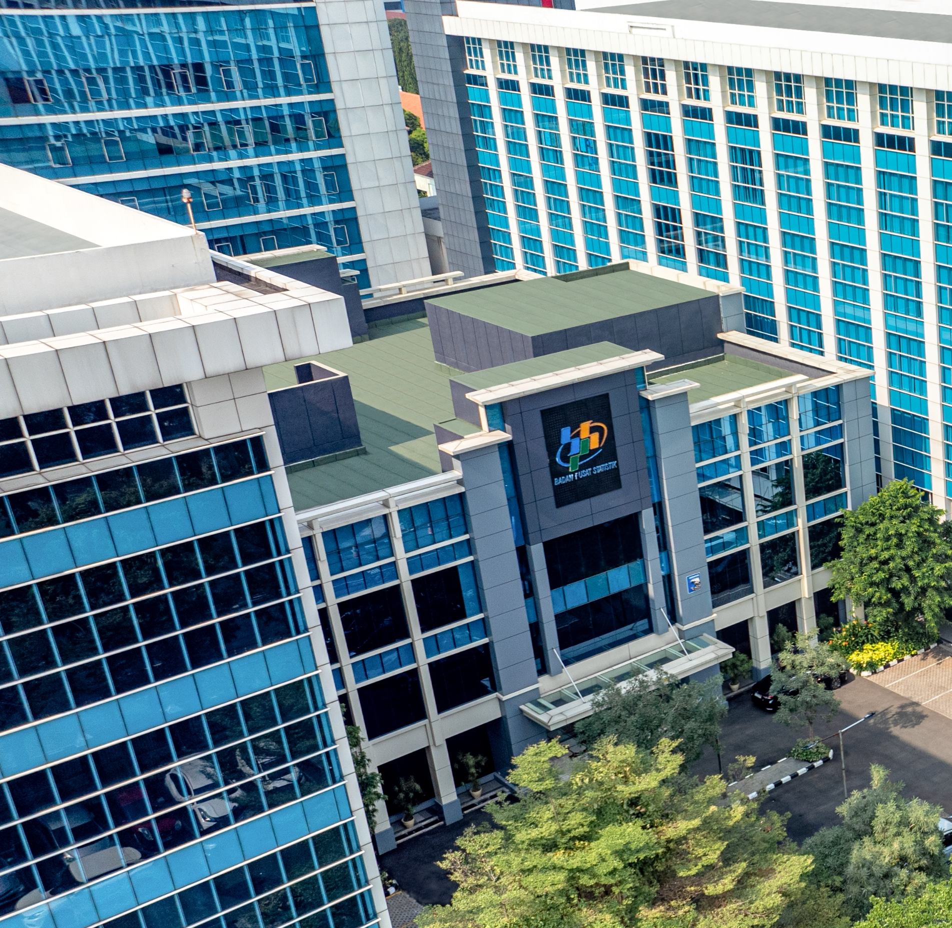



MEASURING SUSTAINABLE TOURISM
Jakarta, 26 November 2025
Eko Rahmadian
BPS-Statistics Indonesia
Notes:
Judulnya disesuaikan dengan tema RKP 2026

Slide 2
DATA SOURCES
Demand Side
Mobile Positioning Data
Digital Survey
Passenger Exit Survey
Data administrative from the Ministry of Immigration
Supply Side
Accommodation services survey
Survey on restaurant
Tourist Attractions survey

Slide 3
Economic Dimension: Demand side
Visitor Flows
Number of foreign tourist visit
Number of domestic tourist trip
Tourists Expenditure
Average expenditure per visit of foreign tourist
Average expenditure per trip of domestic trip
Component of expenditure

Slide 4
Economic Dimension: Supply side
Economic Performance of
Accommodation services
Tourist attractions services
Food and Beverage services
Number of employment
Data can be disaggregate at Tourist destination priority
Note: the data does not illustrate the direct impact of visitor/tourist in businesses

Slide 5
Environmental Dimension
Visitor
Foreign Tourist and Domestic Tourist
Have you implemented ecofriendly principles during your visit, for instance: reduce plastic use, less energy consumption, use the garbage bin.
Business
Accommodation Service and tourism industry
How the business manage the waste and implemented the concept of reduce, recycle, reuse

Slide 6
Social Dimension: Visitor (1)
Visitor flow: Domestic tourist and Foreign Visitor
Number of Domestic Trip and Number of visit for foreign tourist
Data of tourist and same day trip
Length of stay
Visitor Engagement
Proportion of tourist by activity
i.e. marine tourism, Culinary Tourism, wellness tourism, historical and cultural tourism etc.

Slide 7
Social Dimension: Visitor (2)
Visitor Satisfaction
Domestic Tourist
Ask whether the visitor have positive experience and will revisit in the future?
Visitor perspective after the trip (positive, neutral or negative)
Foreign Tourist
What is your satisfaction score during visiting Indonesia? (1= very unsatisfied, 2= unsatisfied, 3=moderate, 4=satisfied, 5= Very Satisfied)
Will you visit Indonesia again in the future? 1. Yes 2. No

Slide 8
Some Notes
Social Dimension:
Still lack of information on host communities, Tourism supplier and Government
Visitor satisfaction has not collected information in detailed of services such as accommodation services, food/beverages, tourist attraction (cleanliness, pollution etc), public services, etc

Slide 9

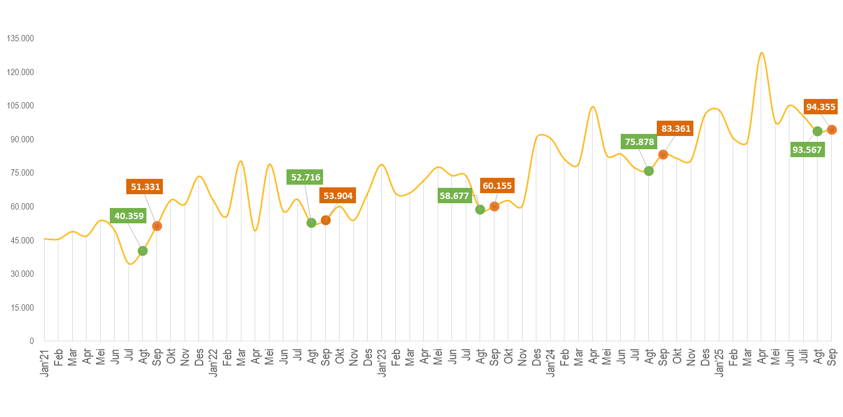
PILLAR 1: ECONOMY
[JUDUL SLIDE SATU BARIS]
Number of domestic tourists, 2021 – 2025 (thousand trips)
September 2025
Number of trips
94.355.423
trips
m-to-m
0,84%
September 2025 to Auguts 2025
y-on-y
13,19%
September 2025 to
September 2024
Idul Fitri: 12-13 Mei
Idul Fitri: 1-2 Mei
Idul Fitri: 21-22 April
Idul Fitri: 9-10 April
Idul Fitri: 31 Mar & 1 Apr
Source: Mobile Positioning Data (MPD)

Slide 10
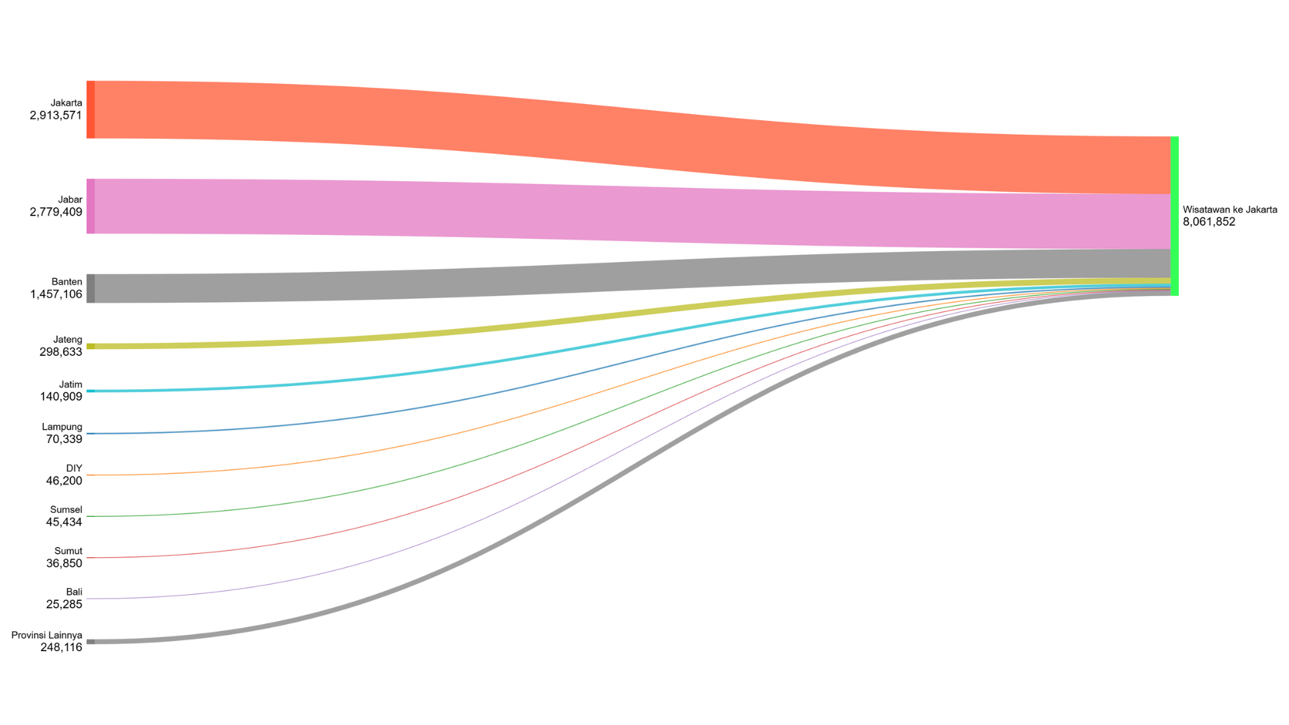
10 Main Provinces to Jakarta, September 2025
PILLAR 1: ECONOMY

Slide 11

PILLAR 1: ECONOMY
Average LoS Per Trip,
2018 s.d. 2024 (Malam)
Rata-rata Pengeluaran Per Perjalanan Wisatawan Nusantara di Daerah Tujuan, 2018 s.d. 2024 (Ribu Rupiah)
Sumber: Survei Wisatawan Nusantara (Konvensional) dan Survei Digital Wisatawan Nusantara
November - Desember
Januari - Desember

Slide 12
PILLAR 1: ECONOMY
Purposes Category of Domestic Tourists Based on Expenditure, 2024
Purposes | Province
Vacation | Kalimantan Tengah, Papua Barat
Health and wellness | Jambi, DIY, Jawa Timur, Banten, Kalimantan Selatan
Relligious | Sumatera Utara, Sumatera Selatan, Gorontalo, Sulawesi Barat
Home-coming | Sumatera Barat, Bengkulu, Kep. Babel, Kep. Riau, Jawa Tengah
Sport and Art | Aceh
Business | Riau, Lampung, Kalimantan Barat, Kalimantan Timur, Kalimantan Utara, Sulawesi Tengah, Sulawesi Tenggara, Maluku Utara, Papua, Papua Tengah, Papua Selatan
MICE | Bali, NTB, Sulawesi Utara
Training | Jakarta, Jawa Barat, NTT, Sulawesi Selatan, Maluku, Papua Barat Daya
Source: Digital Survey
November - Desember
Januari - Desember

Slide 13
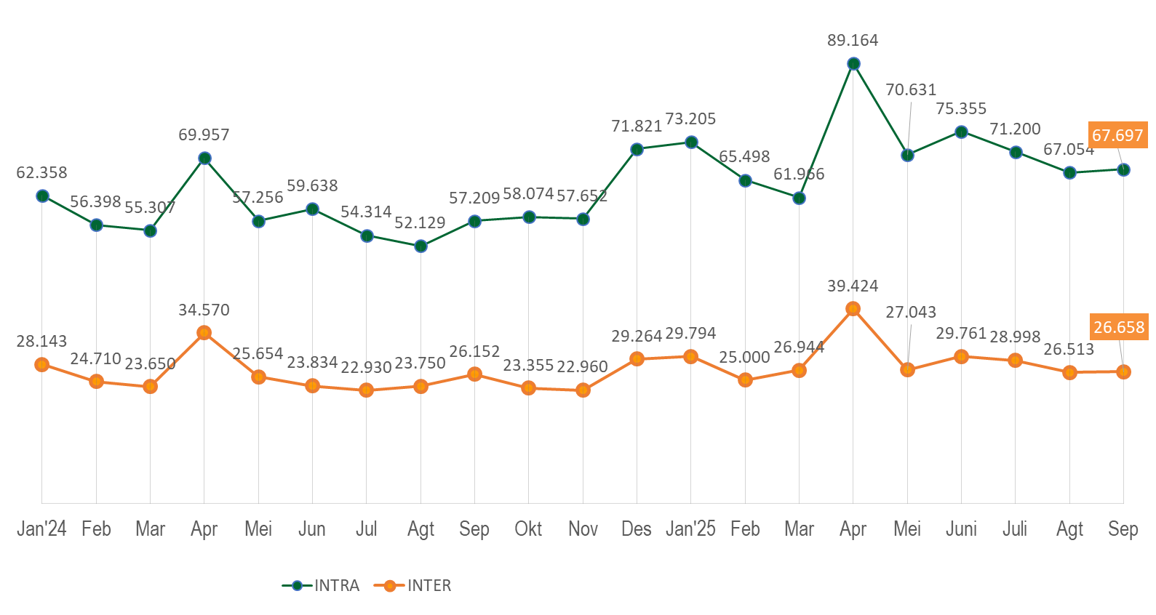
PILLAR 2: SOCIAL AND CULTURE
[JUDUL SLIDE SATU BARIS]
Intra-Inter, 2024-2025 (Thousand Trips)
Sumber: Mobile Positioning Data (MPD), BPS

Slide 14
PILLAR 2: SOCIAL AND CULTURE
[JUDUL SLIDE SATU BARIS]
Trips percentage based on purposes, 2024
Sumber: Survei Digital Wisatawan Nusantara, 2024

Slide 15
PILLAR 3: ENVIRONMENT
[JUDUL SLIDE SATU BARIS]
Activities (percentage), 2024
Sumber:survey digital, BPS

Slide 16
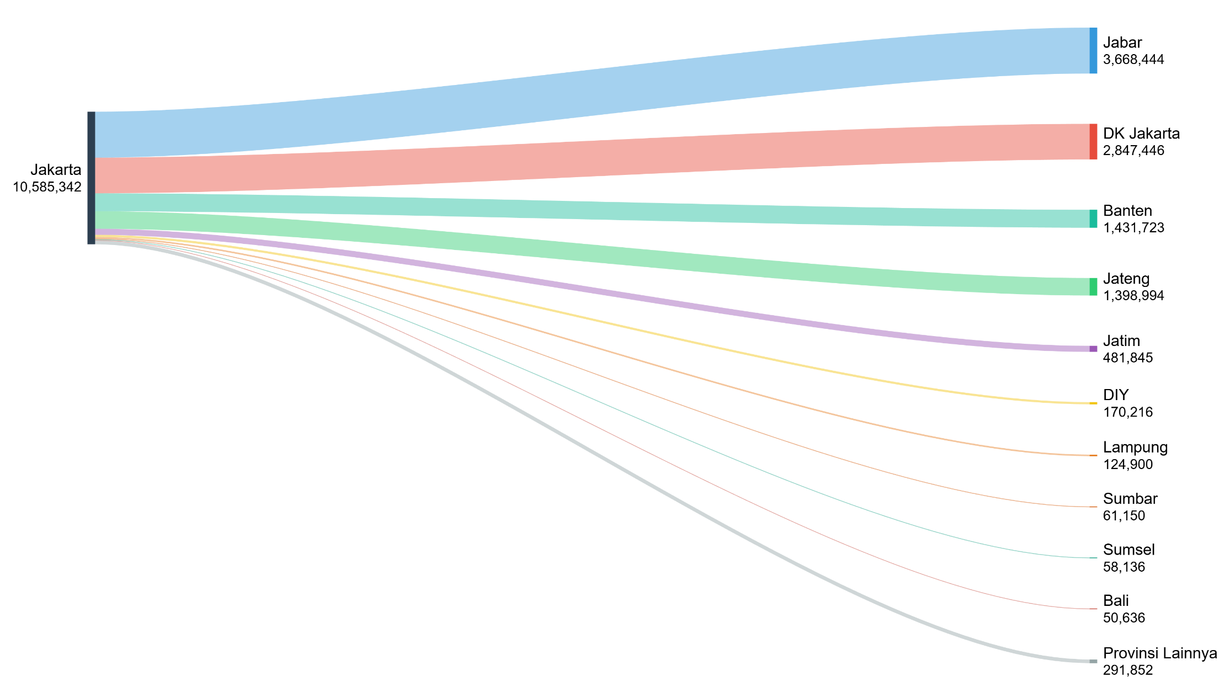
PILLAR 4: GOVERNANCE
Trips from Jakarta, April 2025
Eid al-Fitr 2025 falls at the end of March 2025, so the flow of domestic tourists traveling home for Eid will also be captured in April.
This data on homecoming travel will help the government determine mode priorities, transportation capacity, and infrastructure needs in key travel corridors. This information can serve as the basis for cross-agency planning to create a more prepared and sustainable transportation system and public services.

Slide 17






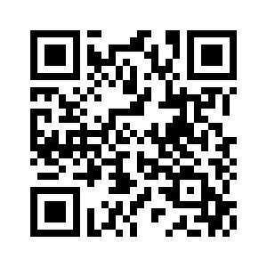
Thank You
SENSUS EKONOMI 2026 MILIK INDONESIA
Bersama kita kawal pelaksanaan SENSUS EKONOMI 2026 untuk mewujudkan kemandirian perekonomian Indonesia
Landing Page
Sensus Ekonomi 2026
https://sensus.bps.go.id/se2026/
#MencatatEkonomiIndonesia

