Slide 1


Net Zero
Storybook
December 2025

Slide 2
Outline
Introduction
Section 1: What is Net Zero and international commitments
Section 2: Net Zero measurement journey
Section 3: The role of National Statistical Organisations and National Statistical Systems
Section 4: Country case studies
Section 5: International and national initiatives
Section 6: Challenges
Section 7: Future opportunities
Section 8: Appendices

Slide 3
Acknowledgements
This Net Zero Storybook has been developed as an output from the Net Zero Statistics Sprint under the UN Network of Economic Statisticans. The Sprints were organised by a working group with staff from the Australian Bureau of Statistics, Statistics Canada, UK Office for National Statistics, Maldives Bureau of Statistics and United Nations Statistics Division.
Thank you to the UN-NES and the Net Zero Sprint contributors and participants for your engagement in this sprint and the storybook.
The working group welcomes feedback on this initial draft. If you have any additional resources or materials that can help tell the net zero story, please contact Jonathon Khoo (j.khoo@abs.gov.au).
Please also make contact if you would like to take the Storybook forward, as the working group is also looking for other forums to progress this work beyond the initial release.

Slide 4

Introduction
Net zero by 2050 is a simple, understandable metric, yet also a specific scientific and operational target by 2050 to balance emissions and removals.
Achieving Net Zero is a complex, cross-cutting challenge that spans climate, environmental, economic, and social dimensions. Measuring progress in this area involves cooperation across national statistical systems and international organisations. Numerous frameworks and indicators already exist at the international and national level, and there remains a need to deepen our collective understanding of both the core and broader narratives surrounding Net Zero.
The Net Zero Storybook has been drafted by the UN Network of Economic Statisticians to raise awareness of what Net Zero entails, why it matters, how countries are responding through policy and practice and what role national statistical systems can play. It highlights international commitments such as the Paris Agreement’s Biennial Transparency Reports and emphasizes that measuring Net Zero goes beyond greenhouse gas emissions—just as wellbeing extends beyond GDP.
By showcasing country case studies and the use of existing statistical frameworks, this storybook provides a foundation for learning, collaboration, and informed decision-making.

Slide 5







Section 1
What is Net Zero and international commitments
Parties to the Paris Agreement formally agreed to undertake rapid reductions … so as to achieve a balance between anthropogenic emissions by sources and removal by sinks of greenhouse gases in the second half of this century.
(Article 4, para 1 – Paris Agreement 2015)
Net Zero is a means to limit global warming to well below the Paris Agreement target of 2°C above pre-industrial levels. To reduce the risks of far more severe climate change events and impacts, including more frequent and severe droughts, heatwaves and rainfall, it pursues efforts to limit the temperature increase to 1.5 °C above pre-industrial levels.
Limiting GHG emissions from human activity to the same levels that can be naturally absorbed by trees, soil, and oceans, or captured through carbon storage or other technologies.
International targets:
Net zero emissions by 2050
43% emissions reduction by 2030 (on 2005 levels)

Slide 6
Section 1
What is Net Zero and international commitments
Key international commitments
The United Nations Framework Convention on Climate Change (UNFCCC) is the parent treaty of the international climate regime and serves as the foundational framework for international climate negotiations. Its primary goal is to stabilize greenhouse gas concentrations to prevent dangerous human interference with the climate system. Adopted in 1992 at the Earth Summit, it has led to subsequent treaties like the Kyoto Protocol and the Paris Agreement, which outline specific steps for countries to take in coordinating their response to the climate crisis.
The Paris Agreement is a legally binding international treaty on climate change. It was adopted by 195 Parties at the UN Climate Change Conference (COP21) in Paris, France, on 12 December 2015. The main aim of the Paris Agreement is to keep the global average temperature rise this century as close as possible to 1.5 degrees Celsius above pre-industrial levels.

Slide 7
Section 1
What is Net Zero and international commitments
Paris Agreement Reporting Commitments*
Nationally Determined Contributions (NDCs)- Parties to the Paris Agreement are required to set up and report progress on NDCs and participate in global stocktakes every 5 years. The first global stocktake was reported at COP28 in 2023 and found that, despite overall progress, parties were not collectively on track towards achieving the purpose and long-term goals of the Paris Agreement.
Enhanced Transparency Framework (ETF) – The ETF is a cornerstone of the Paris Agreement that establishes common rules and procedures for countries to report their climate actions and support as outlined in their NDCs.
Biennial Transparency Reports (BTRs) – Under the ETF parties to the Paris Agreement are required to submit biennial transparency reports, detailing their greenhouse gas emissions, adaptation efforts, and climate finance. To complete BTRs, information from a wide range of sources is required to be compiled. This includes information from national inventory reports, policies and measures and climate financing.
*There is flexibility for all countries per their policy demands and other needs.
+
There is flexibility for developing countries if needed to report fewer or less detailed information while capacity limitations prevail.(NDC Progress Indicators: a guidance for practitioners, p.7.)

Slide 8
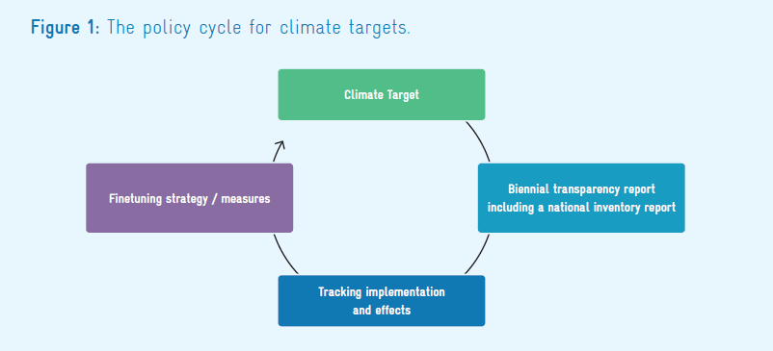
Section 1
What is Net Zero and international commitments
Reporting commitments within the policy cycle
+
Tracking progress towards a climate target is an essential task for ensuring its achievement. As circumstances change, the approach may need finetuning.
NDC Progress Indicators: a guidance for practitioners, p.6.

Slide 9
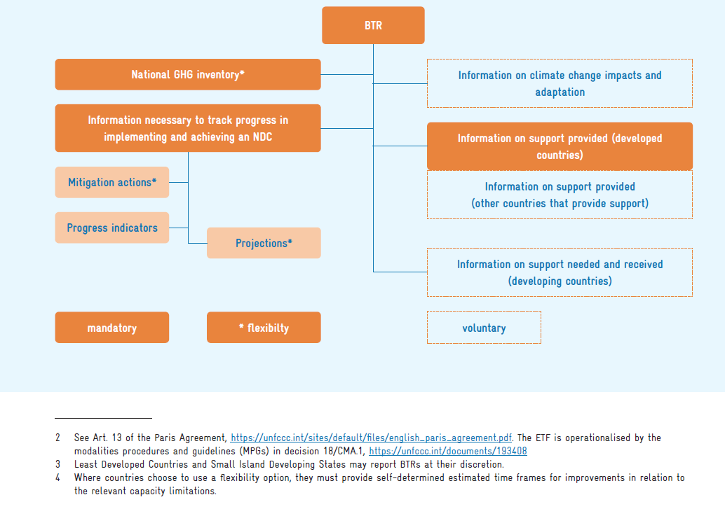
Section 1
What is Net Zero and international commitments
Reporting commitments in the context of the Paris Agreement
+
UNFCCC resources:
https://unstats.un.org/unsd/envstats/fdes/EGES11
https://unstats.un.org/unsd/envstats/fdes/EGES12/2.aUNFCCC_requirementsETF.pdf
NDC Progress Indicators: a guidance for practitioners, p.7.

Slide 10
Section 2
Policy and statistical frameworks relevant to Net Zero measurement
Environment
Climate change
Disaster Management
Framework for the Development of Environment Statistics (FDES)
Paris Agreement
Global set of Climate Change Statistics
and Indicators
Sendai Framework
System of Environmental-Economic Accounting
(SEEA)
UNECE CES set of Core Climate Change-Related Indicators
Strategic Framework on Geospatial Information and Services for Disasters
International Recommendations on Energy Statistics
Global Goal on Adaptation Indicators
+
NSO/NSS are navigating multiple measurement frameworks that are relevant to net zero
Data Gaps Initiative 3 (IMF G20 DGI-3)
Macro frameworks
e.g. SNA, GFS, BOP
Intergovernmental Panel on Climate Change (IPCC)
UN Disaster related statistics Framework
Sustainable Finance
Sustainable Development Goals (SDG)
There is recognition that the proliferation of measurement frameworks can cause confusion and inefficiencies. Effort is being expended in trying to understand overlaps, see UNECE Présentation PowerPoint and International climate indicators, France.pdf (Annex 2 has a cross-reference various climate change indicators across various international dashboards to examine overlaps).

Slide 11
The complex international structures overseeing the monitoring of environment and climate change targets
Section 2
ISO Advisory Group 13 on Land Cover and Land Use
Task force on Monitoring UN Decade of Ecosystem Restoration
Technical Working Group on Indicators of CBD
UN Committee of Experts on Environmental-Economic Accounting (UNCEEA)
London Group on Environmental Accounting
Expert Group on Measuring the Sustainability of Tourism
Global Ocean Accounts Partnership (GOAP)
Environmental Policy Committee’s Working Party on Finance and Investment for Environmental Goals.
UN Committee of Experts on Global Geospatial Information Management
Other
UN Committee of Experts on International Statistical Classification
GEO Groups (e.g. GEOBON, GEO Atlas, GEOLDN, etc.)
World Bank Global Program on Sustainability (GPS)
Intersecretariat Working Group on Services Statistics (Intersec/Strat)
Oslo Group
Expert Group on the Integration of Statistical and Geospatial information
Earth Observations for Sustainable Development Goals (EO4SDG)
Intersecretariat working group on National Accounts (ISWGNA)
Advisory Expert Group (AEG) of ISWGNA
Expert Group on Natural Capital
G20 Finance Ministers and Central Bank Governors (FMCBG)
G20 Data Gaps Initiative (Phase 3)
UN Committee of Expert Group on Business and Trade Statistics
United Nations Statistical Commission
UNECE Steering Group on Climate Change Related Statistics
Inter-Agency and Expert Group on Disaster-related Statistics
Intersecretariat Working Group on Environment Statistics (IWG-ENV)
OECD Environment Policy Committee
Joint Task Force on Environmental Statistics and Indicators
Task Force on the Role of NSOs in Achieving National Climate Objectives
Conference of European Statisticians (CES)
Energy
Tourism
Environment
Climate Change
Circular Economy
Sustainable Finance
UN Network of Economic Statisticians
Expert Group on Environment and Climate Change Statistics
OECD Committee on Statistics and Statistical Policy
Working Party on Environmental Information (WPEI)
UNECE Task Force on Circular Economy
Source: UNCEEA (2023), noting the groups in this assessment were solicited from UNCEEA Area A and UNECE materials and are not meant to be comprehensive.

Slide 12



Section 2
Net zero measurement journey
Example indicators
Renewable energy consumption
Number of hybrid or electric vehicles
Trade in low carbon technology
Analytical examples
Productivity
Regional footprints
Price impacts
+
NSOs role in the net zero story could be thought of as a measurement journey of increasing complexity
There will be a wide range of measures and statistics beyond GHG emissions.
Indicators of wider impacts are often the responsibility of NSOs.
Mitigation
Wider Impacts
Emissions
Adaptation
Example indicators
Territorial / Activity GHG inventories
Residential / Sector Air Emission Accounts
Consumption (footprint) based GHG emissions
Carbon stock accounts (GHG emission with offsets, incl LULUCF carbon sink)
Example indicators
Number of dwellings with adequacy of building materials
Green urban areas
Restored ecosystems

Slide 13
Section 2
Emission measurement approaches
Approaches to measuring GHG emissions
Production basis
Domestic final demand basis
+
There are different ways to measure emissions. The different measurement approaches meet different information needs.
Territory principle
Residence principle
Residence principle
GHG inventory
Air Emission Accounts
Demand-based emissions (footprint)
Source: OECD, Greenhouse Gas Emissions data: Concepts and Data Availability. Adapted from (Statistics New Zealand, 2020[4])

Slide 14
Section 2
Emission measurement approaches - pathway
Inventories
Air Emission Accounts
Demand / Use based emissions
Environmentally extended IO tables
Multi-Region IO tables
UNFCCC
Required under the Paris Agreement according to the IPCC 2006 Guidelines
Users: Gov, analysts, business,
Support mitigation policies and emission reduction targets
Territory principle
Usually compiled by Environment departments.
SEEA
Required under the IMF Data Gap Initiative – Phase 3*
Users: Gov, analysts, business
Support compilation of consistent environment / economy data for policy, analysis and research
Residence principle
Usually compiled by NSO.
Analytical tool to provide a more complete understanding of the carbon footprint, including emissions embodied in supply chains.
Users: Gov, analysts
Support mitigation strategies
Residence principle
Usually compiled by NSO.
Analytical tool (SNA based) linking emissions to IO tables to generate emissions factors per unit of output etc
Users: Gov, analysts
Support research into impact of emissions
Residence principle
Usually compiled by NSOs or economic consultants.
Analytical tool (SNA based) linking emissions using international models
Users: International analysts
Support research into global and supply chain impacts
Residence principle
Usually compiled by international agencies.
+
Emission measurement approaches pathway
*The IMF has an Air Emission Accounts Tool to convert IPCC inventory emissions to ISIC sections. It is a Python-based tool that works with Excel inputs. Please contact the IMF to discuss access to the tool.

Slide 15
Section 2
Net Zero measurement framework
The Global Set of Climate Change Statistics and Indicators (Global Set) is a comprehensive framework adopted by the UN Statistical Commission (UNSD) in 2022, providing a standardised structure of 158 indicators and 190 statistics to guide countries in developing their own national climate statistics programs.
It covers the five policy areas of the IPCC (drivers, impacts, vulnerability, mitigation and adaptation) which are broken down into 34 topics. It does this by connecting reporting requirements for the Paris Agreement and Sustainable Development Goals (SDGs) to indicators available within established frameworks such as:
Paris Agreement / IPCC
Framework for the Development of Environment Statistics (FDES)
System of Environmental-Economic Accounting (SEEA)
Sendai Framework
Sustainable Development Goals
UNECE References (Climate change-related statistics | UNECE)
International Recommendations for Energy Statistics
UNSD, in collaboration with the United Nations Framework Convention on Climate Change (UNFCCC) and the Expert Group on Environment Statistics (EGES), has developed the Climate Change Statistics and Indicators Self-Assessment Tool (CISAT) to support the implementation of the Global Set.
Countries can select and prioritise statistics and indicators most relevant to their national context.
+
The Global Set of Climate Change Statistics and Indicators help identify emissions (drivers), mitigation and adaptation indicators

Slide 16
Section 2
Wider impacts
Net Zero’s reach is wide ranging. There are two main streams:
emissions levels, sources of emissions, and actions to reduce emissions in specific sectors
impacts, adaptation and transition – the move to net zero will have social, technological, workforce etc impacts that need to be planned for
Emissions levels / reductions
Emissions / Carbon accounting (SNA basis)
Supply and use of energy products, including renewables (including behind the meter)
Energy stocks
Carbon markets
Agriculture
Transport (including electric vehicles)
Building efficiency
Circular economy - materials kept in circulation
Economic impacts, including decarbonisation analysis and energy decomposition
Impacts, adaptation and transition
Grid reliability and security
Energy prices
Household and business behavioural change (including for appliances)
Energy investment
Energy equity
Regional analysis
Workforce - energy employment
Sustainable finance
Land use
Critical minerals
+
Net Zero has wide ranging impacts and these are examples of areas where further analysis may be of relevance to NSO/NSS to inform policy making.

Slide 17
Net Zero measurement journey:
Section 2
Emissions:
Nationally Determined Contribution targets set by each country and indicators to limit global average temperatures to well below 2°C above pre-industrial levels.
Drivers
Net zero = Emissions
Examples | Area | Methods Frameworks
NDC target | Driver | IPCC
Total GHG emissions per year (also by sector) | Driver, indicator 1 | CISAT– IPCC; SDG; UNECE; SEEA-CF
Total emissions of indirect greenhouse gases | Driver, indicator 2 | CISAT– IPCC; FDES
Greenhouse gas emissions from Land Use, Land-Use Change, and Forestry (LULUCF) | Driver, indicator 3 | CISAT– IPCC; SDG; UNECE;
Greenhouse gas emissions from the national economy | Driver, indicator 4 | SEEA-CF; UNECE
Total primary energy production from fossil fuels | Driver, indicator 10 | CISAT – IRES
Number of live animals in livestock | Driver, indicator 24 | CISAT - FDES
+
Examples of net zero measures/indicators. See the Appendices for a more complete list of measures drawn from the Global Set.
Climate Change Statistics and Indicators Self-Assessment Tool (CISAT) supports the implementation of the Global Set of Climate Change Statistics and Indicators.

Slide 18
Net Zero measurement journey:
Section 2
Net zero = Adaptation and mitigation
Examples | Area | Methods Frameworks
Production of renewable energy as proportion of total energy production | Mitigation, indicator 109 | CISAT - IRES
Renewable energy share in the total final consumption | Mitigation, indicator 110 | CISAT – IRES; SDG; UNECE
Non-fossil fuel energy consumption as a proportion of final energy consumption | Mitigation, indicator 111 | CISAT – IRES; SDG
Proportion of population with primary reliance on clean fuels and technology | Mitigation, indicator 112 | CISAT – SDG
Climate change mitigation technology | Mitigation, indicator 120 | CISAT
Trade in low carbon technology products | Mitigation, indicator 121 | CISAT – SEEA-CF
Greenhouse gas intensity of the economy | Mitigation, indicator 122 | CISAT – SEEA-CF; UNECE
Rate of decrease of greenhouse gas emissions per unit of GDP | Mitigation, indicator 123 | CISAT - IPCC
Greenhouse gas removals (carbon sequestration) | Mitigation, indicator 124 | CISAT – IPCC; SEEA-EA; UNECE
Increase in forest area | Mitigation, indicator 125 | CISAT – SEEA-CF; FDES
Number of dwellings with adequacy of building materials defined by national of local standards | Adaptation, indicator 147 | CISAT – FDES
Progress towards sustainable forest management | Adaptation, indicator 149 | CISAT – SDG
Notes:
Greenhouse gas removals (carbon sequestration)
Increase in forest area

Slide 19
Net Zero measurement journey:
Section 2
Net zero = Broader analysis and indicators
Examples | Area | Methods Frameworks
Forest area as a proportion of total land area | Impacts, indicator 31 | CISAT – SDG; SEEA-CF
Ecosystem carbon stocks | Vulnerability, indicator 90 | CISAT – SEEA-EA
Regional and / or demographic analysis of net zero impacts | Vulnerability | Broader measures – from NSO data holding
Productivity analysis of the changing energy mix | Impacts | Broader measures – from NSO/other data holdings
Price impacts | Impacts | Broader measures – price indexes

Slide 20
Section 3
The Role of the National Statistical Offices / Systems
National Statistical Offices have the potential to play two key roles in the net zero transition as they can:
Provide official statistics to the domestic agency responsible for NDC and BTR reporting
In collaboration with the country’s National Statistical System, provide broader cross cutting statistical information on the net zero transition for analysis and policy development using international classification and measurement frameworks. These include: GHG inventories and emissions accounts; Energy use and transition indicators; Environmentally-related taxes and subsidies; Employment and skills in “green sectors”.
Collaborate with international partners to develop standardized indicators for measuring progress towards Net Zero.
NSO/NSS (*) data are compiled using the UN Fundamental Principles of Official Statistics
Relevance, impartiality and equal access
Professional standards and ethics
Accountability and transparency
Prevention of misuse
Sources of official statistics
Confidentiality
Legislation
National coordination
Use of international standards
International cooperation
(Fundamental Principles of Official Statistics)
+
Given the Net Zero sprint is under the auspices of the UN Network of Economic Statistician, this section explores the role of NSOs/NSSs in the Net Zero space.
(*) To be considered official statistics data must be compiled using the UN Fundamental Principles of Official Statistics (FBOS). The Handbook on Management and Organization of National Statistical Systems, chapter 3.2 focuses applications of FPOS. In some countries a single agency compiles official statistics, in other countries official statistics are compiled by a range of agencies as part of broader system.

Slide 21
Section 3
The role of NSOs/NSSs in providing Net Zero data and measures
Key Indicators
(Awareness)
Can highlight trends
+
Analysis and insights
(Storytelling to support policy)
Can produce analysis and insights for complex issues that cover economy, environment and society.
See the UNECE statement publication on the role of NSOs in contributing to data for climate action - Data for Climate Action: How National Statistical Offices Can Contribute | UNECE
Countries may also have legislative structures providing NSOs unique powers to request information that other institutions within the country may not have.
Official Statistics
(Complied using the Census and Statistics Act
Public domain
Coherence with other NSO/NSS outputs
Ongoing, consistent timeseries )
Can leverage a range of existing datasets for longitudinal and cross-sectional analysis and international comparisons.
Can integrate and store datasets to enrich data sharing and collaboration.
NSO/NSS data assets can allow microdata analysis.
Basic Data & Data Assets
(Supports bottom-up build and microdata analysis)

Slide 22
Section 3
International structures
NSO/NSS need to navigate the complex international structures overseeing the environment and climate change space. NSOs/NSSs will have to make choices on where effort is directed depending on the policy focus of individual countries.
For example, work presented via the Expert Group on Environment and Climate Change Statist.ics (EG-ECCCS).
International Programme for Action on Climate (IPAC) | OECD
Effort prioritisation is essential: Given the breadth of international initiatives, NSOs/NSSs need to make informed decisions about where to focus their resources and engagement, depending on their country’s specific climate and environmental policy goals.

Slide 23




Section 4
Country case studies
To view country presentations, please see Net-Zero Statistics Sprint

Slide 24
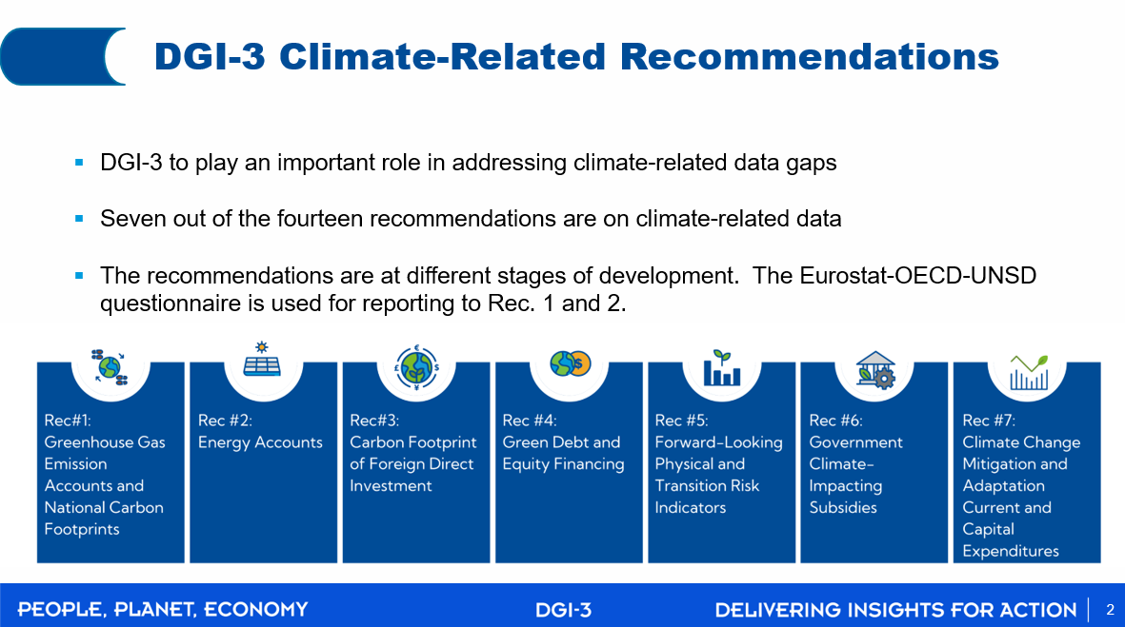
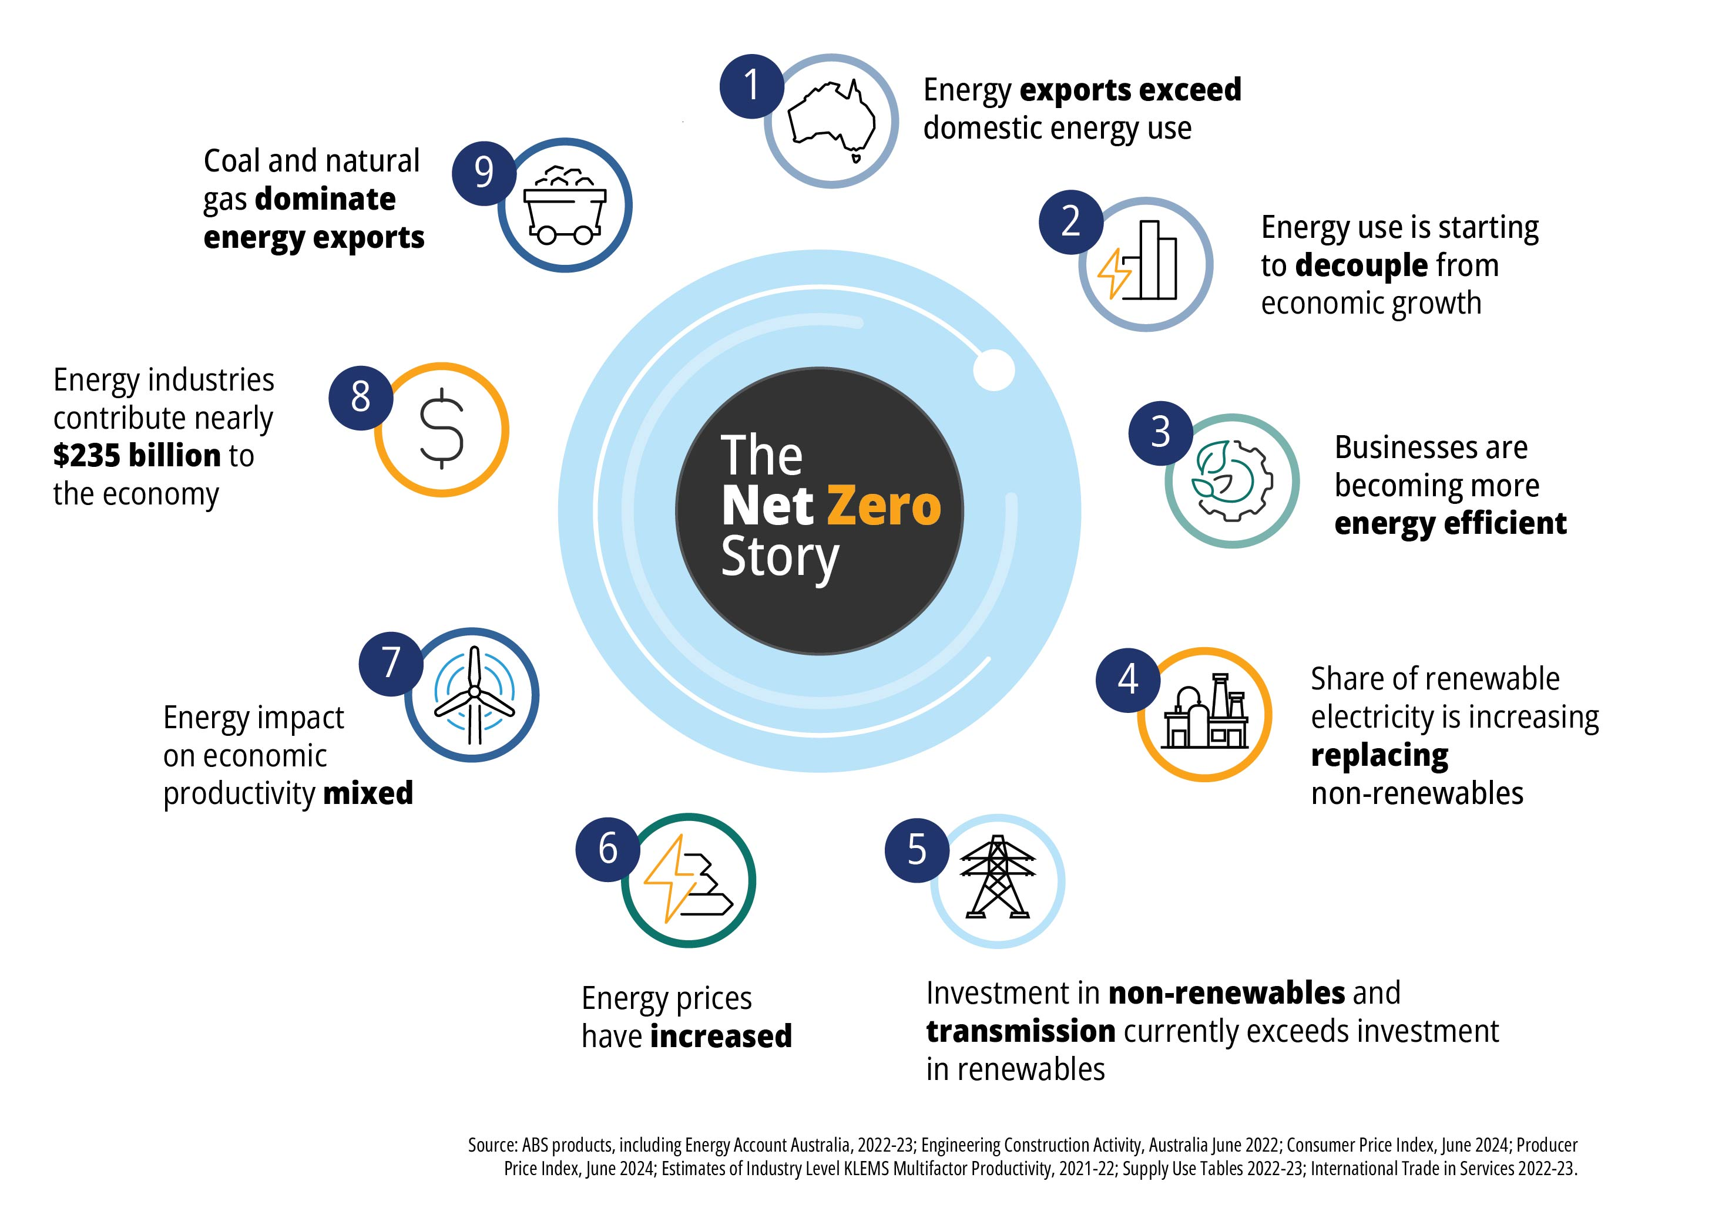
Section 5
International and National Initiatives
This section provides examples of initiatives to measure net zero at both the domestic and international level.
In 2024, the Australian Bureau of Statistics did some work to identify datasets that are already available to help explain the broader Net Zero story.
Internationally, the OECD has done multi-disciplinary work over a range of OECD committees to provide analysis and recommendations for driving a rapid transition to net zero emissions while building resilience to the inevitable physical impacts of climate change. The IMF’s Mapping the Road to Net Zero - Insights from Data Gaps Initiative outlines the monitoring of vulnerabilities in sovereign risk related to climate.

Slide 25
Section 6
Measurement challenges
Some examples of measurement challenges identified in webinar 1 include:
Collaboration across Agencies, Departments and Ministries
Data availability, Forecasting/nowcasting and working within policy needs.
Cost/quality/timeliness trade-off.
Frequency of indicators (sub-annual, annual, less frequent).
Setting up data pipelines.
+
This final section highlights some of the measurement challenges that have been identified through the sprint.

Slide 26
Section 7
Future opportunities
This Storybook is an output of the Network of Economic Statisticians’ Net Zero Sprint and has been included as a background document to the Network’s report to the United Nations Statistical Commission in 2026. The Storybook is provided as a starting point and we welcome feedback from groups focusing on environment and climate change measurement on how they could use this document as part of their ongoing work.

Slide 27
Section 8
Appendices

Slide 28
Appendix 1 – Global Set Indicators – Net zero drivers
 | Area | Methods Frameworks
Total greenhouse gas emissions per year | Drivers, indictor 1 | IPCC; SDG
Total emissions of indirect greenhouse gases | Drivers, indictor 2 | IPCC; FDES
Greenhouse gas emissions from land use, land use change and forestry | Drivers, indictor 3 | IPCC; FDES
Total greenhouse gas emissions from the national economy | Drivers, indictor 4 | SEEA-CF
Greenhouse gas emissions per capita | Drivers, indictor 5 | IPCC; FDES
Greenhouse gas emissions in gross fixed capital formation of direct investment | Drivers, indictor 6 | SEEA-CF
Greenhouse gas emissions in value added of foreign controlled multinational enterprises | Drivers, indictor 7 | SEEA-CF
Carbon footprint | Drivers, indictor 8 | SEEA-CF
Total primary energy production from fossil fuels | Drivers, indictor 10 | IRES
Total energy supply from fossil fuels | Drivers, indictor 11 | IRES
Share of fossil fuel in total energy supply | Drivers, indictor 12 | UN-ECE
Final energy consumption per capita | Drivers, indictor 13 | IRES; UN-ECE
Energy intensity measured in terms of primary energy and gross domestic product | Drivers, indictor 14 | SDG
Fossil fuel dependency | Drivers, indictor 15 | IRES
Amount of fossil-fuel subsidies (production and consumption) per unit of gross domestic product | Drivers, indictor 16 | SDG; UN-ECE
Intensity of use of forest resources | Drivers, indictor 21 | FDES
Deforested area as a proportion of total forest area | Drivers, indictor 22 | FDES
Number of live animals in livestock | Drivers, indicator 24 | FDES

Slide 29
Appendix 2 – Global Set Indicators – Net zero mitigation and adaptation
Net Zero Global Set Indicators | Area | Methods Frameworks
Production of renewable energy as a proportion of total energy production | Mitigation, indicator 109 | IRES
Renewable energy share in the total final energy consumption | Mitigation, indicator 110 | SDG; UN-ECE
Non-fossil fuel energy consumption as a proportion of final energy consumption | Mitigation, indicator 111 | IRES; SDG
Proportion of population with primary reliance on clean fuels and technology | Mitigation, indicator 112 | SDG
Rate of decrease of energy intensity | Mitigation, indicator 113 | UN-ECE
Trade in low carbon technology products | Mitigation, indicator 121 | SEEA-CF
Greenhouse gas intensity of the economy (including transport) | Mitigation, indicator 122 | SEEA-CF
Rate of decrease of greenhouse gas emissions er unit of gross domestic product | Mitigation, indicator 123 | IPCC
Greenhouse gas removals (carbon sequestration) | Mitigation, indicator 124 | IPCC; FDES; SEEA-EA
Progress towards achieving the nationally determined contribution | Mitigation, indicator 126 | Biennial Transparency Reports
Increase in forest area | Mitigation, indicator 125 | SEEA-CF; FDES
Nature-based adaptation | Adaptation, indicator 143 | SEEA-EA
Proportion of important sites for terrestrial and freshwater biodiversity that are covered by protected areas, by ecosystem type | Adaptation, indicator 144 | SDG
Proportion of degraded area of ecosystems that has been restored | Adaptation, indicator 146 | SEEA-EA
Buildings adapted to climate change | Adaptation, indicator 147 | FDES
Progress towards sustainable forest management | Adaptation, indicator 149 | SDG; GBMF

Slide 30
Appendix 3 – Global Set Indicators – Net zero impacts and vulnerability
Net Zero Global Set Indicators | Area | Methods Frameworks
Forest area as a proportion of total land area | Impacts, indicator 31 | SDG; SEEA-CF
Temperature records* | Impacts, indicator 53
Reduction in the extent of natural and semi-natural ecosystems | Impacts, indicator 66 | SEEA-EA
Proportion of forest area affected by forest fires | Impacts, indicator 67 | FDES
Phytosanitary status of forest** | Impacts, indicator 68
Proportion of land that is degraded over total land area | Impacts, indicator 71 | SDG; UN-ECE
Impact on production of wood and non-wood products | Impacts, indicator 74 | FDES
Ecosystem carbon stocks | Vulnerability, indicator 90 | SEEA-EA
*There is no statistically-agreed methodological reference so the indicator follows WMO guidance
** There is no statistically-agreed methodological reference so the indicator follows FAO guidance

Slide 31
Net Zero
Storybook

