Slide 1
“The Regional Accounts of the U.S. Bureau of Economic Analysis:
The Case for Sub-national Economic Statistics”
Mauricio Ortiz
First Webinar of the Sub-national Sprint of the United Nations Network
of Economic Statisticians
September 3, 2025

Slide 2
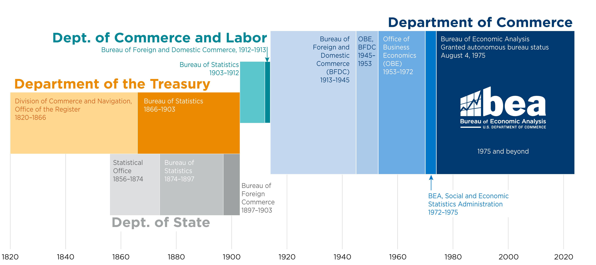
BEA’s Roots Go Back Over 200 Years

Slide 3
BEA’s Structure
Benchmark Supply Use Tables
International Transaction Accounts
National Accounts
Fixed
Assets
International Investment Position
International Services
Industry
Accounts
National Income and Product Accounts
Multinational Enterprises
International Accounts
State & County Personal Income
State & County GDP
Regional Accounts
State Personal Consumption Expenditures

Slide 4

BEA’s Regional Economic Statistics
The Core Statistics
State and county gross domestic product (GDP)
State and county personal income
Consumer spending by state
Regional Accounts
Thematic Statistics
Arts and culture by state
Outdoor recreation by state
Additional Statistics
GDP for U.S. territories
Geographic price level differences

Slide 5
BEA’s Regional Economic Statistics
State & County Personal Income
Compensation
Annual/quarterly
Income detail
  Compensation
  Proprietors’ income
  Property income
  Transfer receipts
Real
State & County GDP
Housing
Annual/quarterly
Industry detail
  Goods producing
  Services providing
  Government
Housing
Real
State & Metro Regional Price Parities
State Personal Consumption Expenditures
PCE Expenditure Weights
Annual
Item detail
  Goods
  Housing
  Utilities
  Other services
Annual
Detailed expenditure categories
  Goods
  Services
Expenditures by function

Slide 6

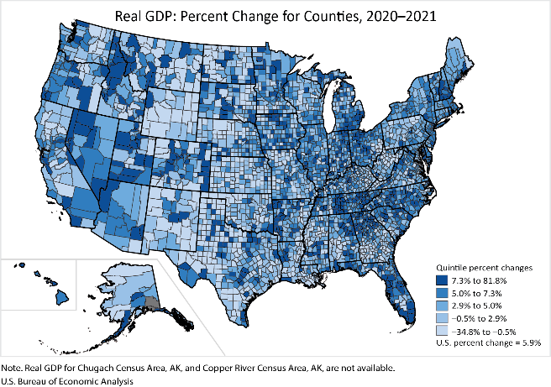
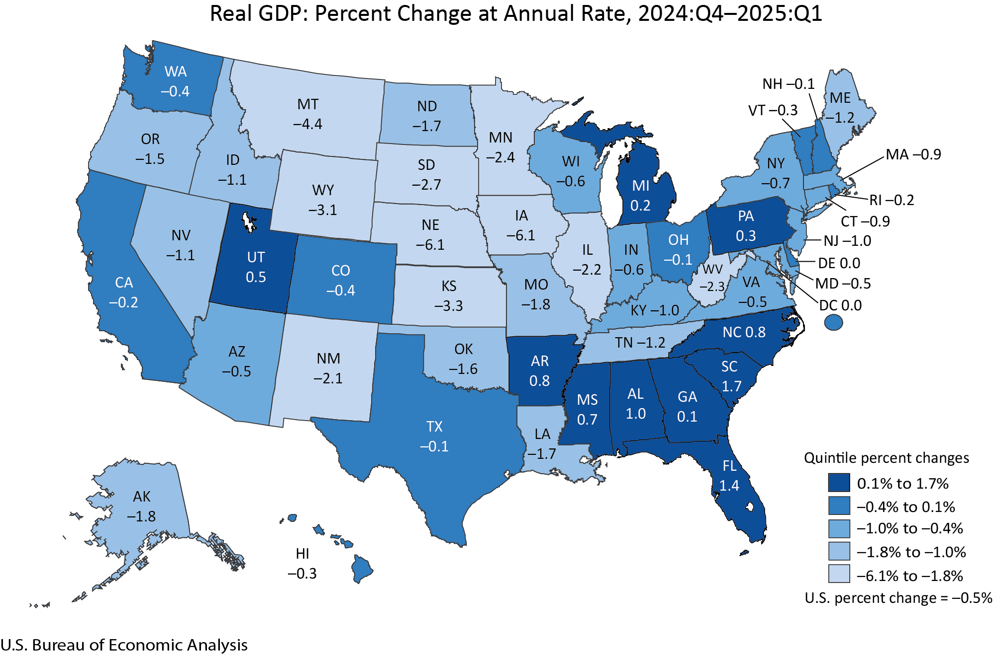

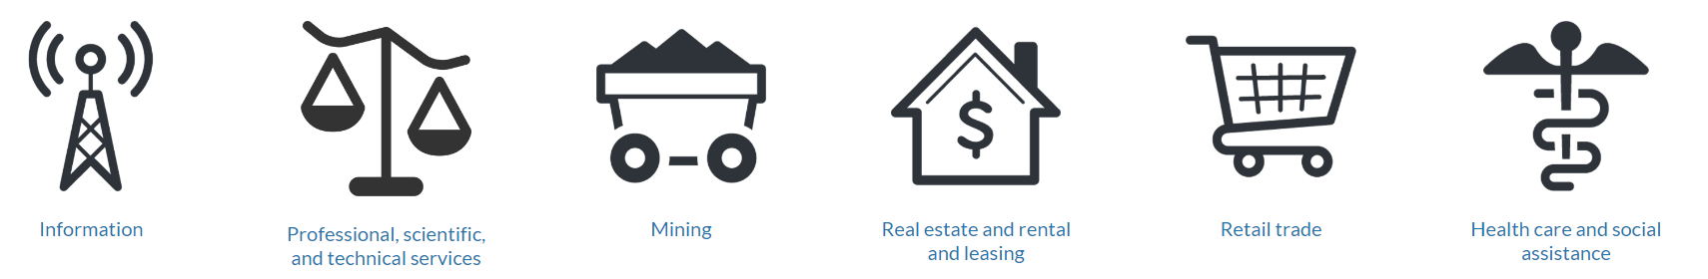
Gross Domestic Product (GDP)
U.S. GDP
State
County
Answer questions like:
How fast is the economy growing?
How does my state’s economy stack up against others?
Which industries are taking off?
Which are slowing down?
Industry

Slide 7
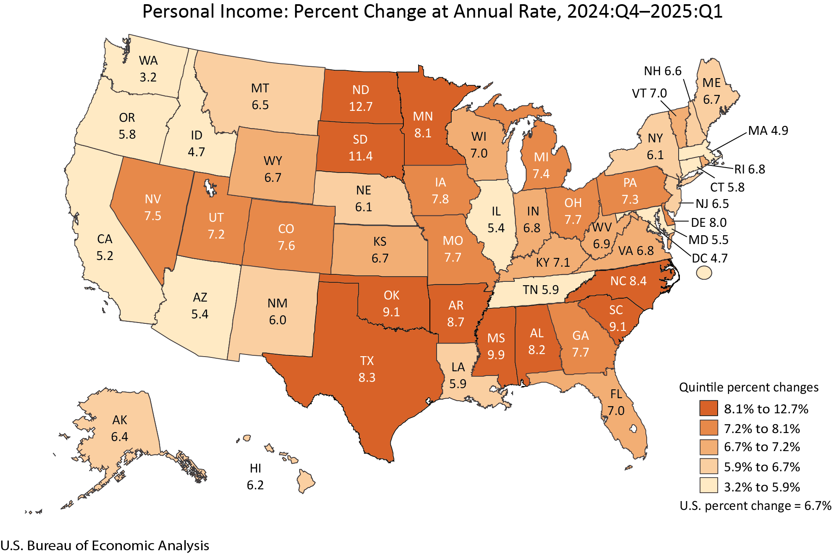
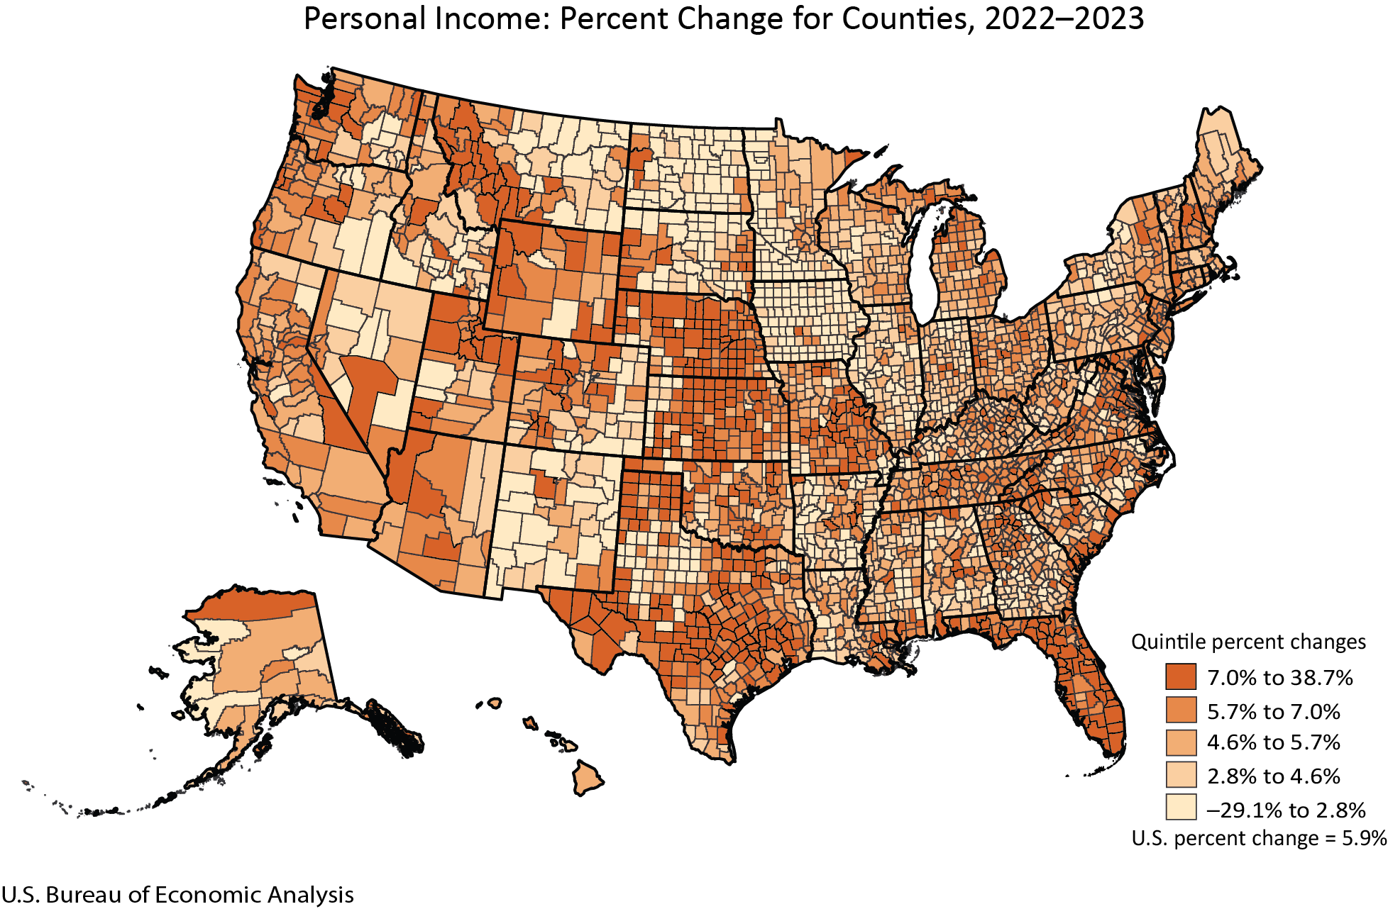


Personal Income
Personal income
State
County
Answer questions like:
Are workers bringing home more money these days?
How does my county’s income per person compare with the rest of the state?
How is income distributed among the people?
Household distribution by State

Slide 8
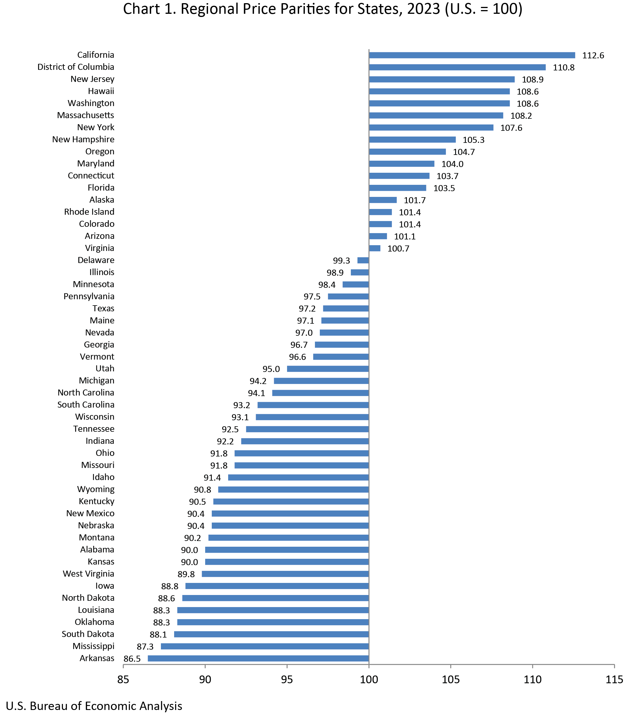
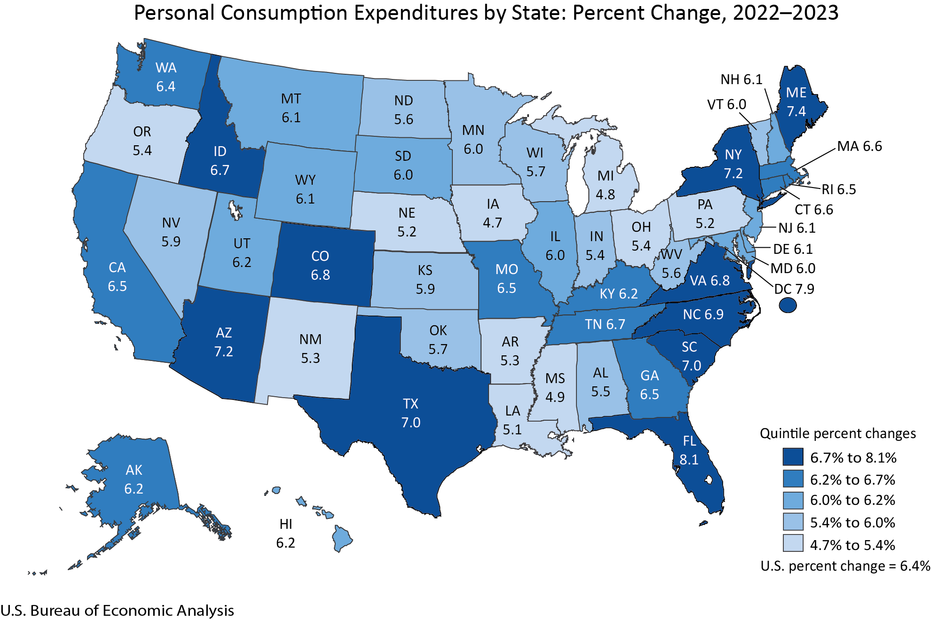
Consumer Spending (Personal Consumption Expenditures)
U.S. consumer spending
Answer questions like:
Regional Price Parities
How much are people spending and what are they buying?
How is consumer spending changing over time?
What are the relative price levels in my state compared to the nation and other states?
State

Slide 9
Measuring GDP
Expenditure Approach
  GDP = Consumption + Investment + Government Spending + (Exports – Imports)
Income Approach
  GDP = Compensation + Taxes on Production and Imports (less subsidies) + Gross Operating Surplus
Value-Added Approach
  GDP = Total Industry Output – Intermediate Inputs

Slide 10




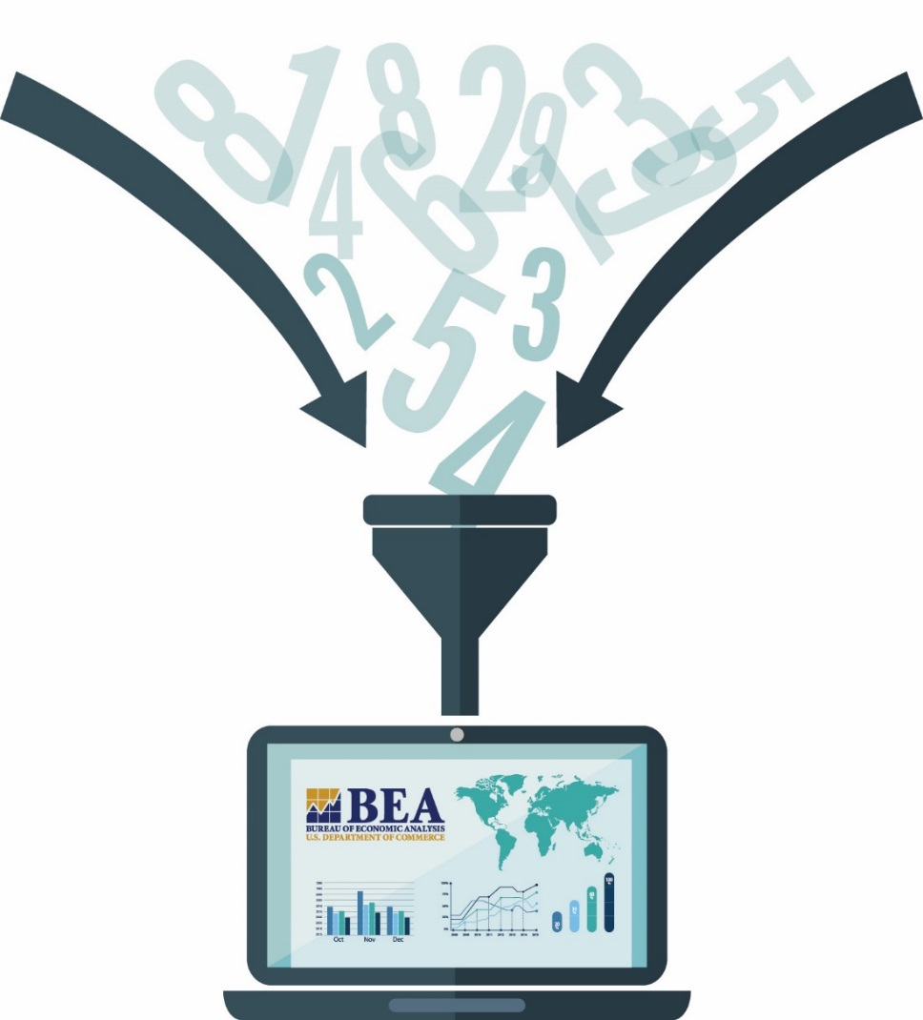






Data Used by BEA

Slide 11
Regional GDP Statistics VS Personal Income Statistics
 | GDP | Personal Income
Wages and salaries (Compensation) | ❐ | ❐
Employer contributions for government social insurance (Compensation) | ❐ | ❐
Employer contributions for employee pension and insurance funds (Compensation) | ❐ | ❐
Taxes on production and imports less subsidies | ❐
Corporate income (Gross operating surplus) | ❐
Proprietors’ income (Gross operating surplus) | ❐ | ❐
Rental Income (Gross operating surplus) | ❐ | ❐
Transfer receipts (Social Security benefits, Medicare, Medicaid) |  | ❐
Receipts on assets (dividends, interest) |  | ❐
Place of residence |  | ❐
Place of work | ❐

Slide 12




Importance of Sub-National Statistics
State and local statistics
U.S. government to distribute over $600 billion in federal funds
State governments to plan state spending, make revenue estimates, and track state economies
Regional development officials to measure the impact of business investment on regional growth
Businesses and labor to research local market conditions

Slide 13
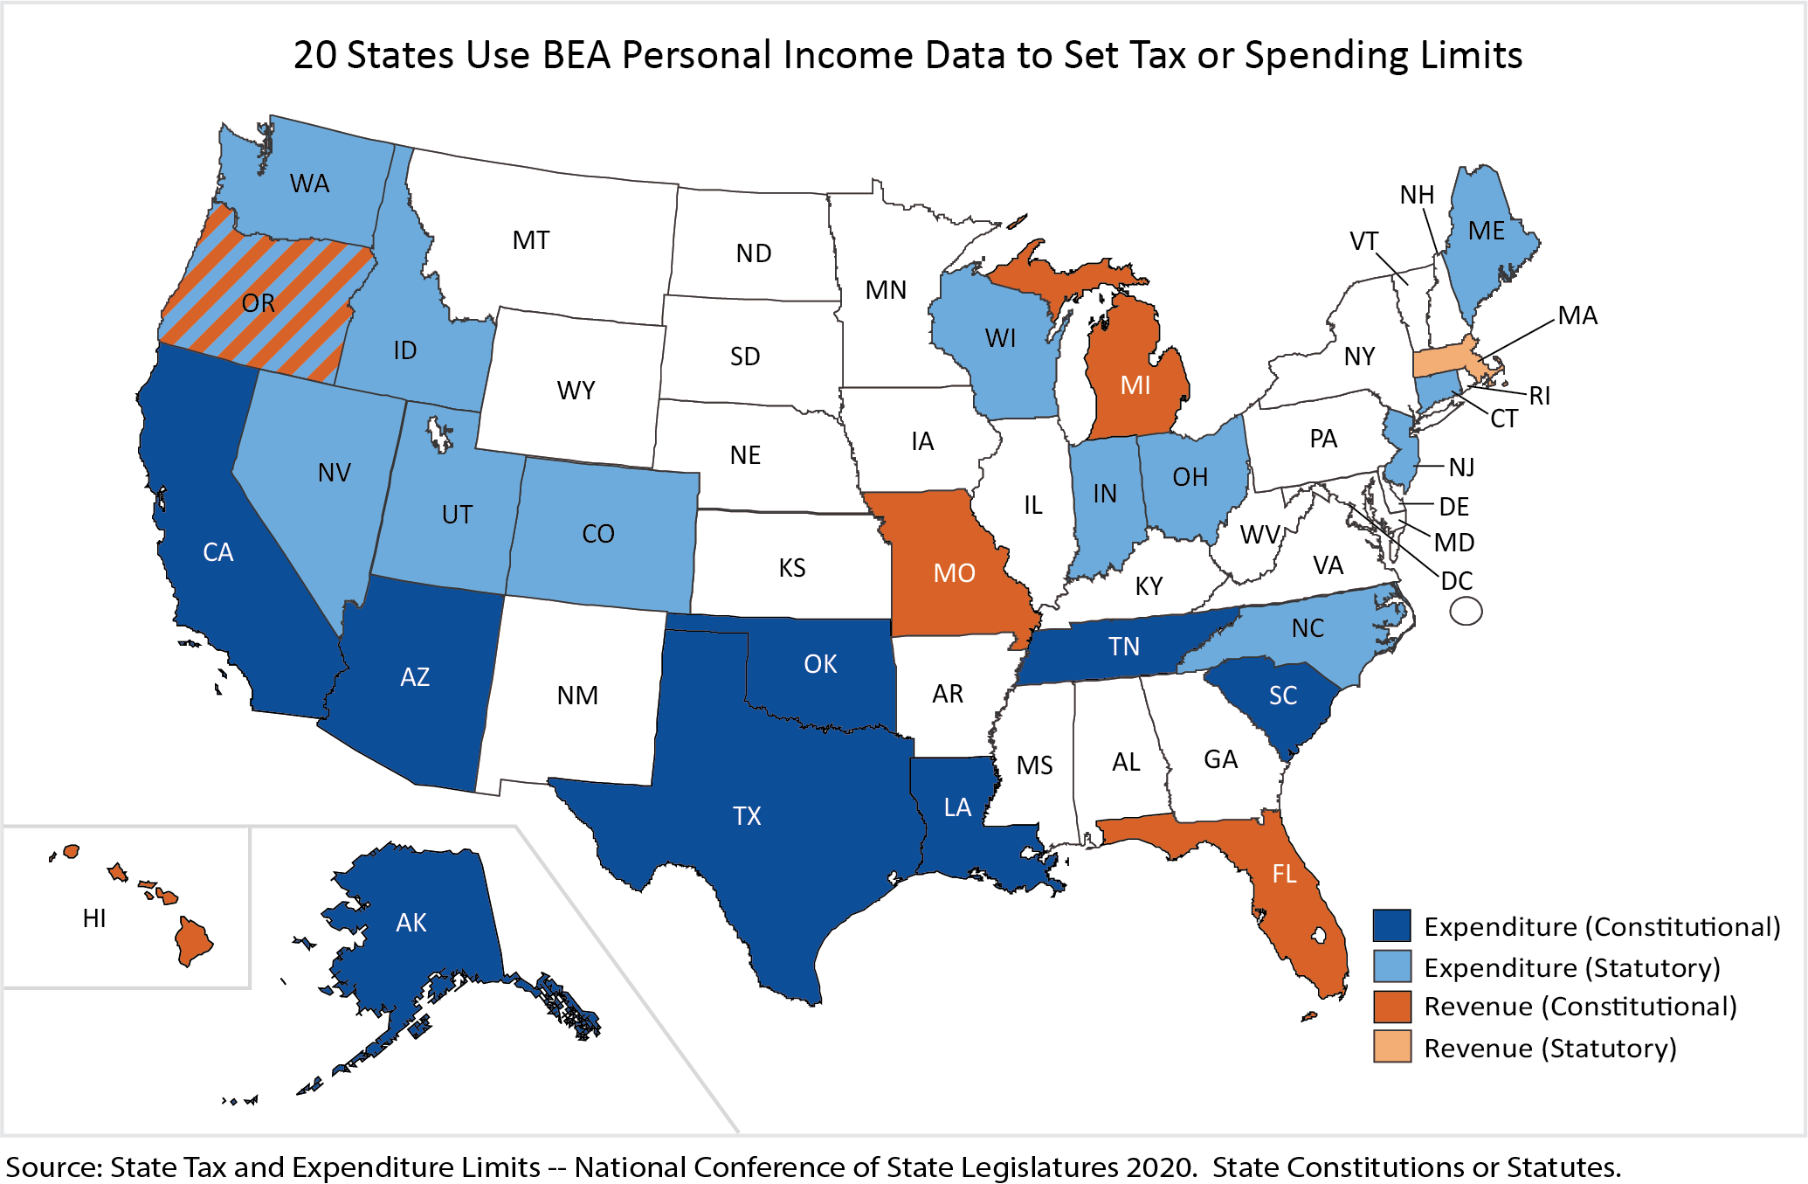
State Tax and Expenditure Limits – BEA Regional Statistics

Slide 14
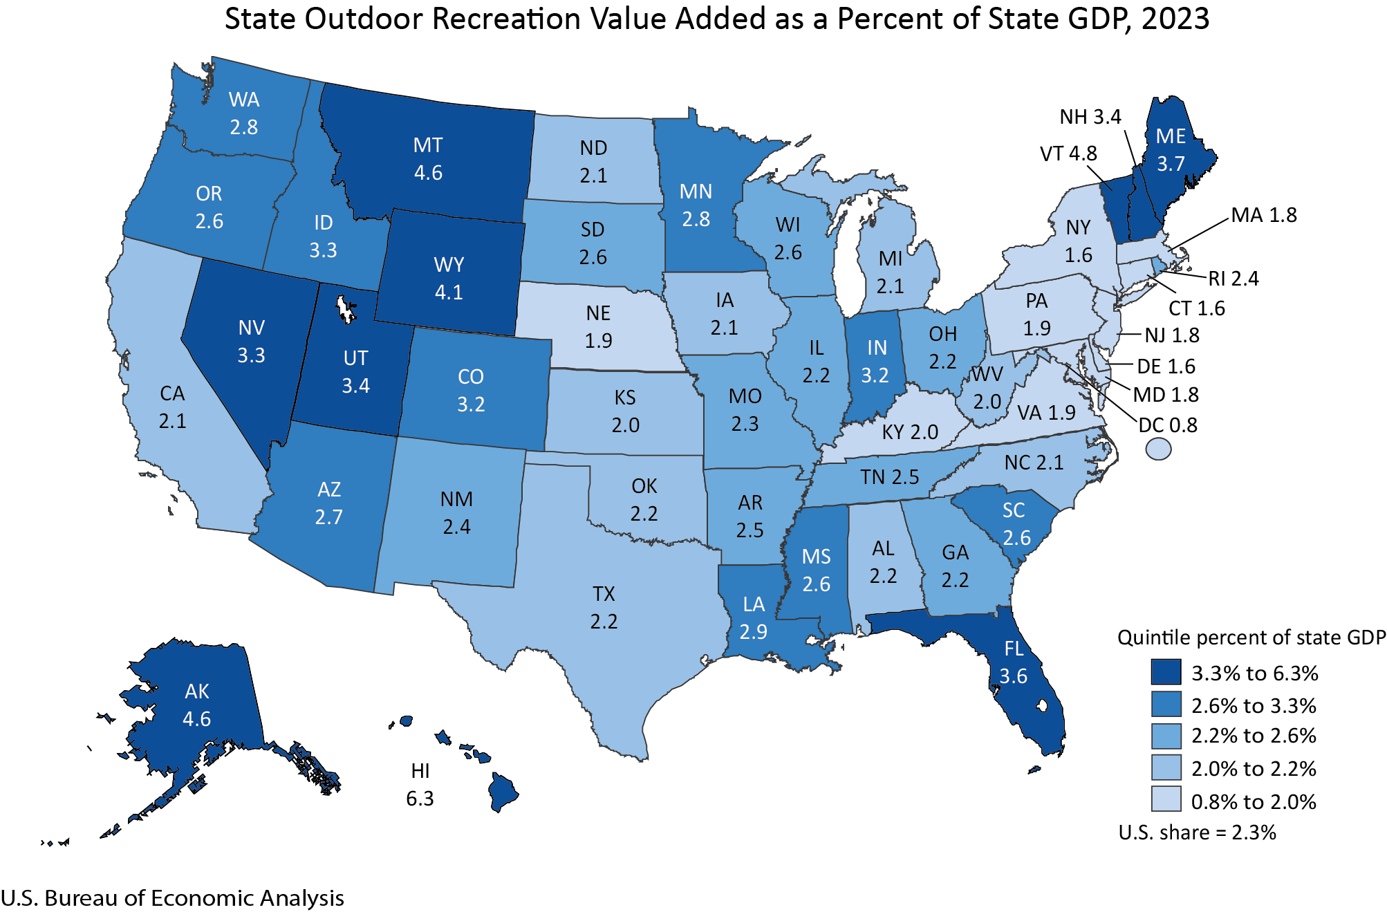
Thematic Account: Outdoor Recreation by State

Slide 15
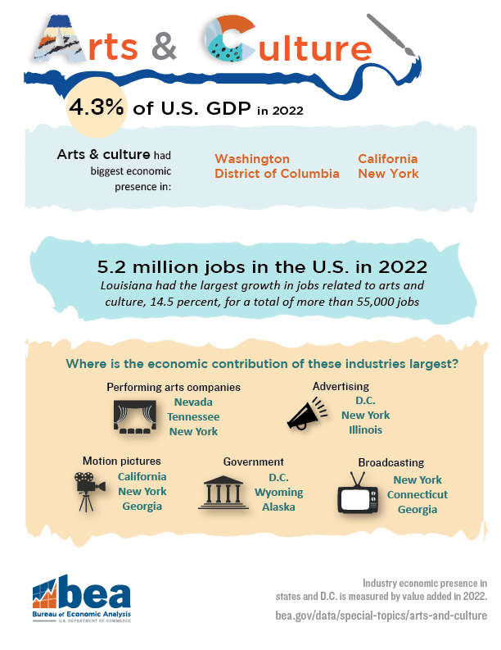
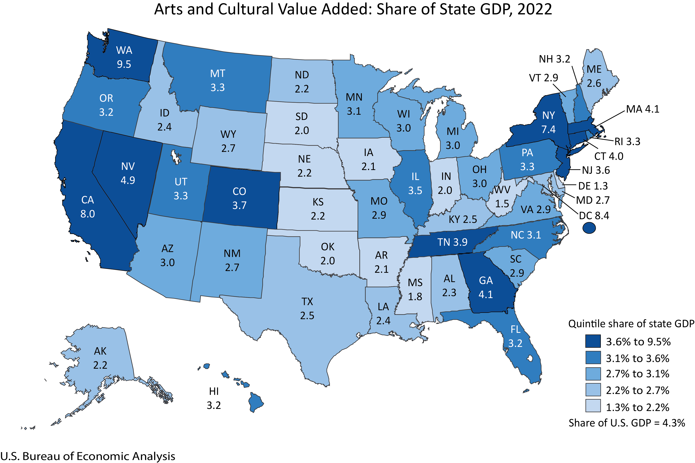
Thematic Account: Arts and Cultural Production by State

Slide 16
Challenges to Compiling Sub-National Statistics
Availability of data and data privacy
  Problematic for small geographies
Trade across sub-national geographies
  Difficult to measure trade in services
Place of residence vs place of production
  Impact of movement of individuals and per capita measures
Treatment of special geographies like territories
  Included or not included

Slide 17
Current Research into Future Sub-National Statistics
Timelier statistics by state
  Quarterly consumer spending
Additional GDP expenditure statistics by state
  Private fixed investment
  Government investment and expenditures
  Trade in goods and services
Statistics on research and development
  R&D activity by state
  R&D investment by state
Gross output by industry by state

Slide 18
Contact Information
Mauricio Ortiz
Associate Director for Regional Economics
U.S. Bureau of Economic Analysis
(301) 278 -9269
Mauricio.Ortiz@Bea.gov

