Slide 1
UNNES LCU Sprints, 16 June 2026
Globalisation,
System of National Accounts &
Large Cases Units
Christopher Sibley
Assistant Director General
Central Statistics Office Ireland

Slide 2

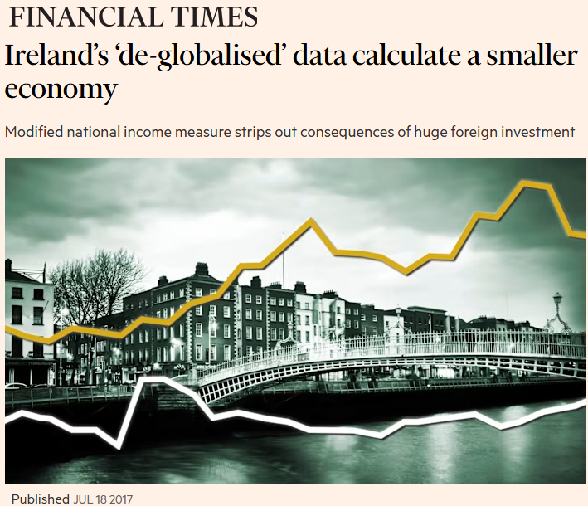

Slide 3
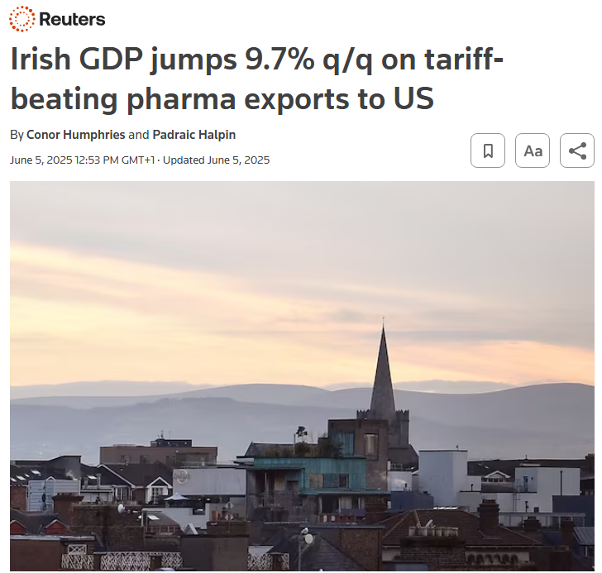
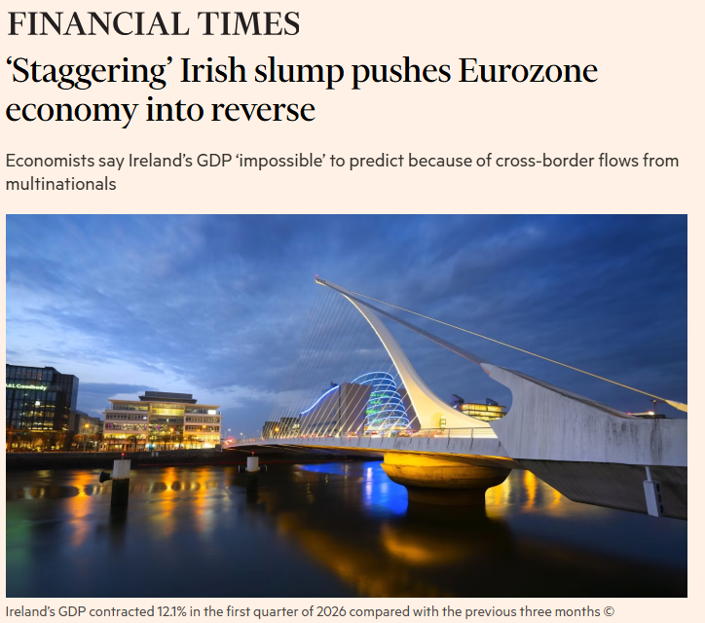

Slide 4
The back story
Ireland – we are a small open economy with a high concentration of MNEs
Ireland is widely referenced as a prime case study of the impact of globalisation on national economic statistics
2015 NA and BOP data (published in July 2016 by the CSO) the case in point
The level shift in GDP of 26 percent in 2015 was largely a consequence of IP/R&D, aircraft leasing and redomiciled public limited companies (plcs)
CSO data compiled as per ESA2010/BPM6 frameworks
Lessons learned – CSO now publishing international and national indicators

Slide 5
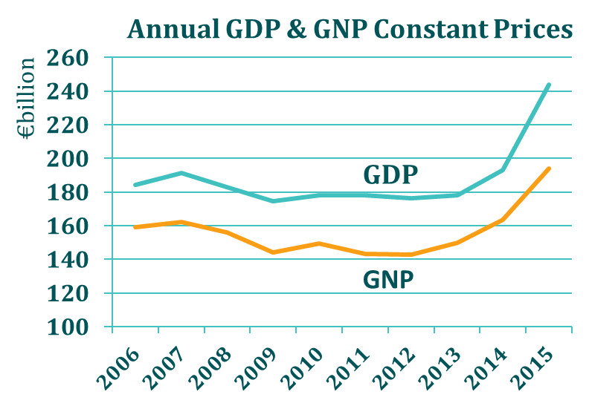
National Accounts 2015
Year-on-Year
Growth Rates
GDP + 26.3% (+7.8%)
GNP + 18.7% (+5.7%)
Previous provisional annual estimate in brackets

Slide 6
Economic Statistics Review Group (ESRG)
The CSO recognised the need to meet user needs for insight into Irish economic activity
The CSO convened the ESRG to broaden the dimension to its deliberations on the challenges of globalisation
ESRG comprised policymakers, analysts, regulators, business and trade union representatives, academics, international statistics community - Eurostat and IMF
ESRG Chair Philip Lane (then Governor of the Central Bank of Ireland)
Secretariat provided by the CSO

Slide 7
Some data

Slide 8
Walk through: Exports & Imports - from Cross-border to International Trade Basis
Item | €million | 2021 | 2022 | 2023 | 2024
International Trade (Cross-border basis) | Exports | 165,716 | 208,763 | 196,030 | 224,738
 | Imports | 99,549 | 135,181 | 134,698 | 128,352
plus Adjustments
Goods for processing | Exports | 101,456 | 131,973 | 97,631 | 91,112
 | Imports | 9,021 | 8,993 | 9,711 | 16,037
Net exports of goods under merchanting | Exports | 24,035 | 24,473 | 27,146 | 31,630
Other Conceptual adjustments | Exports | -10,551 | -10,422 | -14,563 | -20,109
 | Imports | 3,670 | 5,479 | 5,150 | 7,428
equals Goods (Ownership basis) | Exports | 280,656 | 354,786 | 306,245 | 327,370
 | Imports | 112,240 | 149,653 | 149,558 | 151,817
Plus
Services | Exports | 331,013 | 371,648 | 410,148 | 482,967
 | Imports | 312,145 | 361,950 | 391,559 | 423,277
Goods & Services | Exports | 611,669 | 726,434 | 716,393 | 810,337
 | Imports | 424,385 | 511,604 | 541,117 | 575,094

Slide 9
Modified GNI (GNI*) - 2024
GDP
€562.8bn
Net Factor Flows
-€140.6bn
GNP
€422.2bn
EU Taxes and Subsidies
+€0.6bn
GNI
€422.8bn
Adjustments
-€101.7bn
GNI*
€321.1bn
+
=
+
=
+
=

Slide 10
Components of GNI* adjustments
€ million | 2019 | 2020 | 2021 | 2022 | 2023 | 2024
GNI at current market prices | 274,097 | 278,709 | 391,941 | 355,917 | 390,996 | 422,827
Factor income of redomiciled companies | -5,290 | -4,234 | -10,614 | -4,648 | -10,977 | -10,484
Depreciation on R&D service imports and trade in IP | -52,995 | -66,899 | -69,832 | -75,079 | -78,602 | -80,918
Depreciation on aircraft leasing | -9,216 | -9,292 | -9,317 | -9,508 | -9,989 | -10,328
Modified GNI (GNI*) | 206,596 | 198,283 | 230,178 | 226,682 | 291,428 | 329,098

Slide 11
Modified measures as a % of GDP at constant prices

Slide 12
Current Account * (CA*)
Designed to be a complementary indicator to GNI*
Excludes the retained earnings of re-domiciled firms
Adjusts for the depreciation of categories of foreign-owned domestic capital assets
  R&D service imports and trade in IP
  Aircraft related to Aircraft Leasing
Additional to GNI* - exclude the cost of investment in aircraft related to Leasing and the cost of R&D related IP from the current account balance

Slide 13
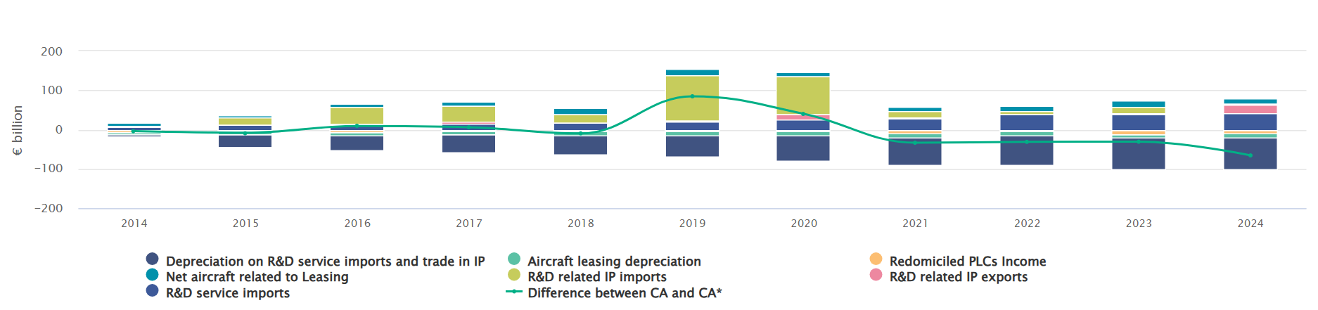
A Modified Current Account Balance for Ireland, CA*

Slide 14
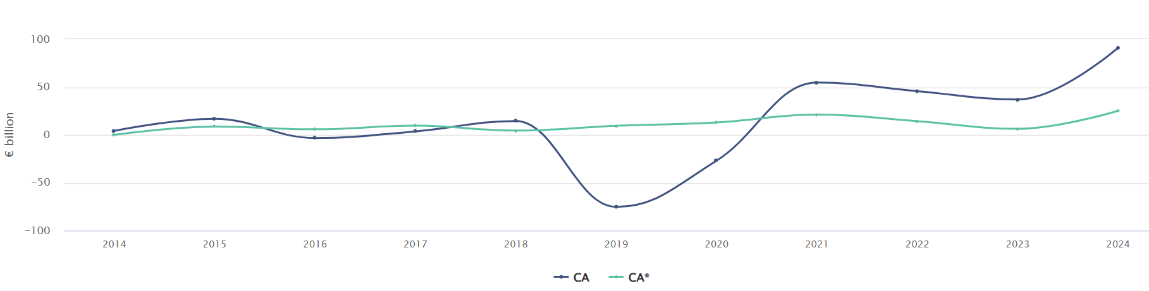
A Modified Current Account Balance for Ireland, CA*

Slide 15
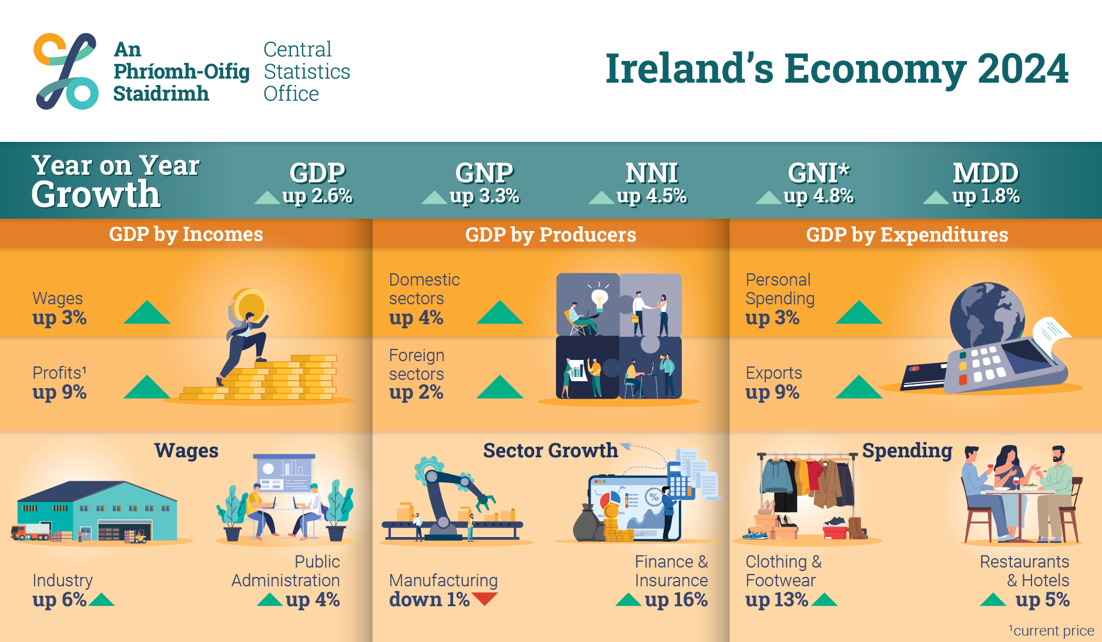

Slide 16
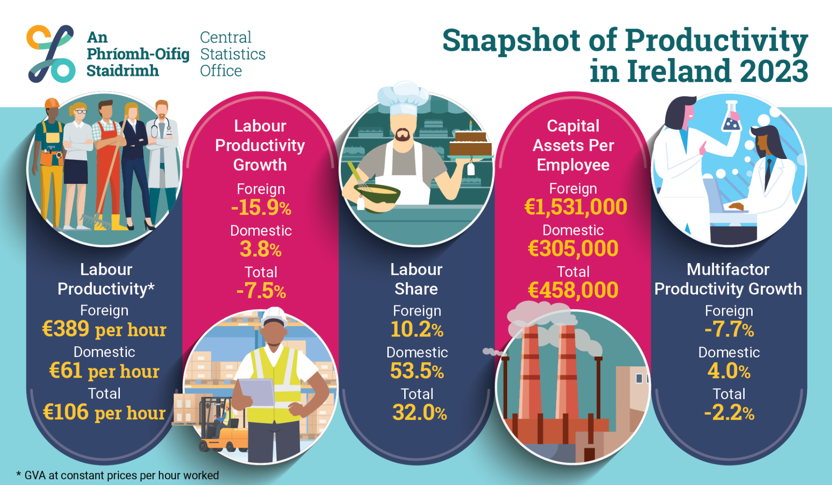

Slide 17
CSO Ireland
Large Cases Unit

Slide 18
LCU timeline
Pre 2009: Consistency Unit – 1 statistician, support from accountant
2009: LCU part of National Accounts Integration Division
  centralised unit - economic data for top MNEs
2009-2013: Development of co-ordinated data collection processes & IT systems
2023: Economic Statistics Directorate split into National/International Accounts
  LCU established as dedicated division
  Head of Division, 4 statisticians, 2 accountants, 1 team lead and 4 accountant managers
Notes:
The structure of the Large Cases Unit in the CSO has evolved from a relatively small consistency unit in 2009 to a stand alone division within the National Accounts and Prices Directorate in 2024.
Following an organizational review in 2009, the first iteration of the LCU was established within the National Accounts Integration Division and over the following years a centralised and co-ordinated data collection process was developed.
In 2023, after a period of expansion the (then) Economic Statistics Directorate was split into two parts, the National Accounts and Prices Directorate and the International Accounts, Trade and Government Finance Statistics Directorate. At this time the LCU was also established as a separate division.

Slide 19
Key functions of CSO LCU, Ireland
Dedicated one-stop shop for economic data collection
Data collection, cleaning, editing, consistency checks
Burden management including survey matrix outlining annual requirements
Relationship management – dedicated per MNE:
  Account manager per MNE – 1st point of contact
  Statisticians
  Accountants
Company meetings
Notes:
The LCU performs a number of key functions, specifically:
Acting as a dedicated centralised point of contact for the largest foreign-owned MNEs in Ireland.
Providing a co-ordinated data collection and processing function for economic data from these MNEs for delivery to Balance of Payments, Short Term, and Structural Business Statistics, and ultimately for use in the National Accounts.
Managing communications around all survey requirements from LCU MNEs including surveys not under the direct management of the LCU such as prices data, earnings and employment surveys, business energy use and ICT.
Relationship management is key to all of the LCU functions, and each MNE is assigned an account manager from the administrative staff team as well as a primary and secondary statistician.

Slide 20
Business Register
Industrial Statistics
Service Statistics
International Accounts
MNE Tax Records
Company Reg. Office (audited annual accounts)
External Trade in Goods
Survey Forms
Labour Market & Earnings
LCU
Survey
Areas
National Accounts and International Accounts
Data collection and editing.
Consistency analysis and adjustments.
Transmit clean data to other statistical domains.
Integrate LCU data into respective surveys (BOP, SBS, STS, Prices).
Transmit completed datasets to National Accounts for compilation.
Compile National Accounts.
Compile International Accounts.
Large Cases Unit

Slide 21
MNE complexity
MNEs with key globalisation themes
  Structural set up
  Contract manufacturing
  Merchanting
  Intellectual property
  Royalties

Slide 22
Contribution of LCU enterprises
High concentration of foreign-owned MNEs in a small open economy
Consistency unit since 1990s and LCU since 2009
LCU increased capacity since 2024

Slide 23
Questions?

