Slide 1

Multinational enterprises: analytical challenges for the euro area
UNNES LCU Sprint
16 June 2026
Fausto Pastoris
European Central Bank

Slide 2
Challenges of analysing euro area economy in presence of MNEs
The activities of MNEs have become an increasingly important feature of the euro area economy, affecting output, trade and financial linkages
MNEs activities can take several forms, including production for domestic or export markets, cross-border production, supply chains and the provision of financial and consultancy services
However, MNE activities are frequently highly volatile and large compared to the size of many economies where they are resident
MNEs activities can blur real-time assessment – and forecasting – of the business cycle, the current account, and the capital stock in the euro area
The economic impact of MNE activities has become much more evident in measures of intellectual property product (IPP) investment and trade flows
Euro area cross-border financial linkages are also highly affected by MNEs financial flows and intra-group financial transactions

Slide 3
Examples of MNEs activities with impact on macroeconomic accounts
Intellectual Property Products (IPPs)
Redomiciliation and corporate restructuring
Goods sent abroad for processing/contract manufacturing
Merchanting
Quasi-transit trade
Intra-company flows
Special purpose entities
Transfer pricing
GVA/GDP, capital formation, trade in services
GNI, financial flows, external assets
GVA/GDP, trade in goods and services
Trade in goods and services
GVA/GDP, trade in goods
Allocation of GVA/GDP across countries, trade in goods and services, investment income and financial flows
Trade in goods and services, investment income and financial flows, external assets
GVA
Aircraft leasing
GDP
Source: ECB Occasional Paper - Intangible assets of multinational enterprises in Ireland and their impact on euro area activity

Slide 4
1. Intangible assets of MNEs and impact on euro area activity

Slide 5
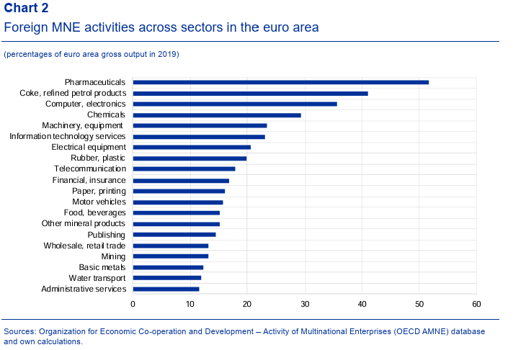
Foreign MNEs in the euro area relevant in knowledge-intensive industries
Source: ECB Occasional Paper - Intangible assets of multinational enterprises in Ireland and their impact on euro area activity

Slide 6
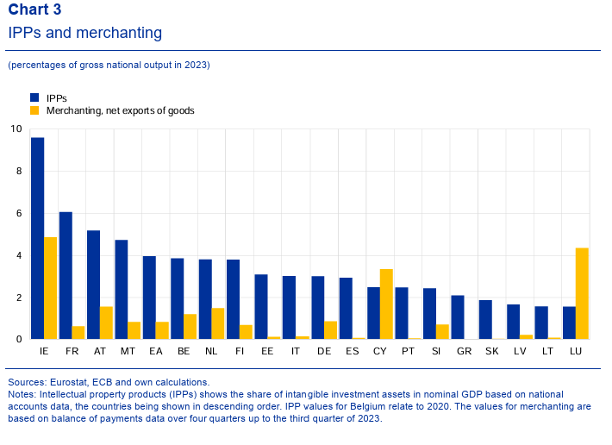
MNE activities have a disproportionate impact on national output, especially for smaller countries
Source: ECB Occasional Paper - Intangible assets of multinational enterprises in Ireland and their impact on euro area activity

Slide 7
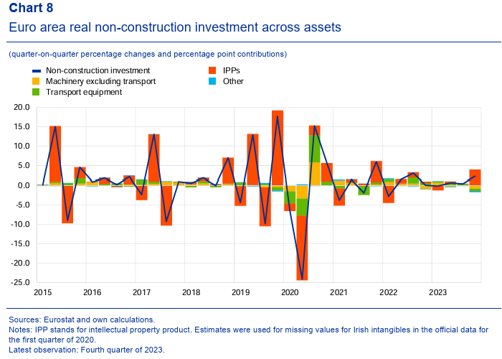
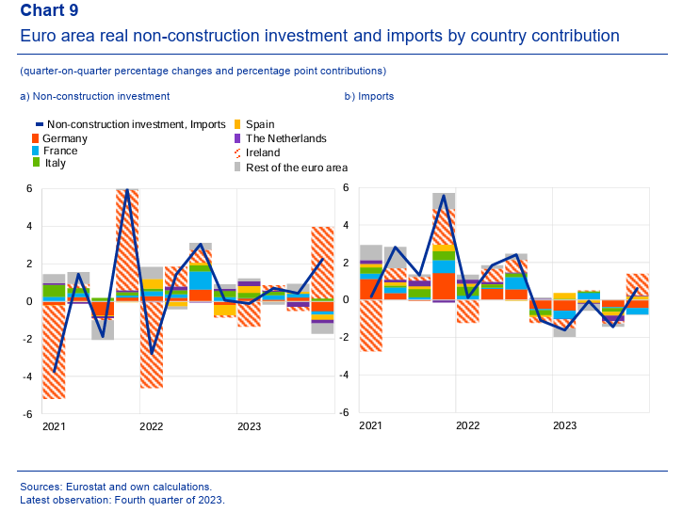
Impact of intangible investment in Ireland on volatility of euro area aggregates
Source: ECB Occasional Paper - Intangible assets of multinational enterprises in Ireland and their impact on euro area activity

Slide 8
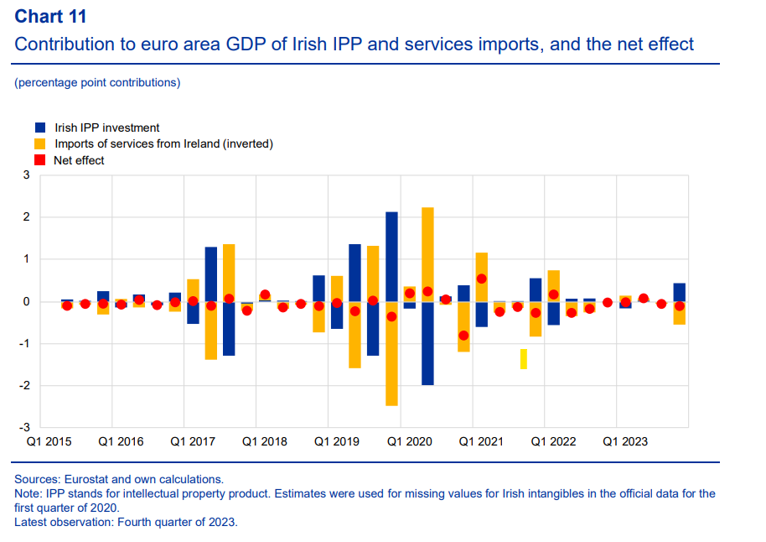
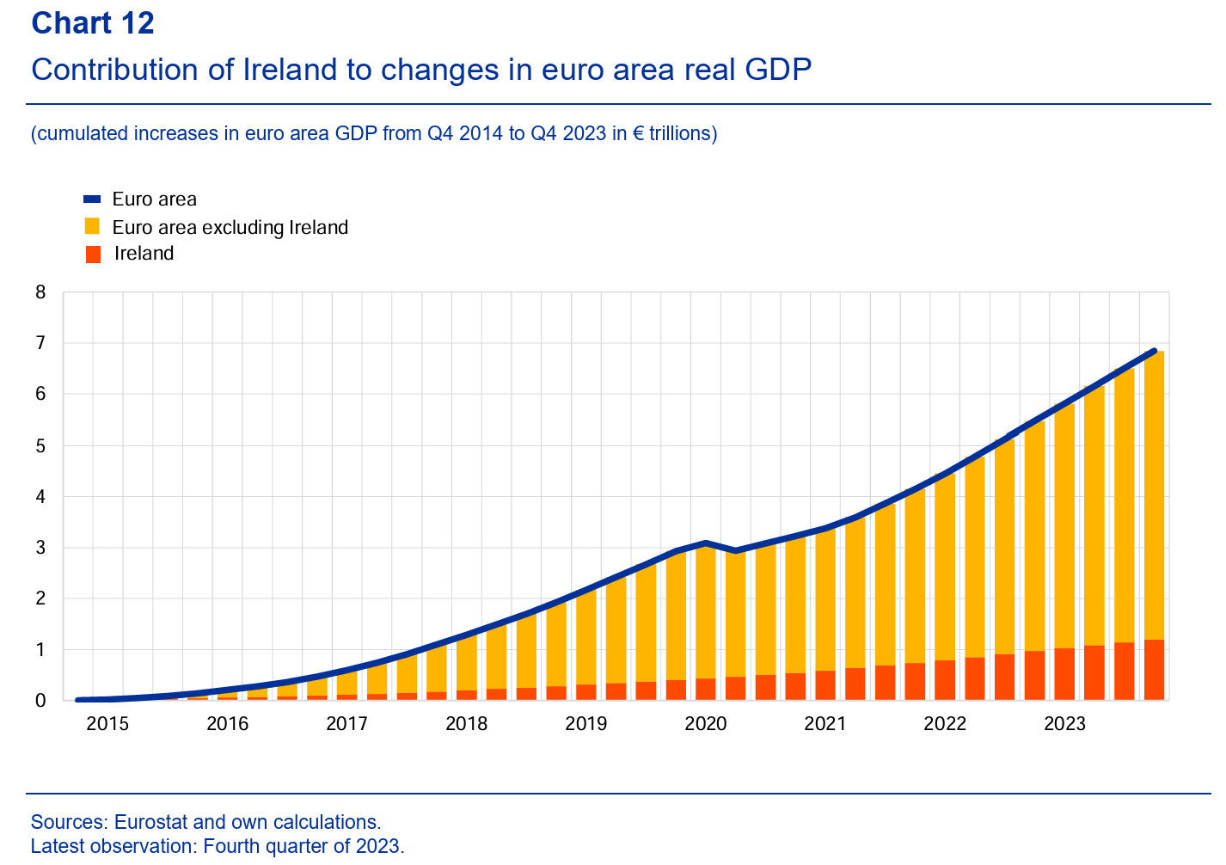
Disproportional contribution of Ireland to euro area GDP growth
Source: ECB Occasional Paper - Intangible assets of multinational enterprises in Ireland and their impact on euro area activity

Slide 9
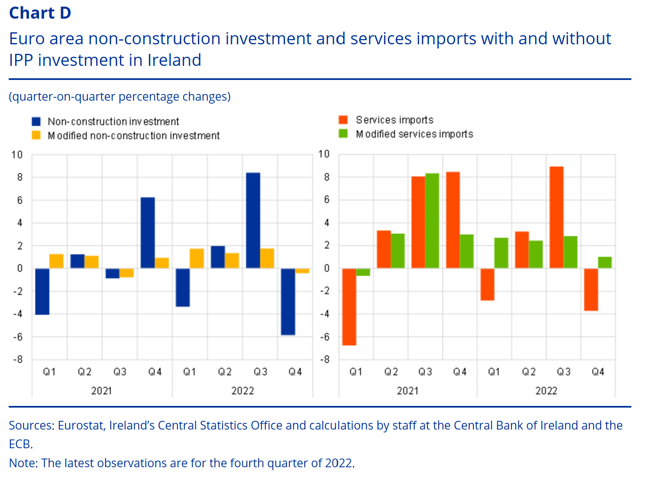
Modified investment and import data series can give a clearer picture of underlying dynamics in the real economy
Source: ECB Economic Bulletin - Intangible assets of multinational enterprises in Ireland and their impact on euro area GDP

Slide 10
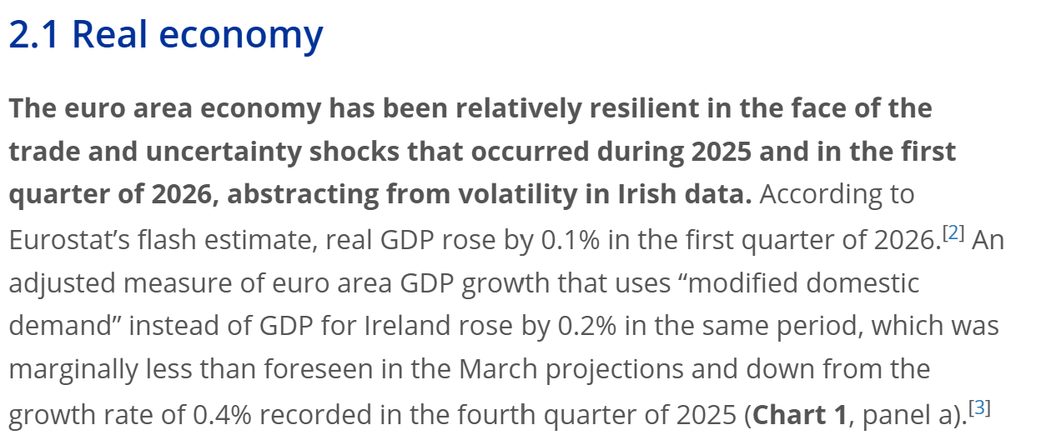
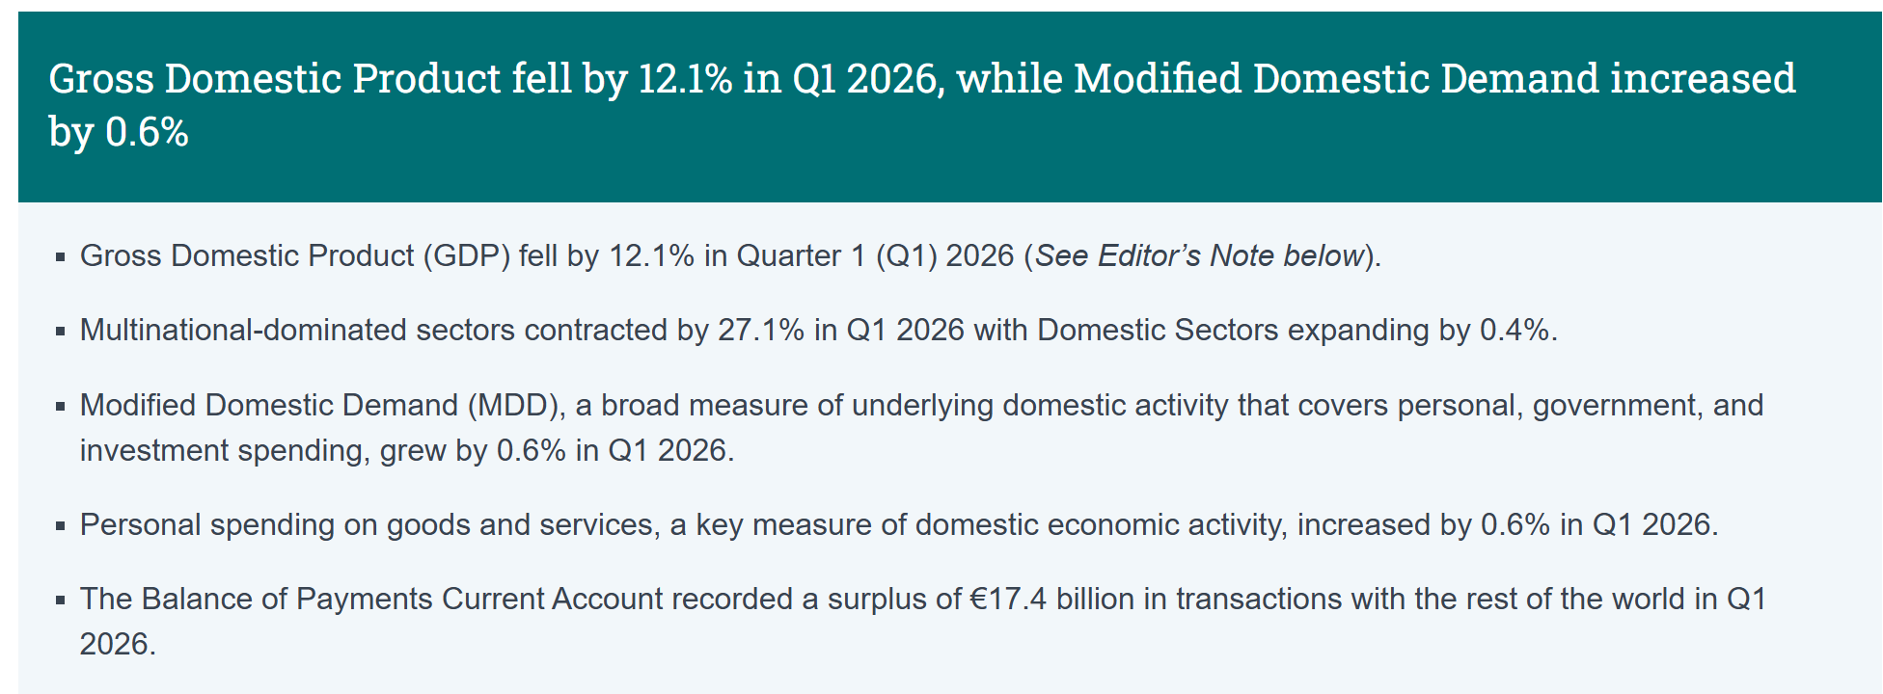
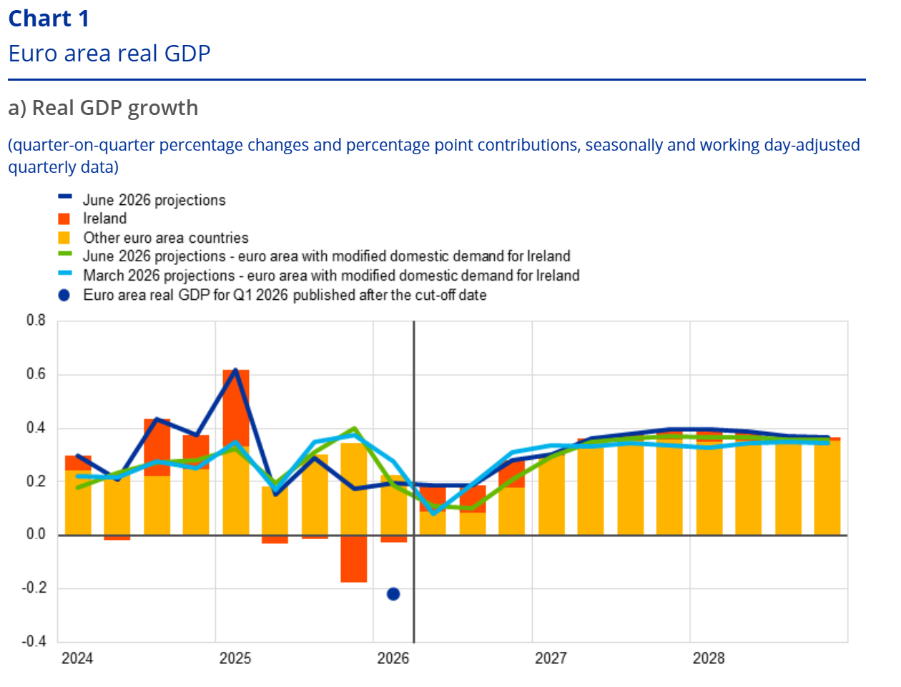
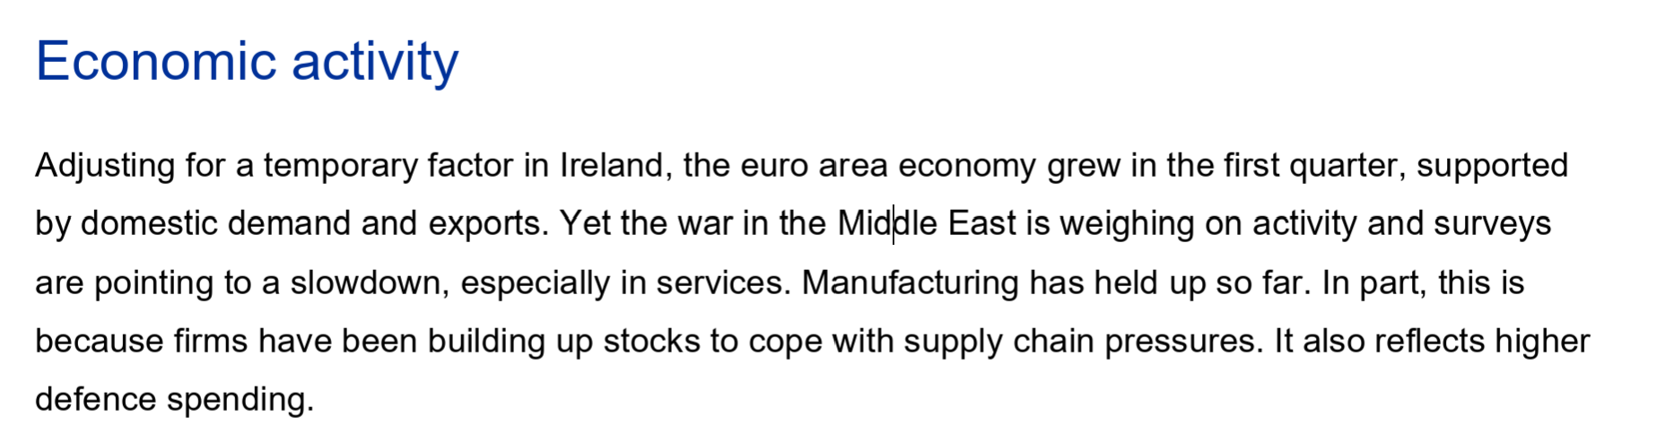
2026 Q1: huge drop in Irish GDP linked to MNEs sector
Source: Irish CSO Press Statement Quarterly National Accounts and International Accounts Q1 2026
Source: Christine Lagarde, Boris Vujčić: Monetary policy statement (with Q&A) - 11 June 2026
Source: Eurosystem staff macroeconomic projections for the euro area, June 2026

Slide 11
2. US trade policies and the activity of US MNEs in the euro area

Slide 12
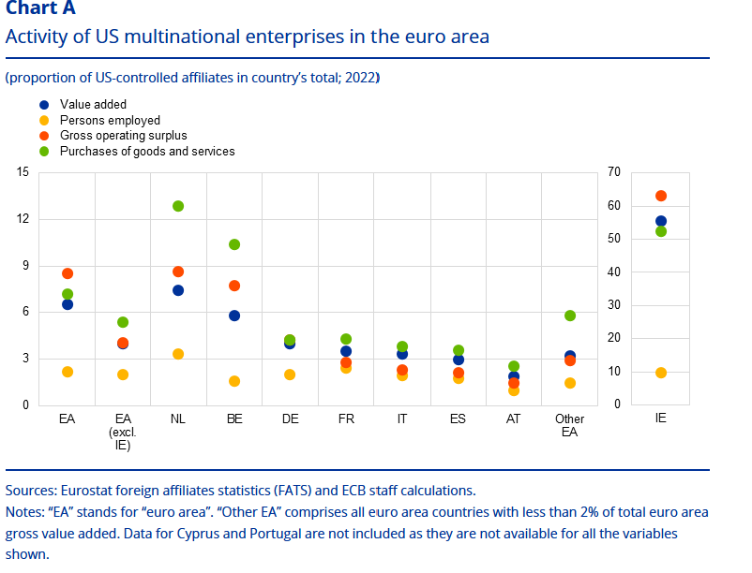
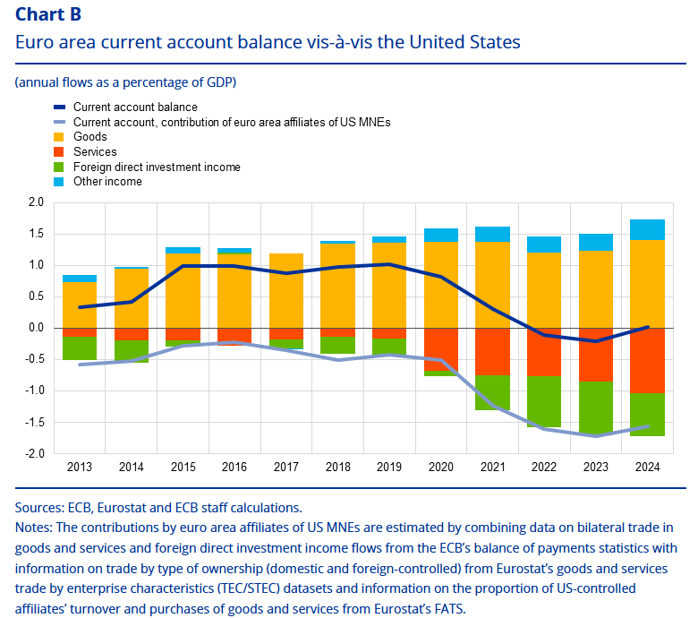
Affiliates of US MNEs contribute substantially to euro area economic activity and bilateral current account development
Source: ECB Economic Bulletin - US trade policies and the activity of US multinational enterprises in the euro area

Slide 13
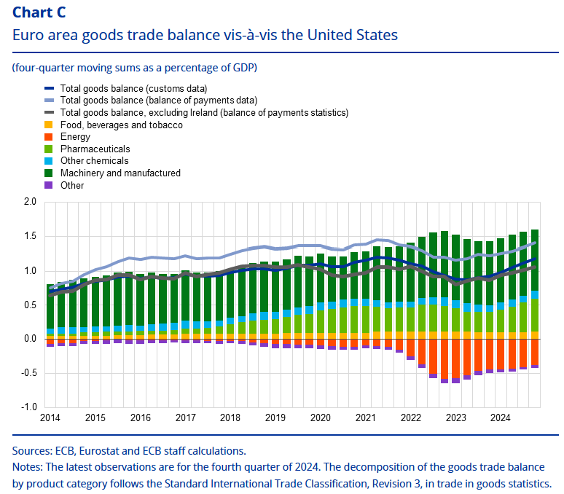
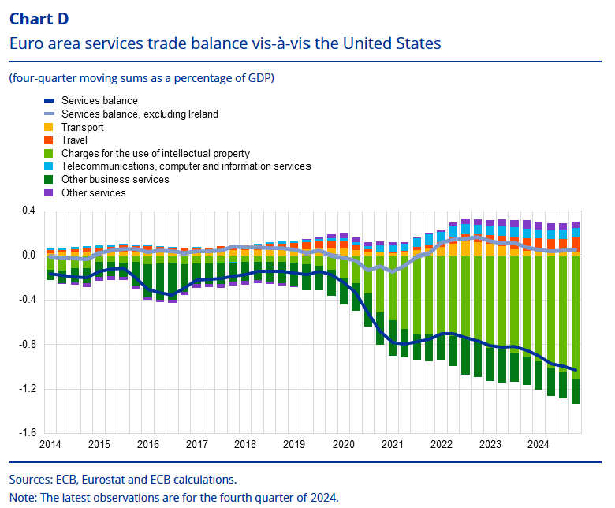
Production and exports linked to US MNEs in the euro area is closely connected to corresponding services imports
Source: ECB Economic Bulletin - US trade policies and the activity of US multinational enterprises in the euro area

Slide 14
3. The impact of SPEs on euro area cross-border financial linkages

Slide 15
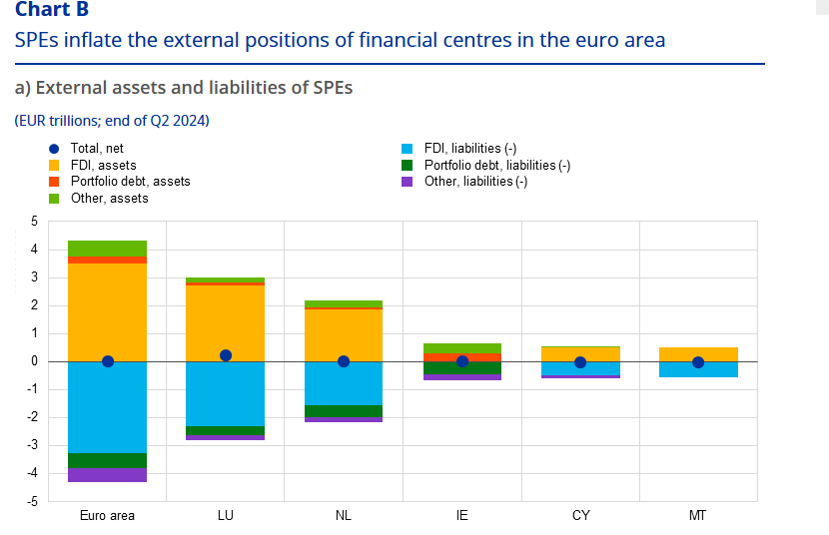
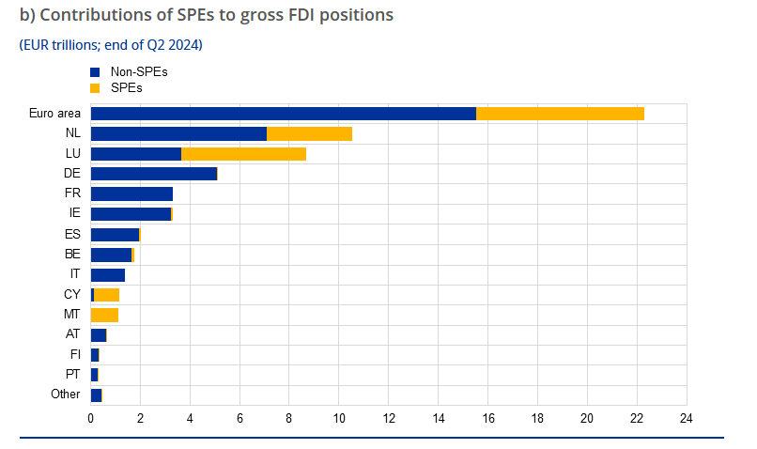
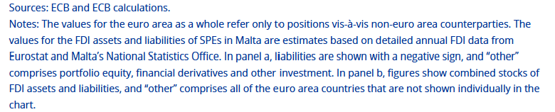
One third of euro area gross FDI positions linked to SPEs
Source: ECB Economic Bulletin - The impact of special-purpose entities on euro area cross-border financial linkages

Slide 16
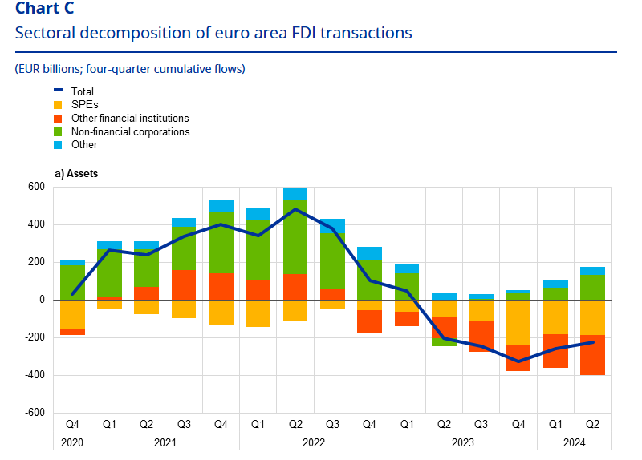
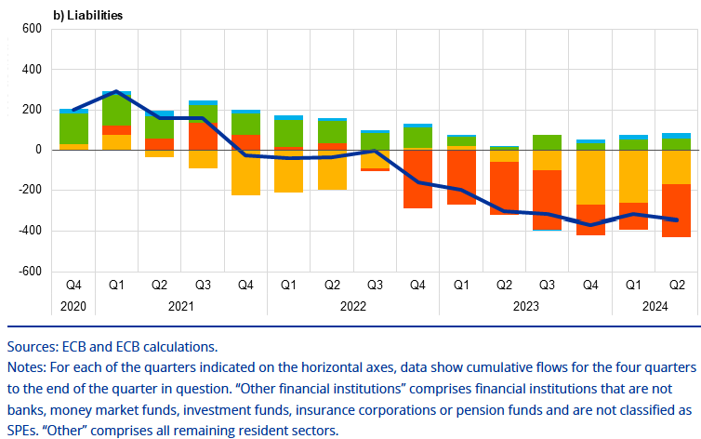
Recent euro area FDI retrenchment strongly connected to SPEs and other financial institutions
Source: ECB Economic Bulletin - The impact of special-purpose entities on euro area cross-border financial linkages

Slide 17
MNEs are important part of euro area economy, need enhanced data to improve analytical toolkit
  Large footprint of MNEs on euro area economic and financial indicators poses a challenge for analytical interpretation of turning points, business cycle dynamics and financing dynamics
  Need for more granular and internationally harmonised data on MNEs activities to gain a clearer understanding of the dynamics of IPP operations and the implications for trade flows and short and long-term macroeconomic developments
  Need for data on foreign-controlled non-financial corporations to quantify the impact of MNEs on sectoral balance sheets, improving analytical toolkit for the analysis of globalisation, geopolitical risks and threats to financial stability

